Slide 1
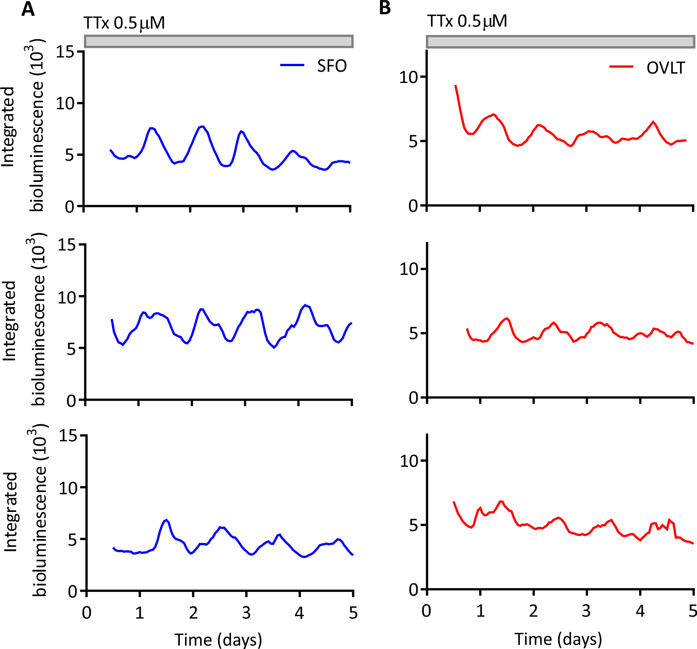
Supplemental Figure 2. Single cell oscillations during TTx treatment. Example traces of single cell oscillators during TTx treatment, note they are out of phase yet still rhythmic. Duration of TTx treatment is denoted by the filled grey bar.

