Slide 1
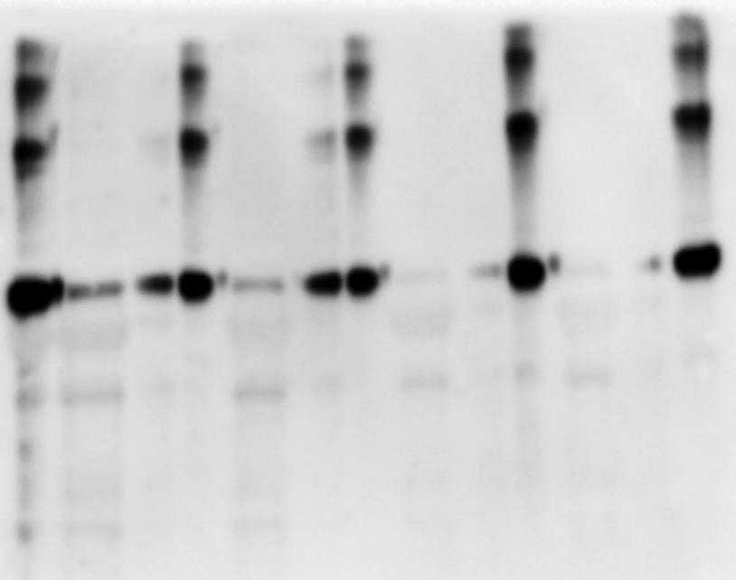
23 ◦C
37 ◦C
1.0 M
1.2 M
1.0 M
1.2 M
kDa
E
S1
S2
P
S1
S2
P
S1
S2
P
S1
S2
P
SUPPLEMENTARY FIGURE 1 Inverse Transition Cycle for NS1 ELP-ER purification. The ITC was performed using different concentrations of NH₄(SO₄)₂ solution (1.0 and 1.2 M) at the temperatures of 23 ºC and 37 ºC. The highest NS1 ELP-ER recovery rate was under 1.2 M NH₄(SO₄)₂ at 23 ° C, leading to a yield of 50 % of the recombinant protein in its soluble form (S2) while the rest of it remained in the pellet (P). E: crude extract, S1: supernatant 1, S2: supernatant 2, P: pellet.
250
150
100
75
50
37
25
20
15

