Slide 1
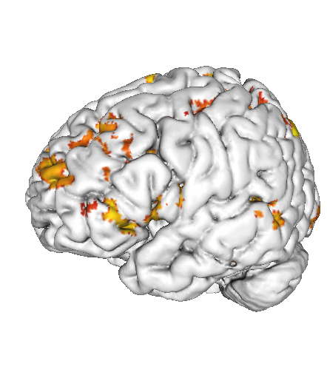
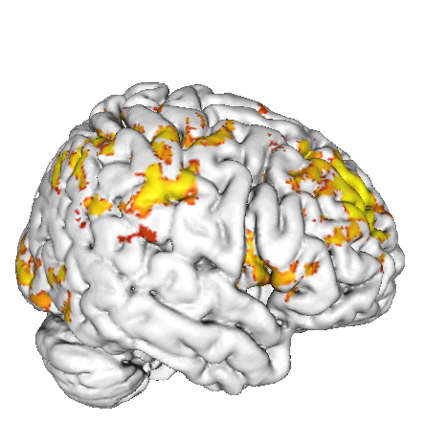
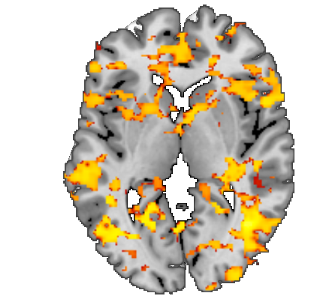
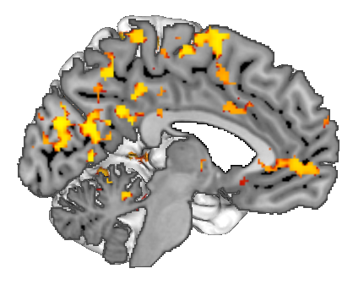
5
4.5
4
3.5
3
t-value
R
Notes:
Fig. S1. Stress induced changes in salience network connectivity in the neurodevelopmental group. This figure displays the stress induced change (stress – neutral condition) in salience network functional connectivity in the neurodevelopmental group. Abbreviation: R: right.

