Slide 1
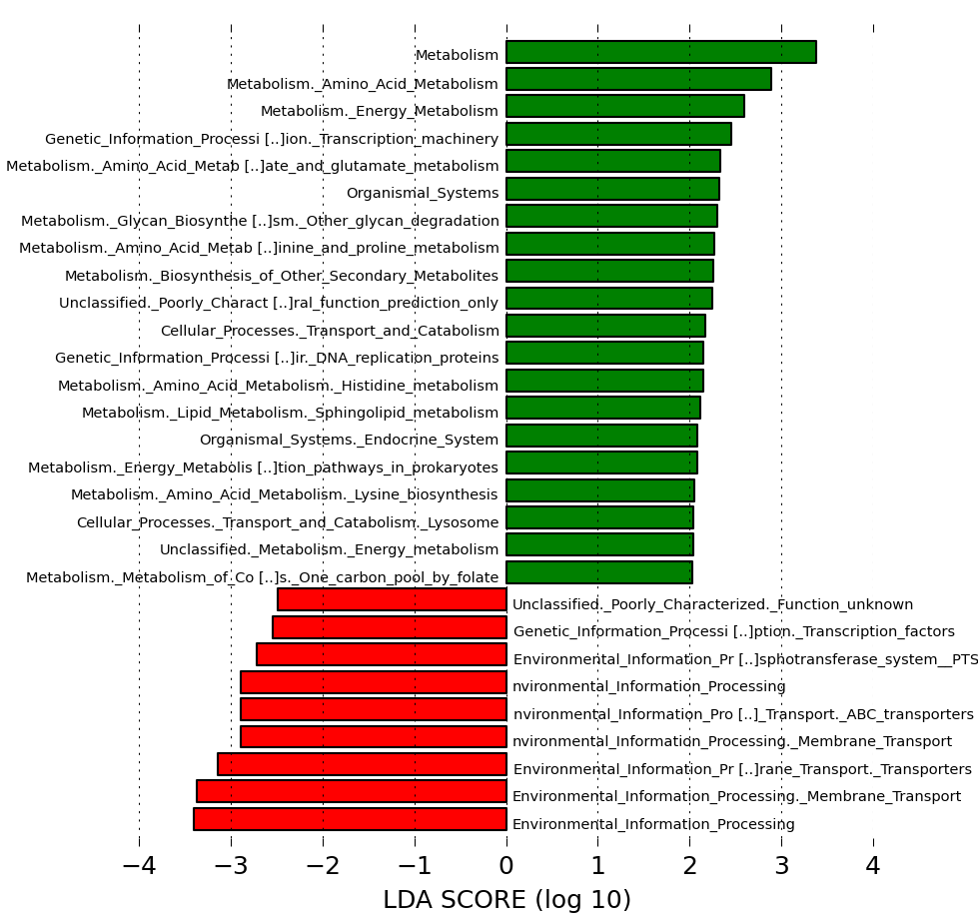
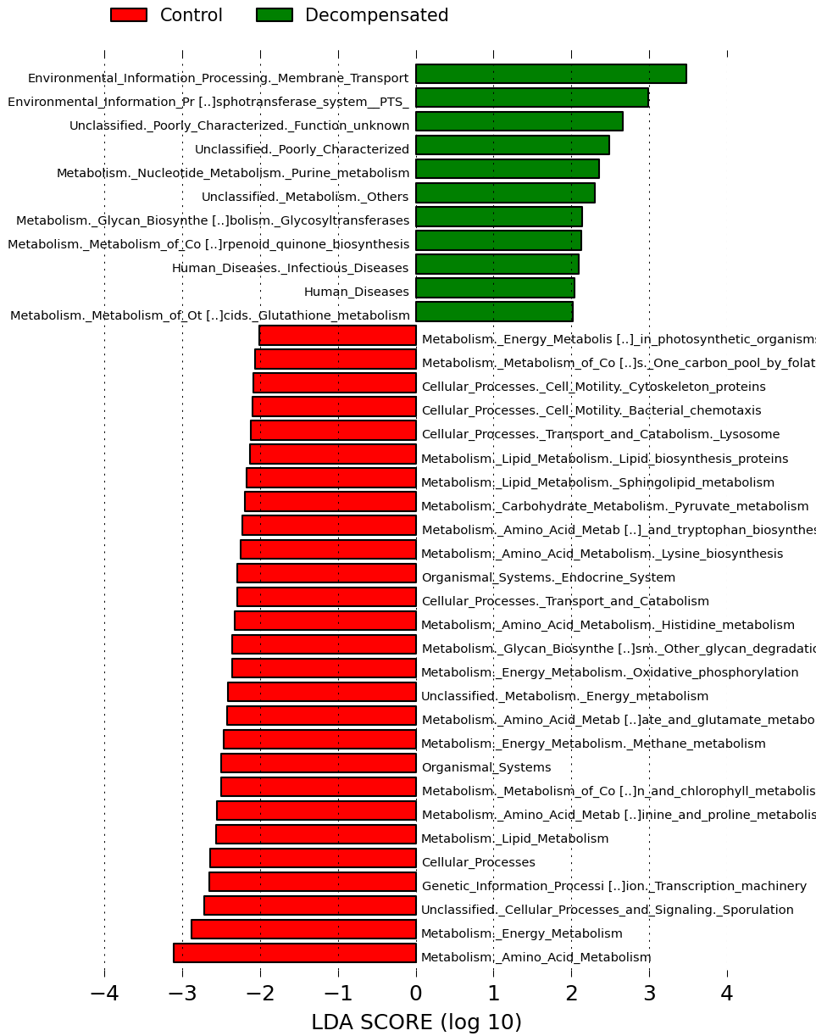
Supporting Figure 1A:
USA & Turkey: Controls (green) vs compensated cirrhosis (red)
Supporting Figure 1B: USA & Turkey: Controls (red) vs decompensated cirrhosis (green)

Slide 2
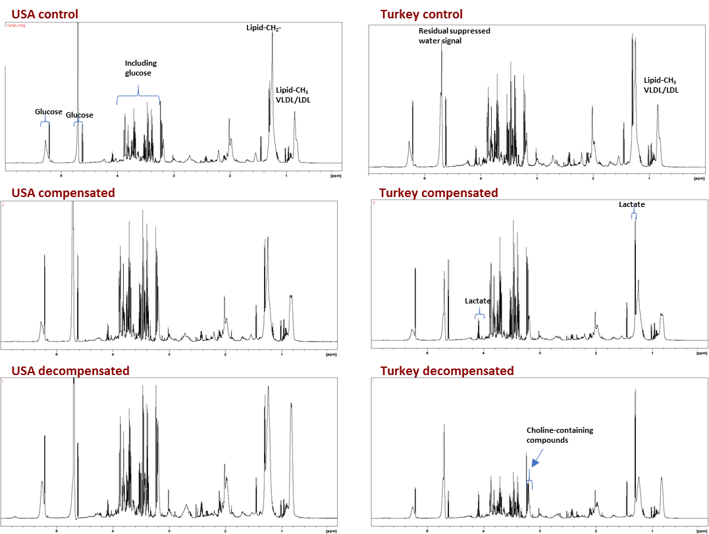
Supporting Figure 2: Illustrative plasma NMR data sets

Slide 3
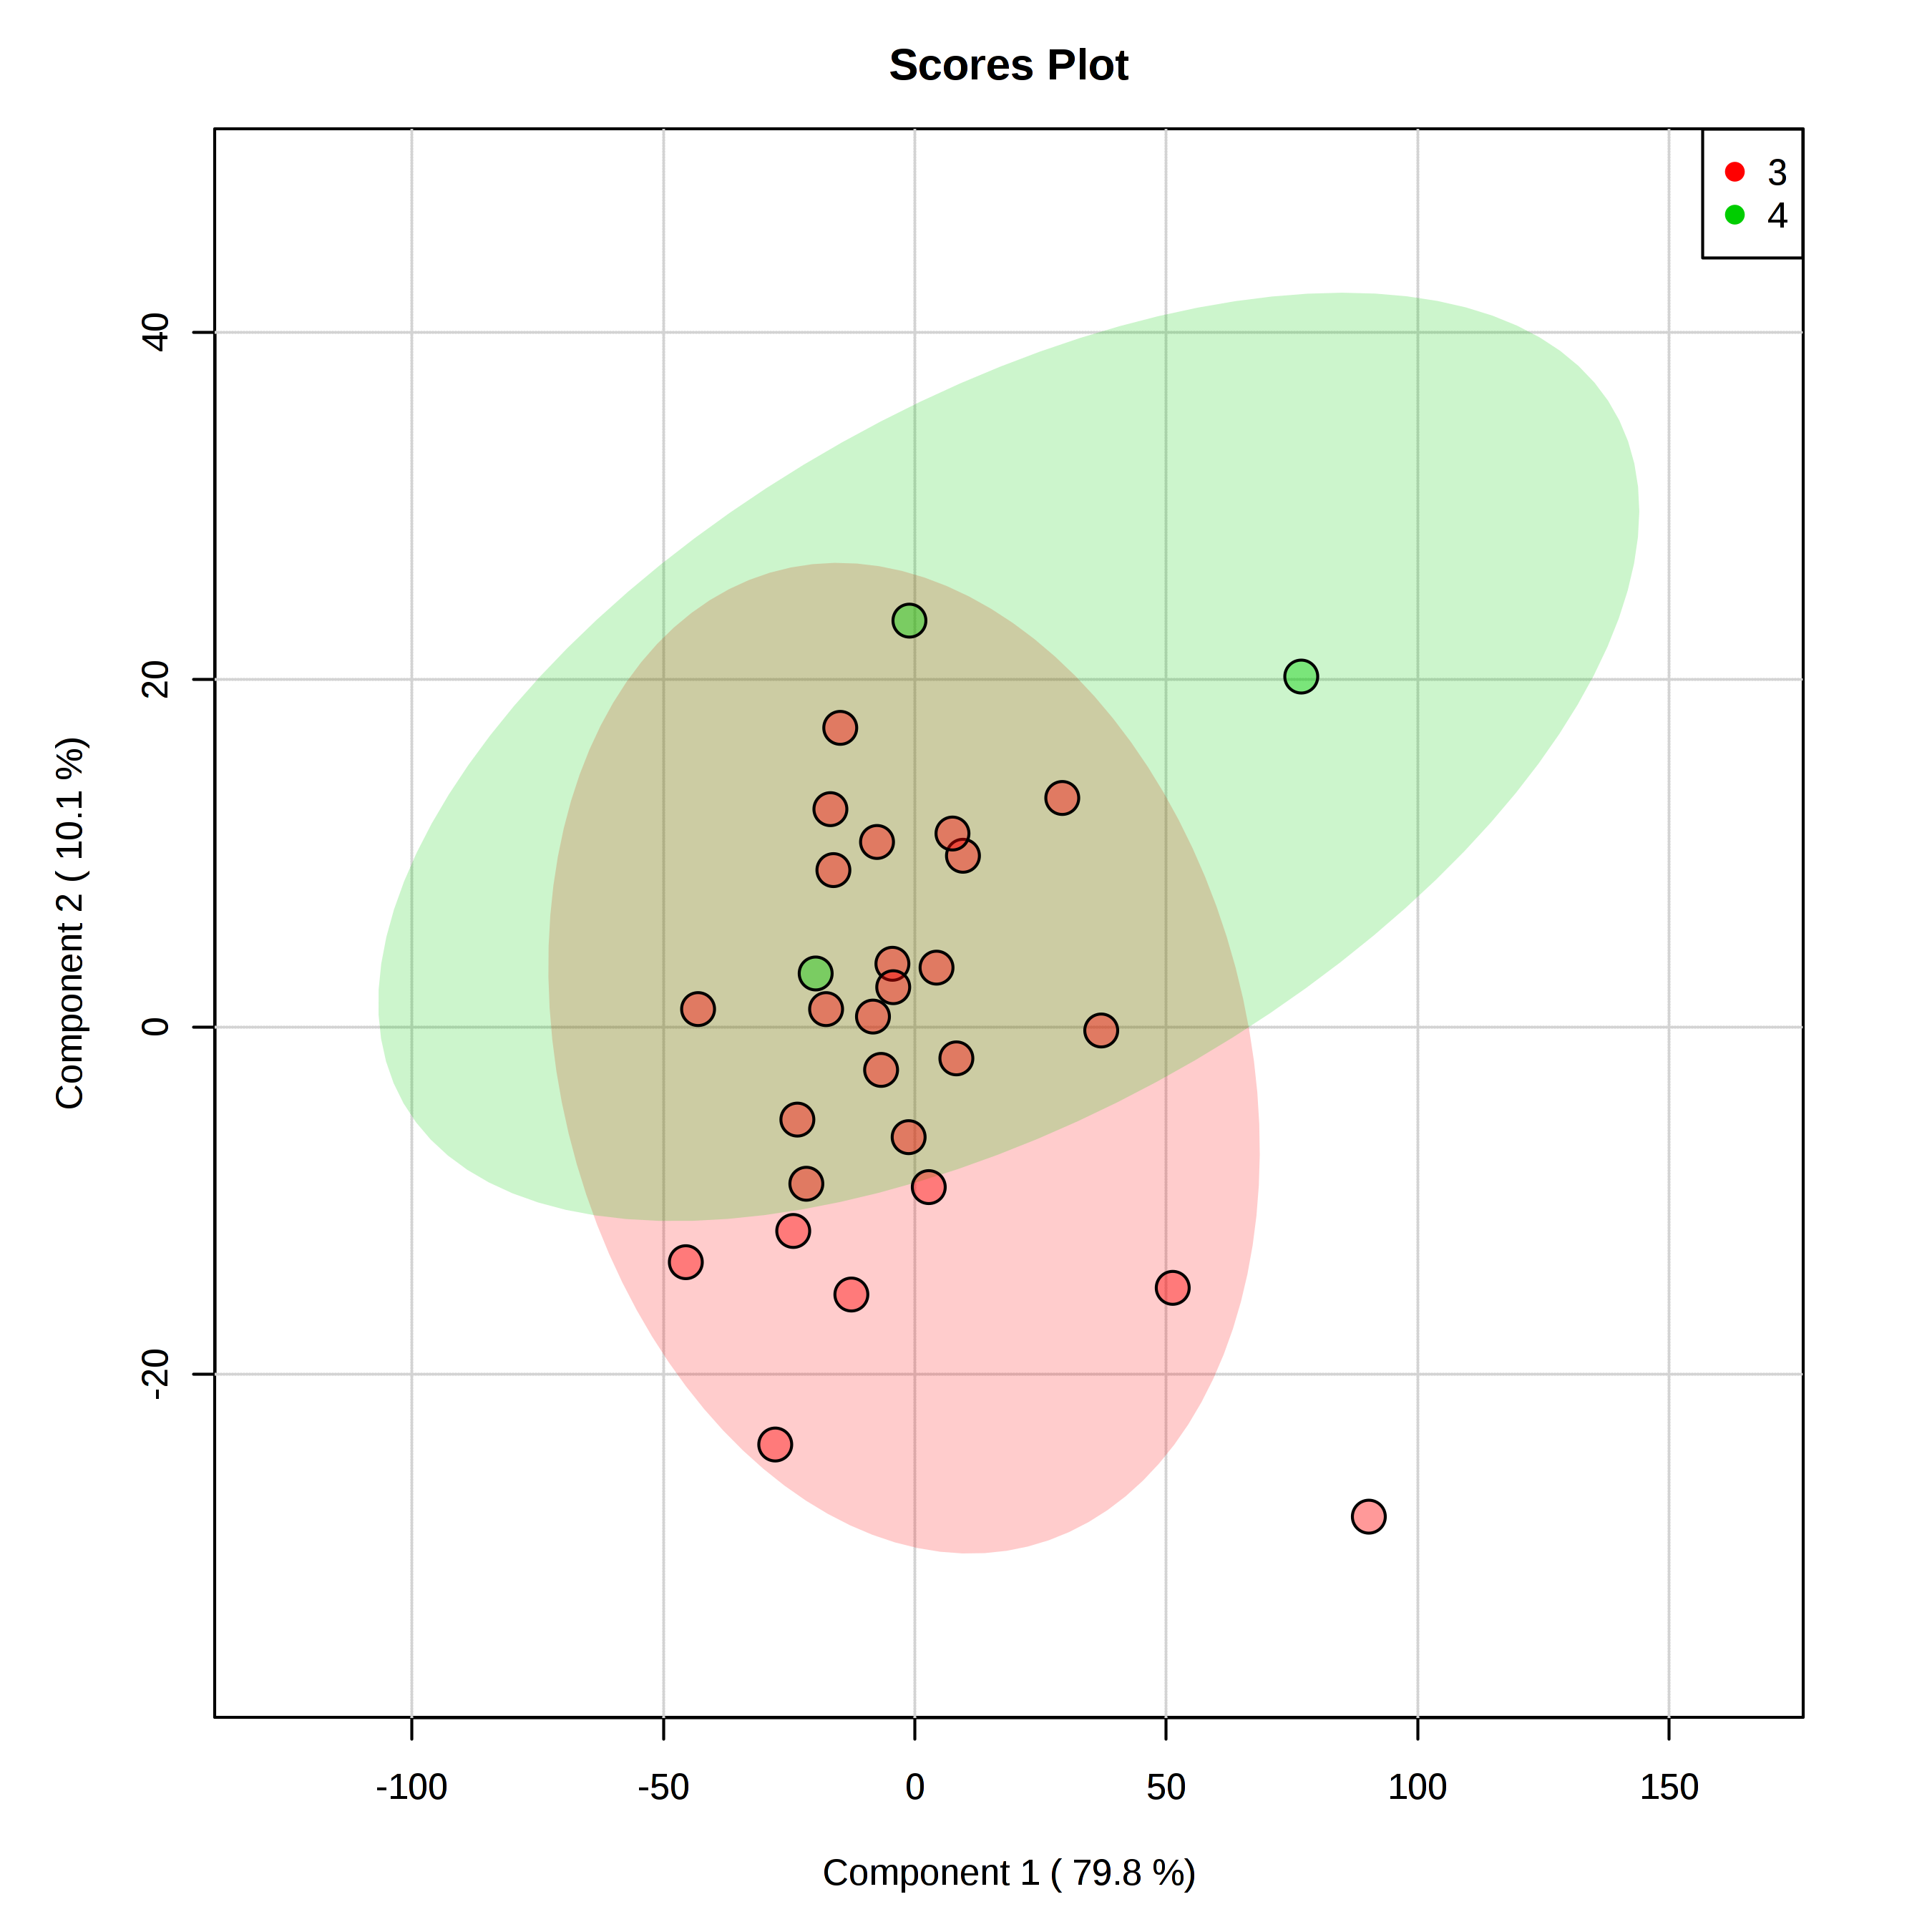
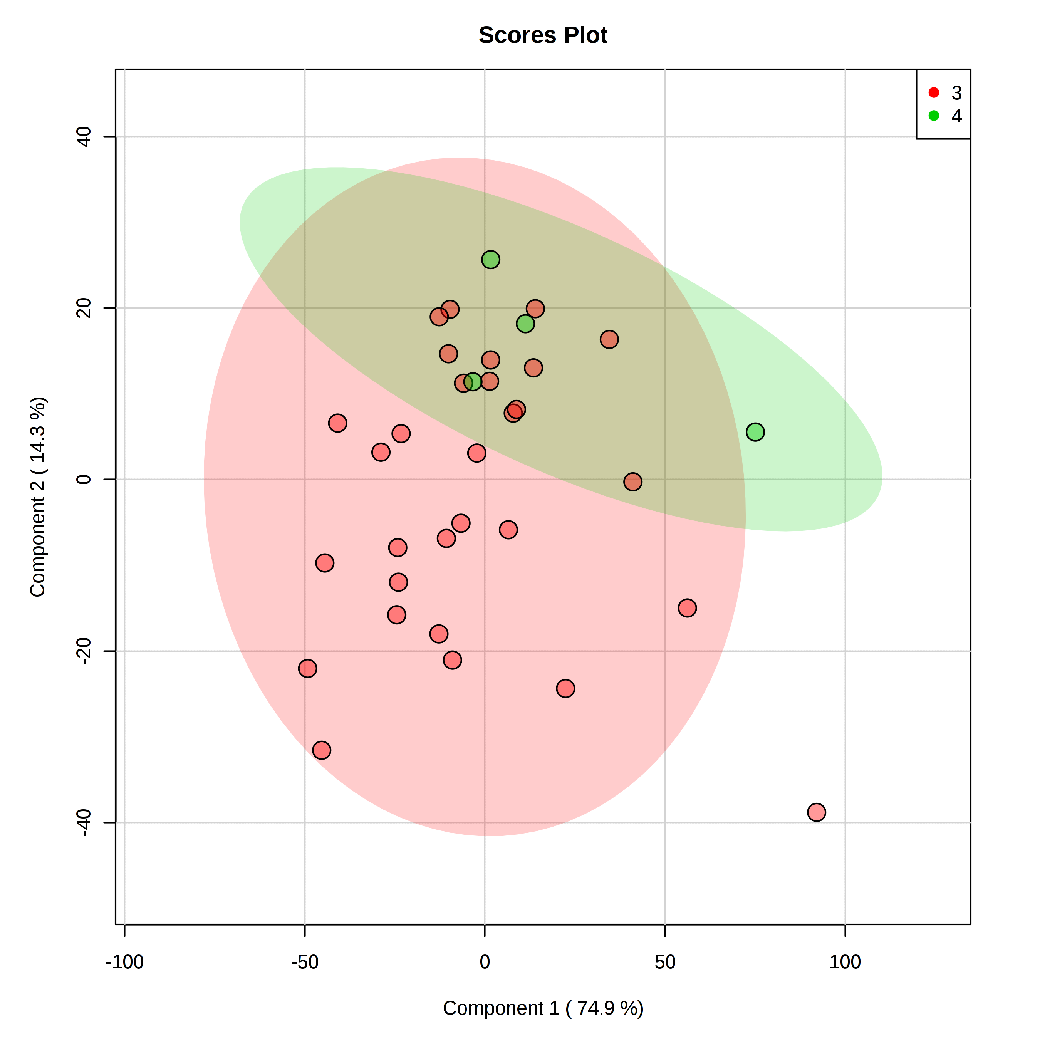
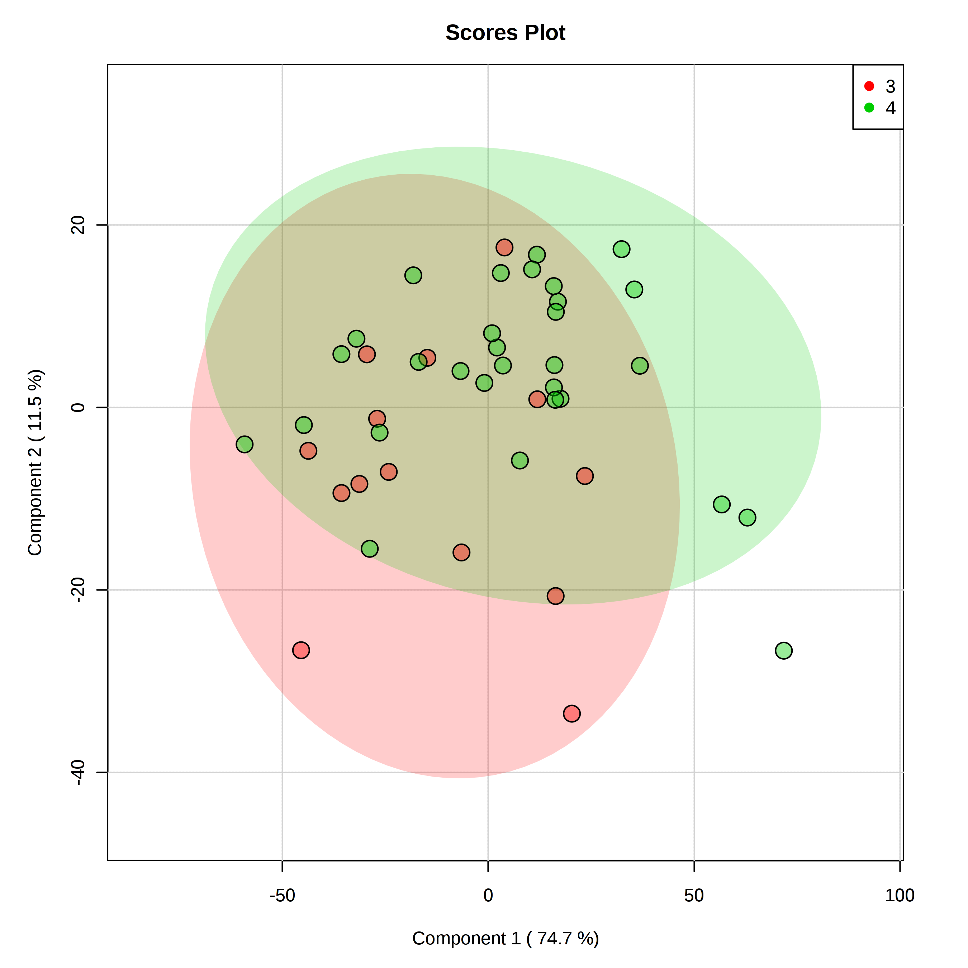
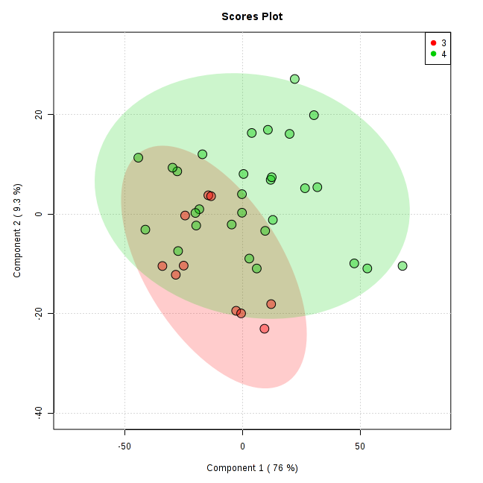
Supporting Figure 3: PLS-DA decompensated cirrhosis according to medication
Decompensated cirrhosis
taking rifaximin
USA (red) –
Turkey (green)
PLSDA Q2 not significant
Decompensated cirrhosis
taking lactulose
USA (red) –
Turkey (green)
PLSDA Q2 not significant
Decompensated cirrhosis
NOT taking rifaximin
USA (red) –
Turkey (green)
PLSDA Q2 0.42
Decompensated cirrhosis
NOT taking lactulose
USA (red) –
Turkey (green)
PLSDA Q2 not significant

Slide 4
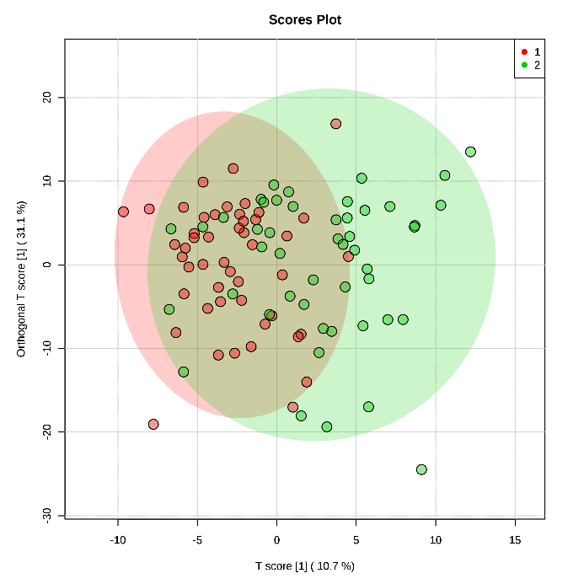
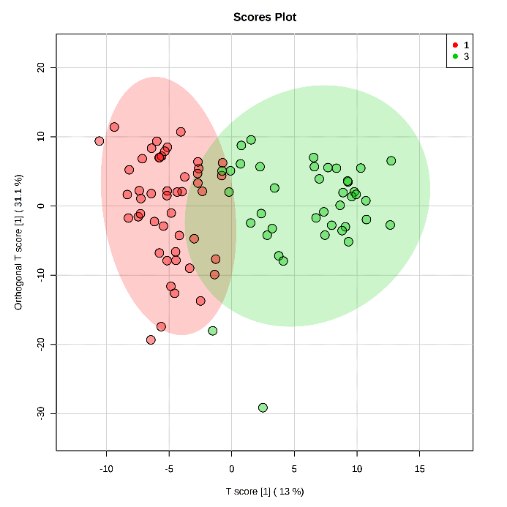
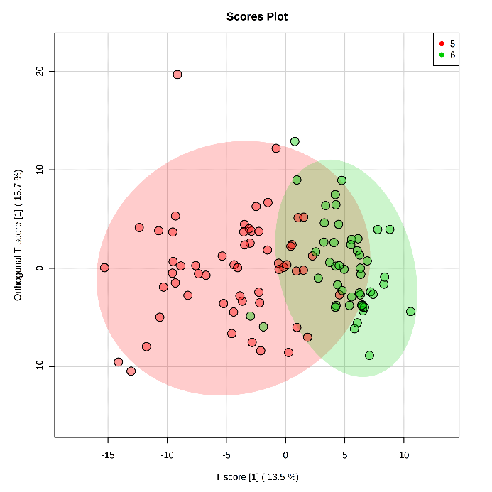
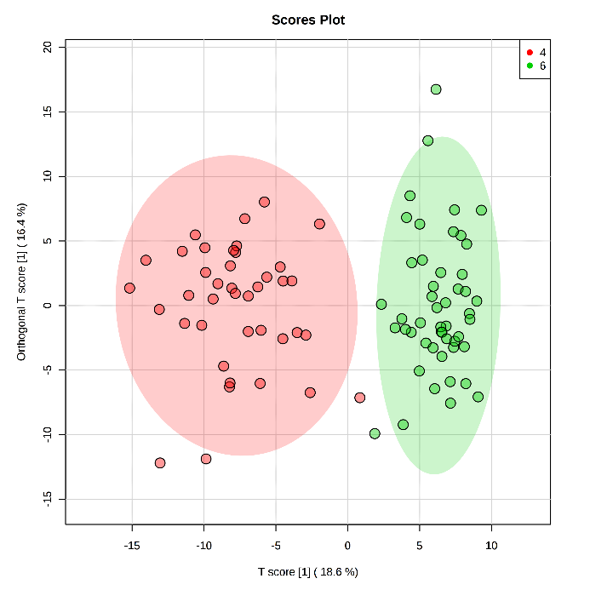
Supporting Figure 4: OPLS-DA controls versus cirrhosis according to country
USA control (red) –
USA comp cirrhosis (green)
USA control (red) –
USA decomp cirrhosis (green)
Turkey control (green) –
Turkey comp cirrhosis (red)
Turkey control (green) –
Turkey decomp cirrhosis (red)

Slide 5
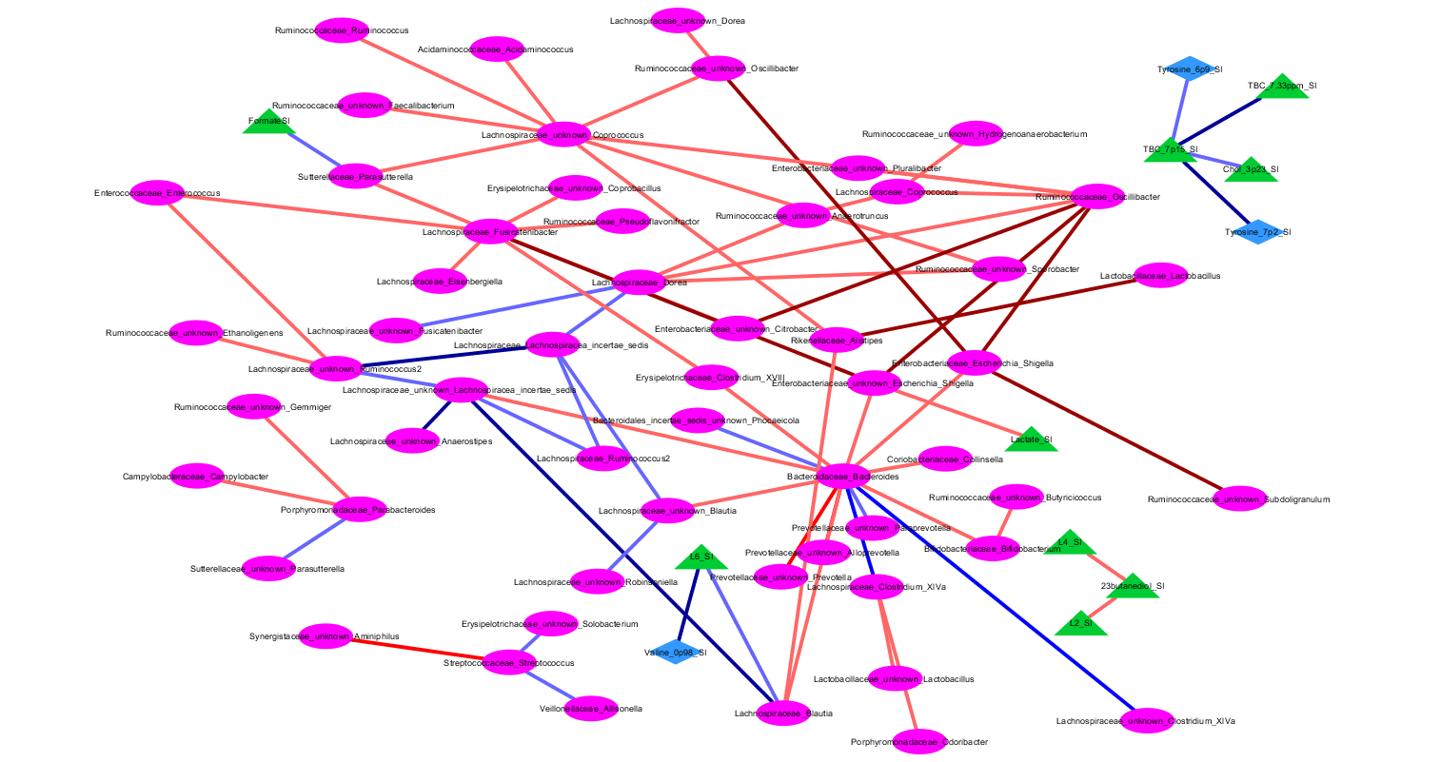
Supporting Figure 5: Correlation network differences
Brown: gain in negative from Turkey to USA, Red: Positive in turkey and negative in USA, Light Blue: Negative in Turkey and positive in USA, Dark Blue: gain in positive from Turkey to USA.

