Slide 1
Acute increase in O-GlcNAc improves SURVIVAL in mice with LPS-induced systemic inflammatory response syndrome.
Silva JF^{1*}, Olivon VC^{2*}, Mestriner FLAC^{1,4}, Zanotto CZ¹, Ferreira RG¹, Ferreira NS¹, da Silva CAA³, Luiz JPM¹, Alves JV¹, Fazan R³, Cunha FQ¹, Alves-Filho JC¹, Tostes RC¹.
Representative membrane of Western blot
LPS-induced SIRS plus Thiamet G treatment

Slide 2
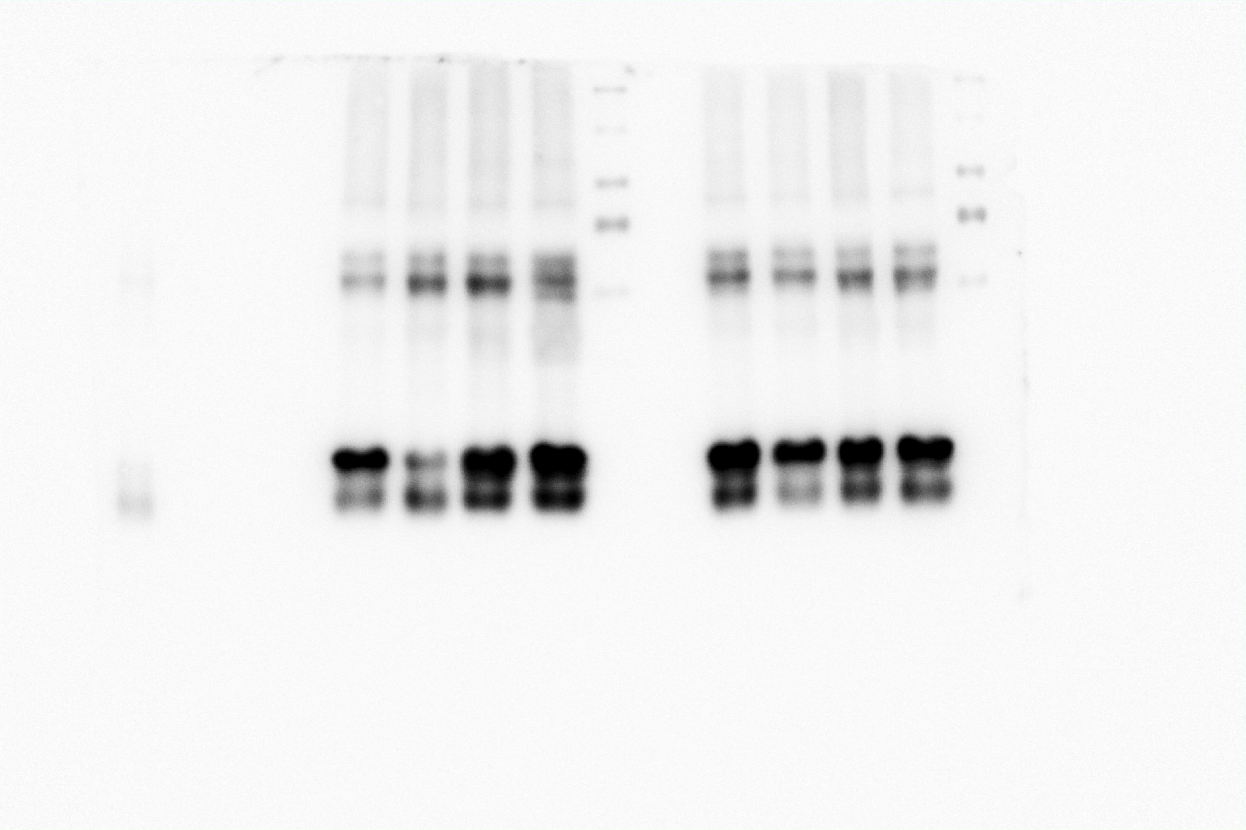
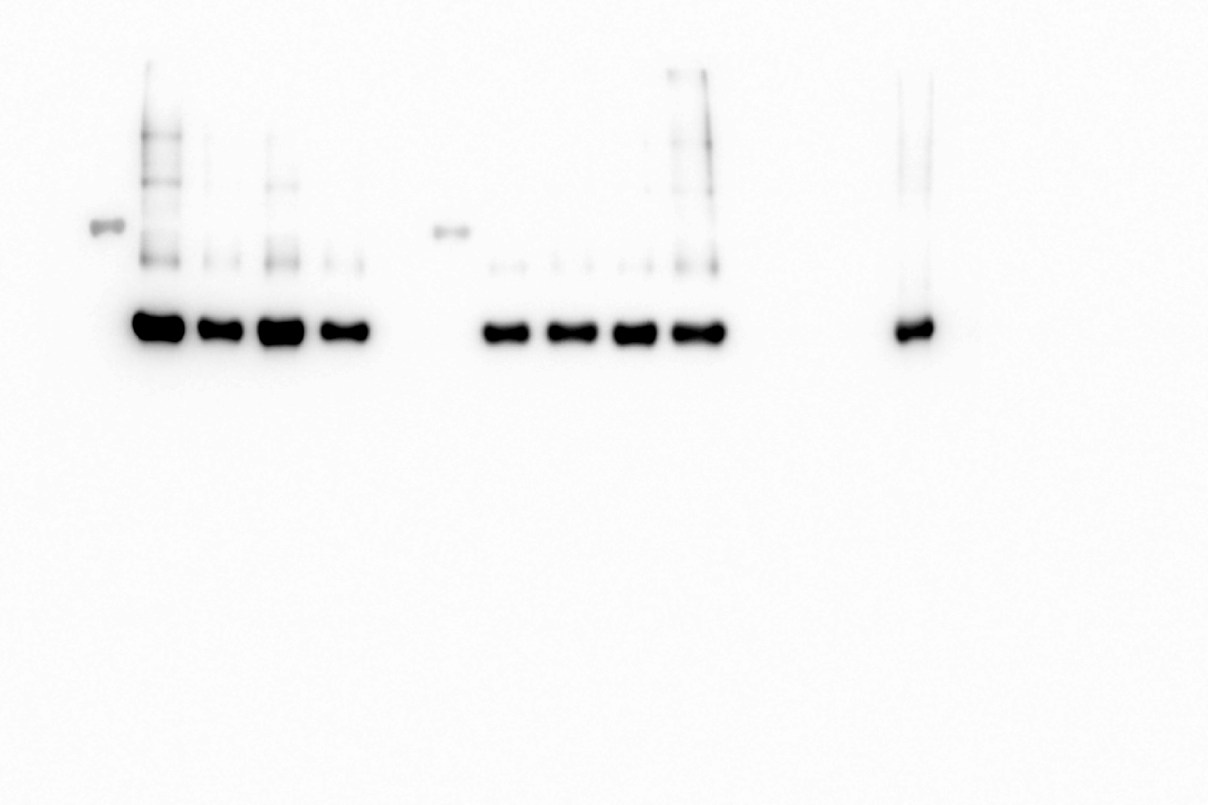
Total O– GlcNac protein level in mesenteric artery
O-GlcNac (Sigma-Aldrich, O7764)
β-actin (Sigma cat.: A3854)
1
2
3
4
5
6
7
8
9
10
11
12
13
14
15
1
2
3
4
5
6
7
8
9
10
11
12
13
14
15
100 kDa
100 kDa
70 kDa
70 kDa
50 kDa
50 kDa
40 kDa
40 kDa
O–GlcNac protein level in mesenteric artery: (1) molecular standard weight “Spectra™ Multicolor Broad Range Protein Ladder cat.:26634 ThermoFisher”; (2) control mice with vehicle group; (3) control mice with Thiamet G treatment group; (4) LPS-induced SIRS mice with vehicle group; (5) LPS-induced SIRS mice with Thiamet G treatment group; (6) empty; (7) molecular standard weight control mice with vehicle ”; (8) control mice with vehicle group; (9) control mice with Thiamet G treatment group; (10) LPS-induced SIRS mice with vehicle group; (11) LPS-induced SIRS mice with Thiamet G treatment group; (12) empty; (13) empty; (14) empty; (15) positive control Raw264.7 cell stimulated with LPS (1µM for 6 h).

Slide 3
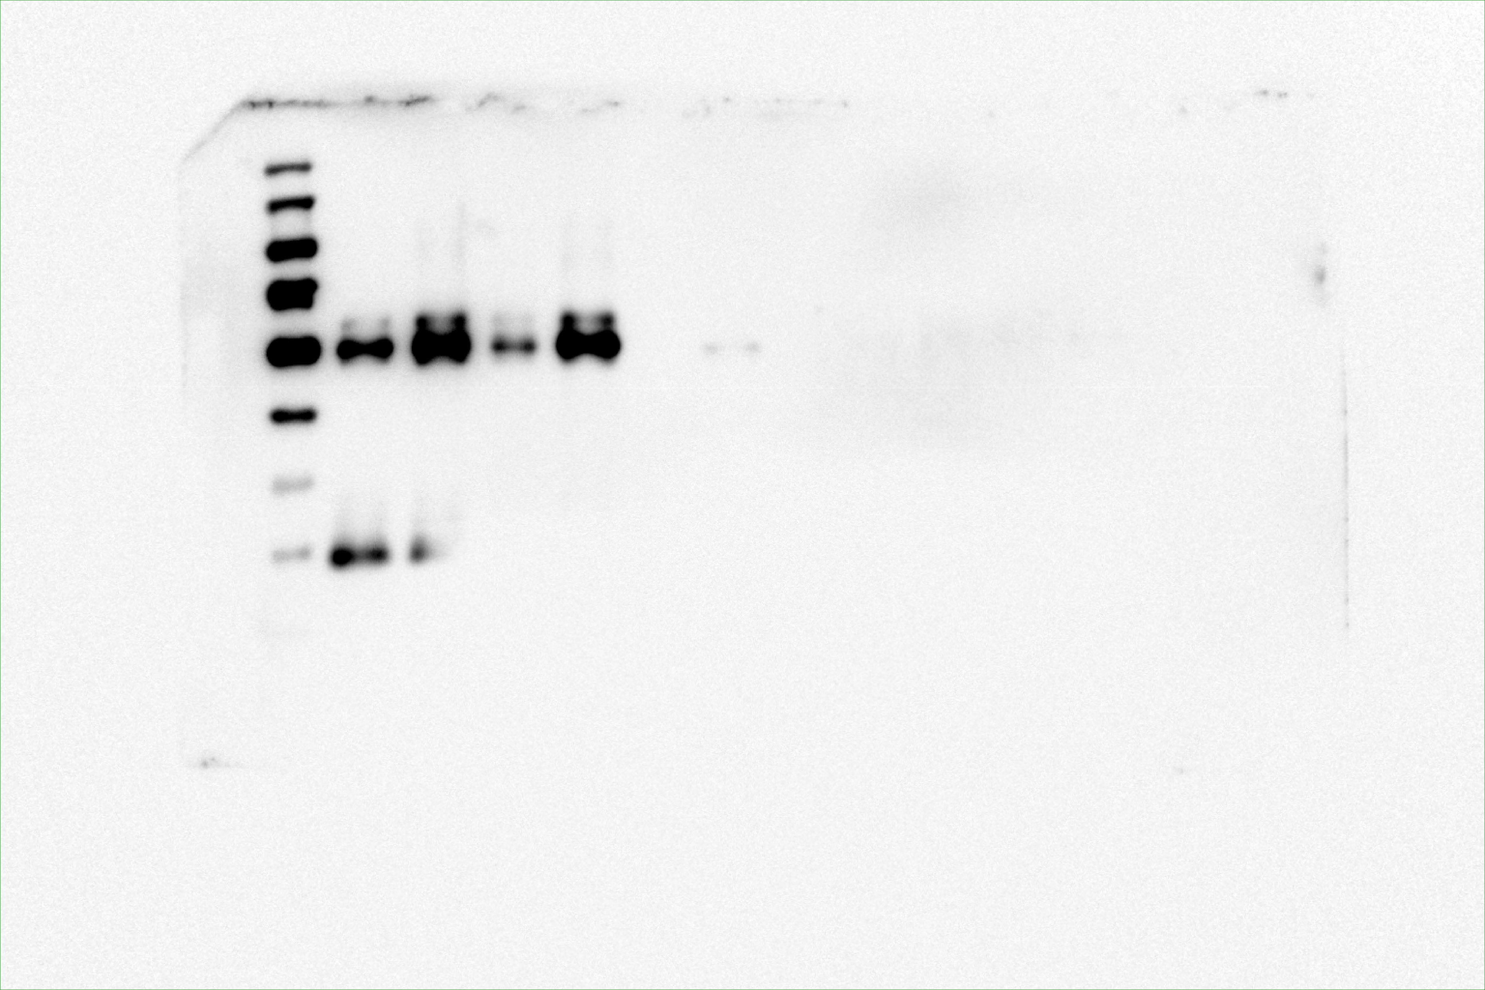
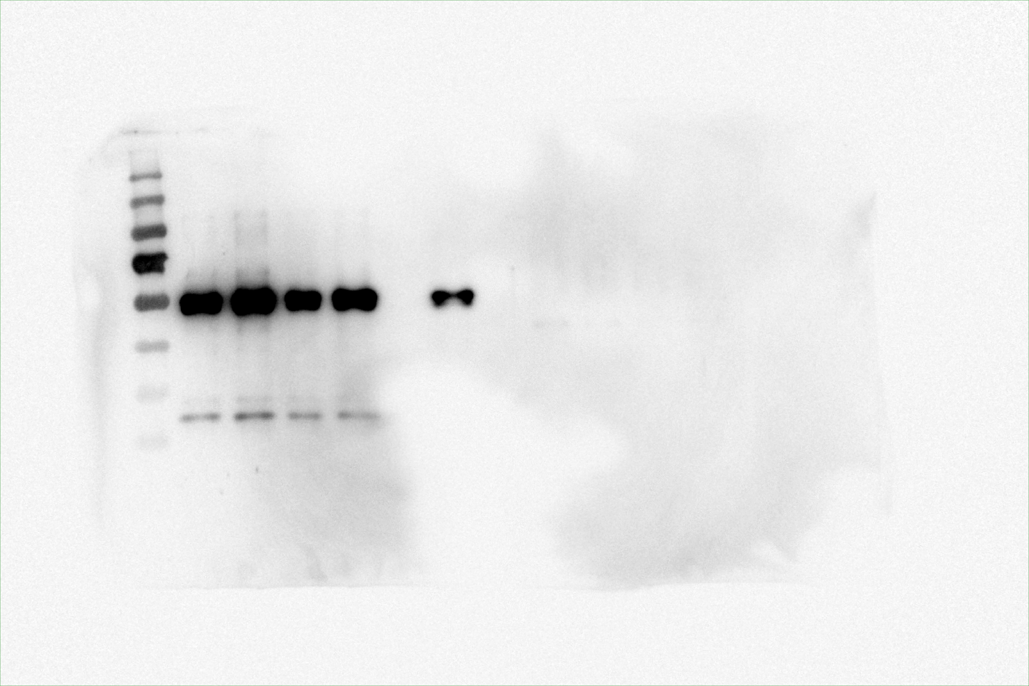
Immunoprecipitation assay of p65 NFkB
O-GlcNac
Subunit p65 NFkB
1
2
3
4
5
6
7
8
9
10
11
12
1
2
3
4
5
6
7
8
9
10
11
12
100 kDa
70 kDa
100 kDa
55 kDa
70 kDa
55 kDa
NFkB p65 subunit immunoprecipitation assay. The p65 subunit from mesenteric artery was immunoprecipitated using magnetic beads (Millipore , LSKMAGG02) and p65 subunit antibody (cell signalling #8242). O-GlcNAc was evaluated using the monoclonal Anti-β-O-Linked N-Acetylglucosamine antibody (Sigma-Aldrich, O7764). Thiamet G treatment induced higher O-GlcNAc p65 levels in mesenteric artery from control and LPS-induced SIRS mice. Lanes: (1) molecular standard weight “Pageruler cat.:26619 ThermoFisher”; (2) control mice with vehicle group; (3) control mice with Thiamet G treatment group; (4) LPS-induced SIRS mice with vehicle group; (5) LPS-induced SIRS mice with Thiamet G treatment group; (6) PBS + p65 antibody + magnetic beads; (7) control mice with vehicle input sample 10ug of protein; (8) PBS + magnetic beads; (9) control mice with vehicle group output sample ; (10) control mice with Thiamet G treatment group output sample; (11) LPS-induced SIRS mice with vehicle group output sample; (12) LPS-induced SIRS mice with Thiamet G treatment group output sample.

Slide 4
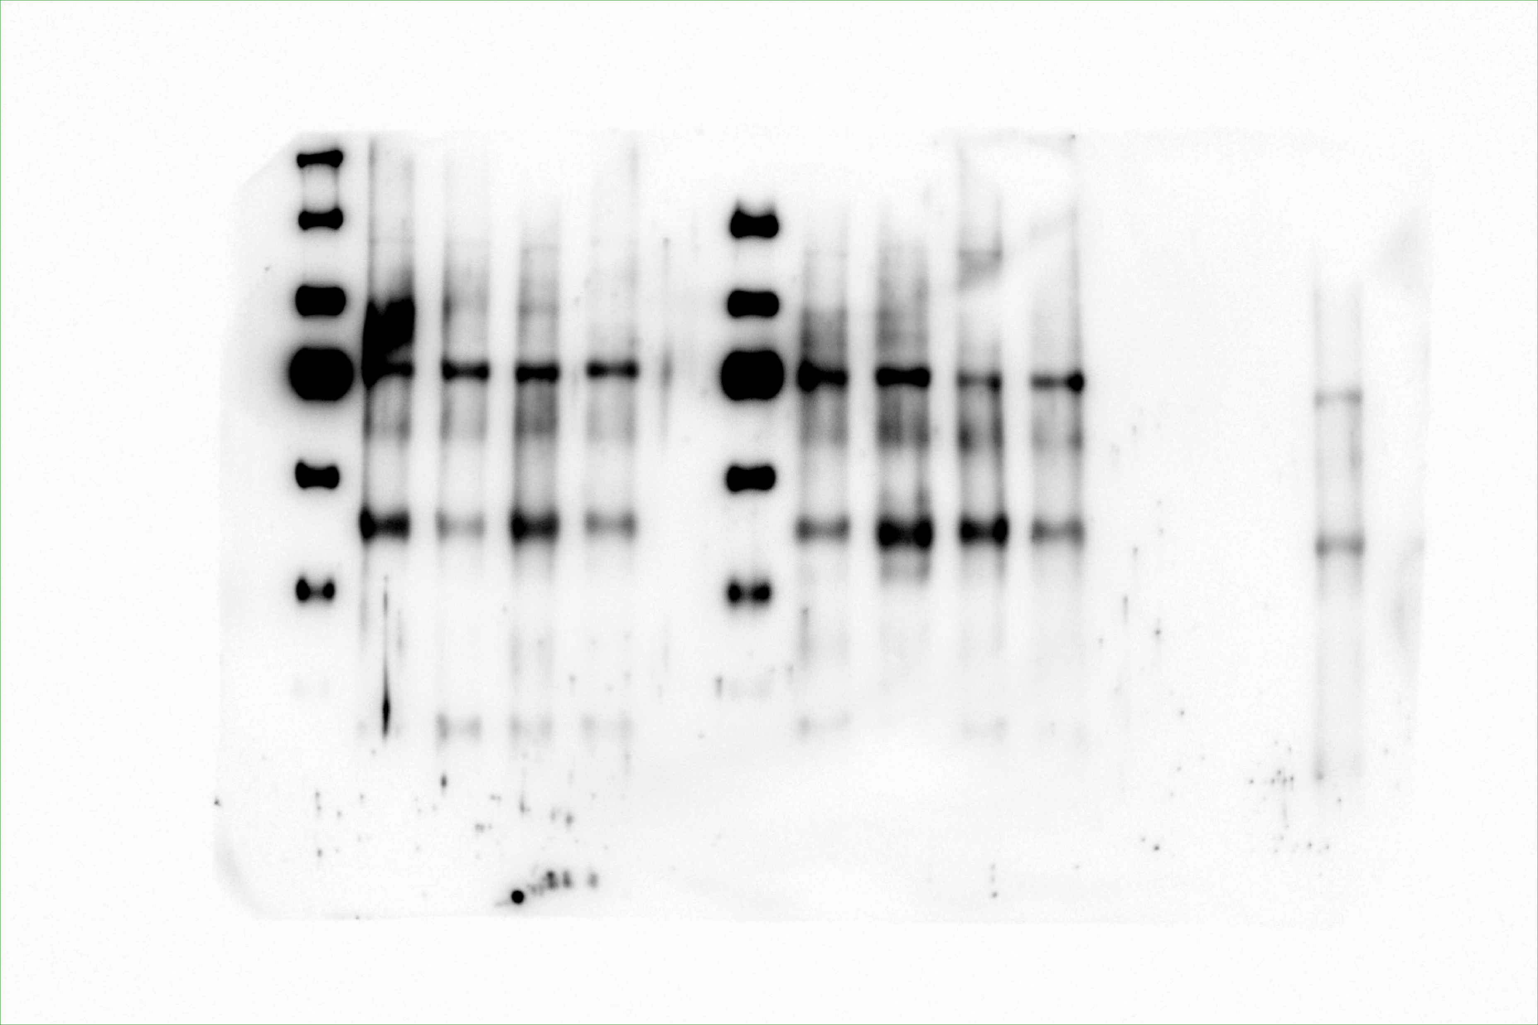
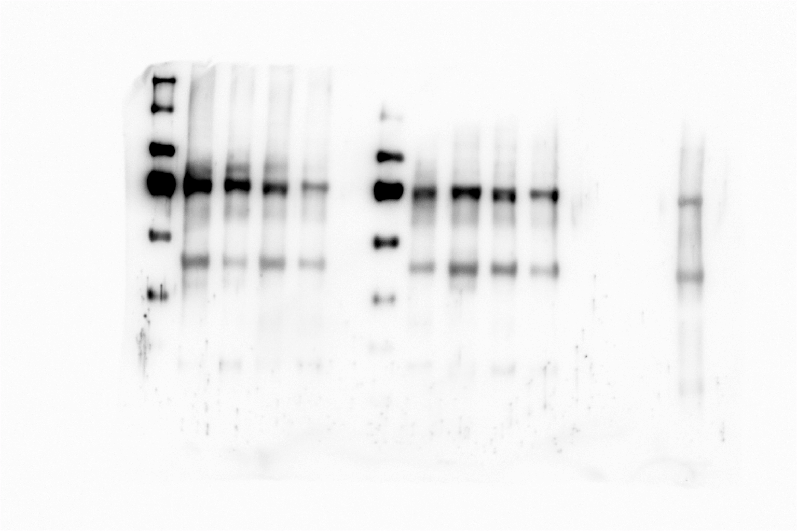
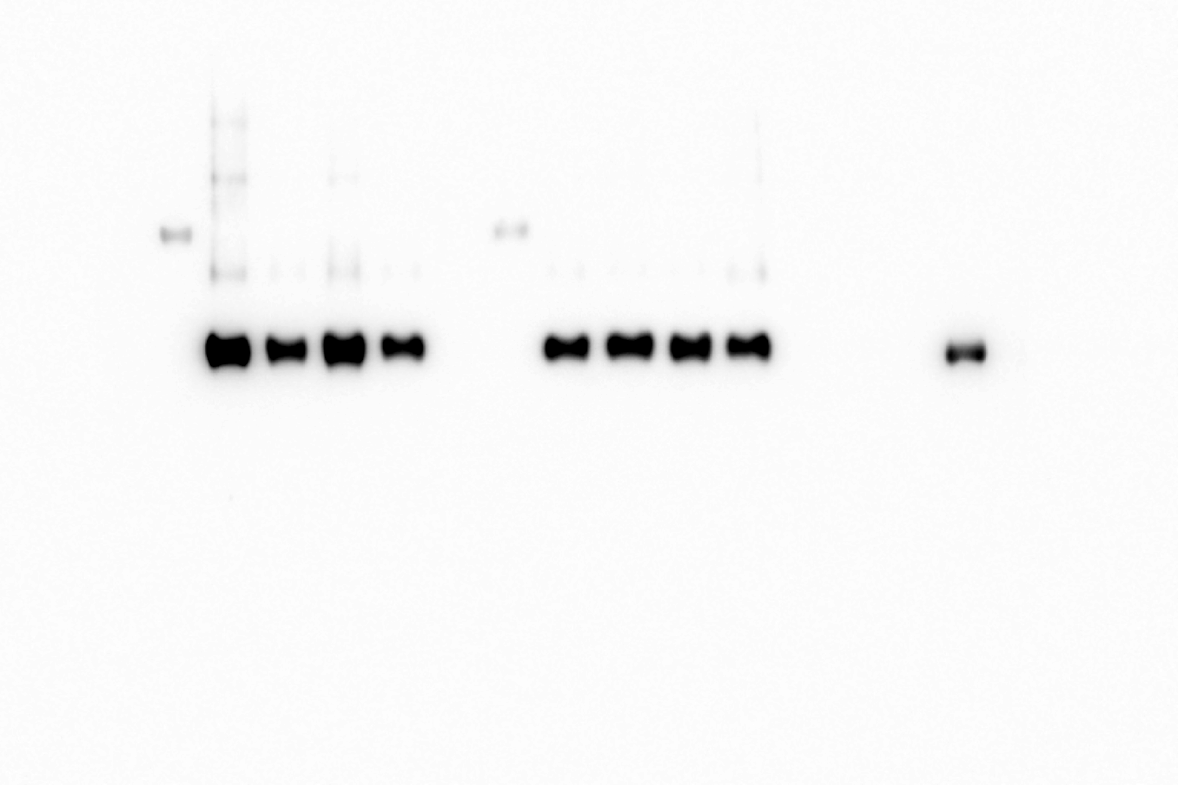
Phosphor-p65 and total p65 NF-kB subunit immunoblotting
phosphor-Ser536-p65 (cell signaling #3033)
Total p65 (cell signaling #8242)
β-actin (Sigma cat.: A3854)
1
2
3
4
5
6
7
8
9
10
11
12
13
1
2
3
4
5
6
7
8
9
10
11
12
13
14
15
14
15
1
2
3
4
5
6
7
8
9
10
11
12
13
14
15
100 kDa
100 kDa
100 kDa
70 kDa
70 kDa
70 kDa
50 kDa
50 kDa
50 kDa
40 kDa
40 kDa
40 kDa
NFkB p65 subunit phosphorylated at serine 536 residue and total p65 subunit in mesenteric artery. Lanes: (1) molecular standard weight “Spectra™ Multicolor Broad Range Protein Ladder cat.:26634 ThermoFisher”; (2) control mice with vehicle group; (3) LPS-induced SIRS mice with vehicle group; (4) control mice with Thiamet G treatment group; (5) LPS-induced SIRS mice with Thiamet G treatment group; (6) empty; (7) molecular standard weight control mice with vehicle ”; (8) control mice with vehicle group; (9) LPS-induced SIRS mice with vehicle group; (10) control mice with Thiamet G treatment group; (11) LPS-induced SIRS mice with Thiamet G treatment group; (12) empty; (13) empty; (14) empty; (15) positive control Raw264.7 cell stimulated with LPS (1µM for 6 h).

