Slide 1
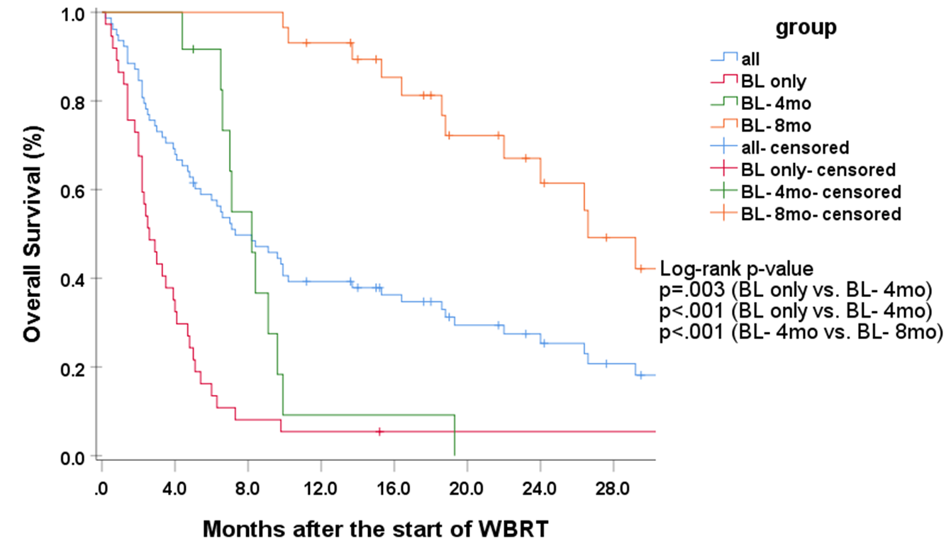
Supplementary Fig. 1
 | MST, months, (95%CI)
All | 7.3 (4.2–10.4)
BL only | 2.6 (1.8–3.4)
BL- 4mo | 8.2 (6.1–10.3)
BL- 8mo | 26.6 (21.8–31.4)
Supplementary Fig 1. Overall survival in the patients who underwent examinations at baseline only, at baseline and 4 months only, or at baseline, 4 months and 8 months. BL: baseline. MST: median survival time. WBRT: whole-brain radiotherapy.

