Slide 1
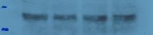
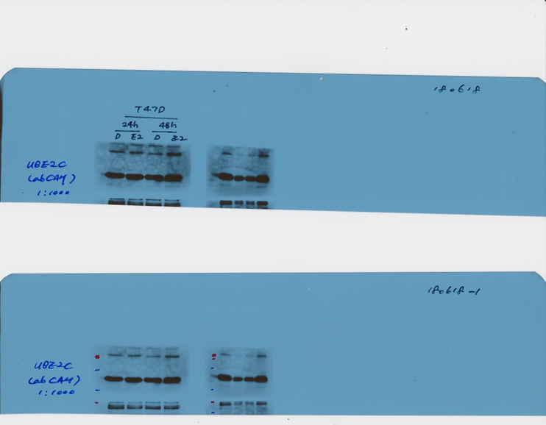
Supplementary Figure 1.
DMSO E2
DMSO E2
Sample | HPRT1 mean | UBE2C mean | UBE2C/ HPRT1 ratio | E2/DMSO fold change
DMSO_24h | 19.92683 | 19.10449 | 1.768278 | 1.35
E2_24h | 19.72267 | 18.87152 | 2.392401
DMSO_48h | 19.74979 | 17.96202 | 3.452795 | 1.68
E2_48h | 19.59287 | 17.05592 | 5.803641
UBE2C
6.34 7.17 6.51 8.36
β-ACTIN
24 48 (h)

Slide 2
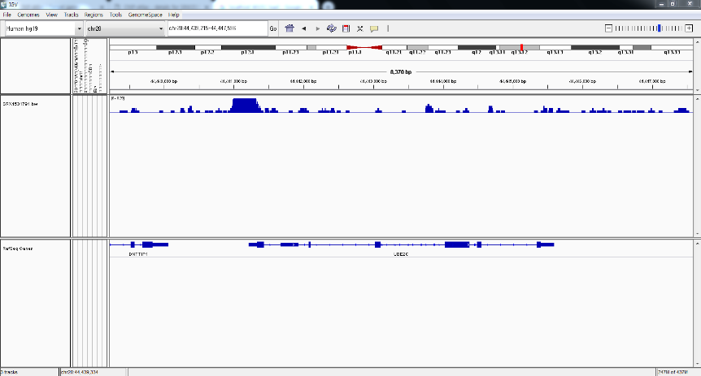
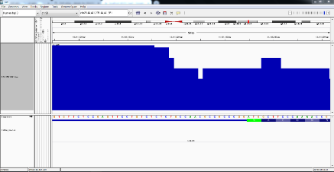
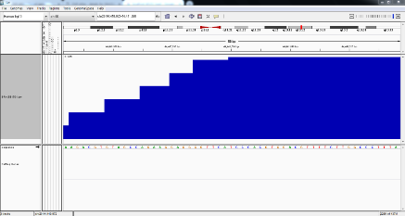
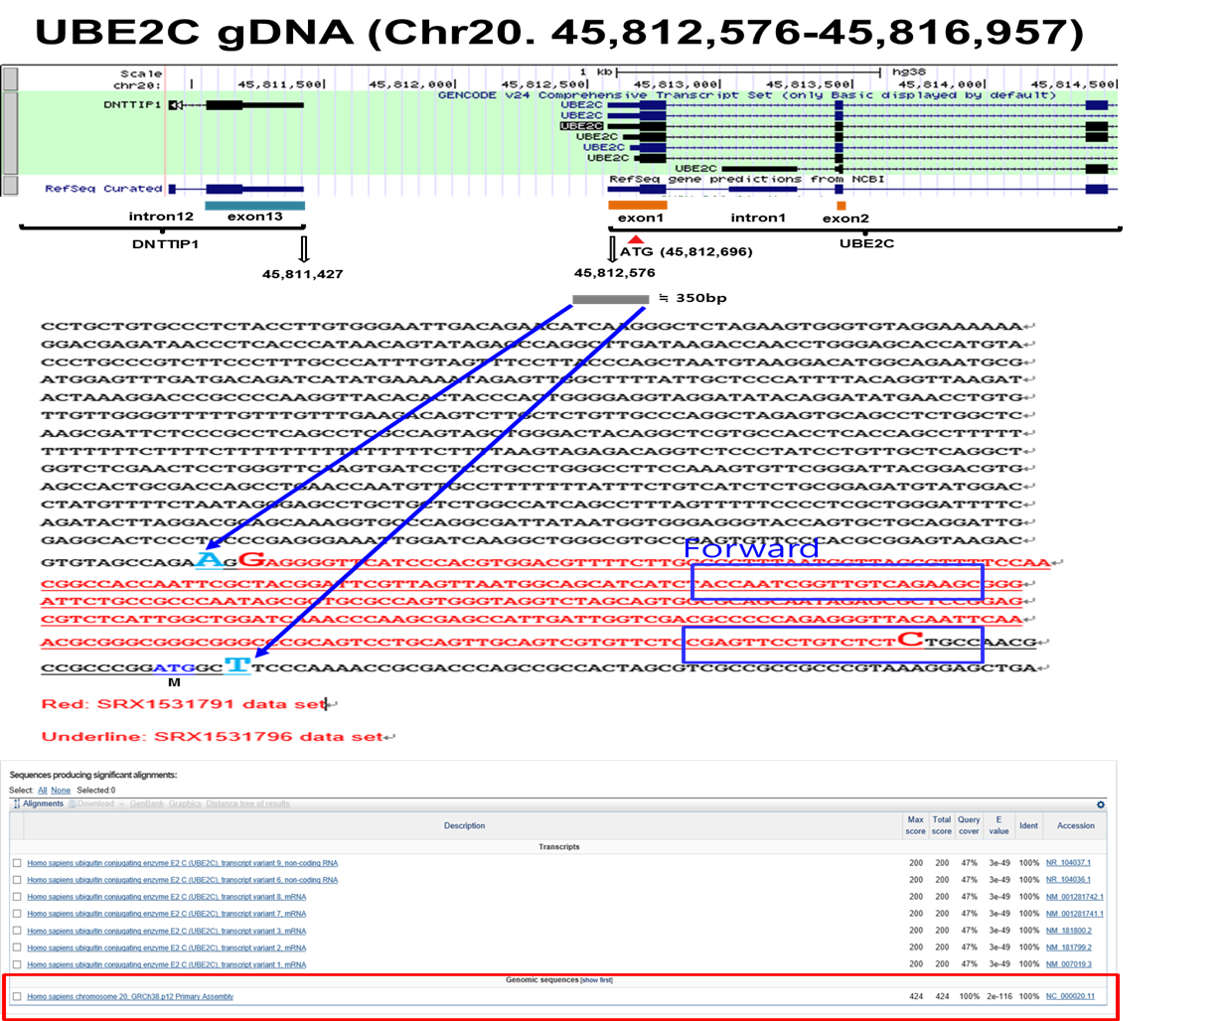
Supplementary Figure 2.
A
SRX1531791_ChIP-seq
B

Slide 3
Supplementary Figure 3.
T47D (IC50: 7.61μM) | UBE2C siRNA (nM) | Tamoxifen (µM) | fa | CI
48hr after siRNA transfection following Tam for 24hr | 10 | 8 | 0.5120 | 0.9578±0.0139
 | 20 | 8 | 0.5343 | 0.8874±0.0148
 | 50 | 8 | 0.5743 | 0.8200±0.0083

