Slide 1
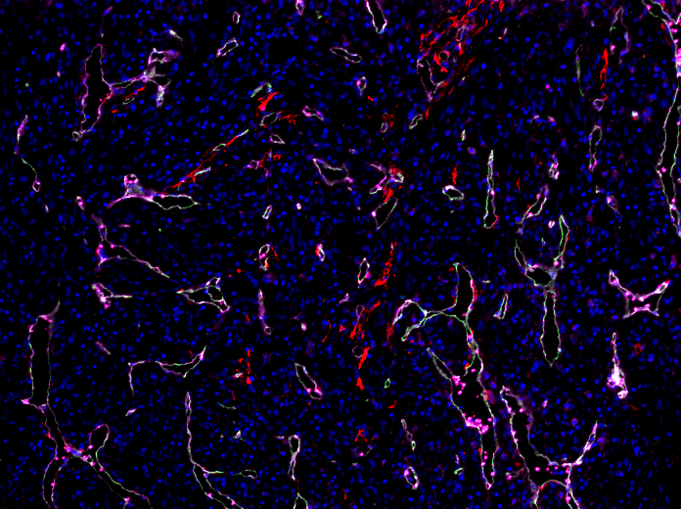
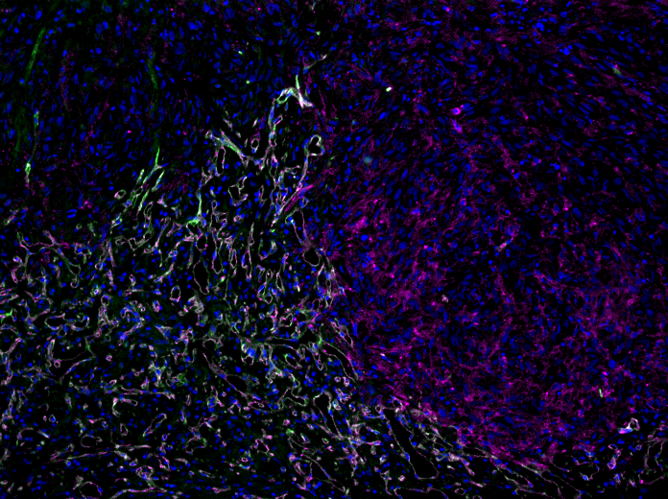
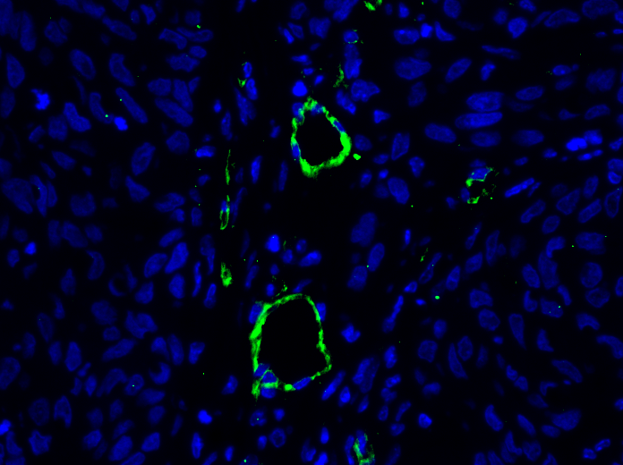
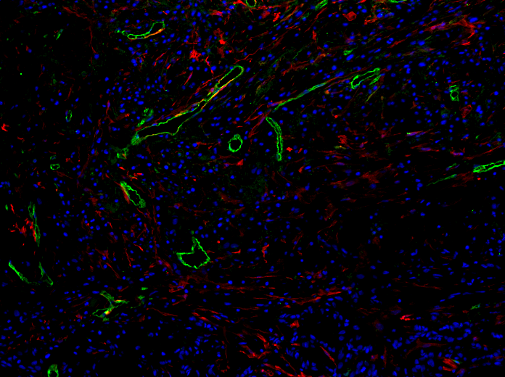
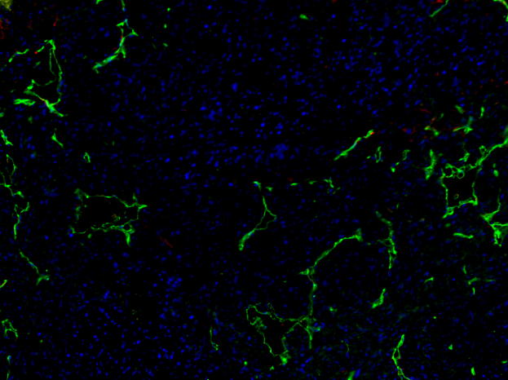
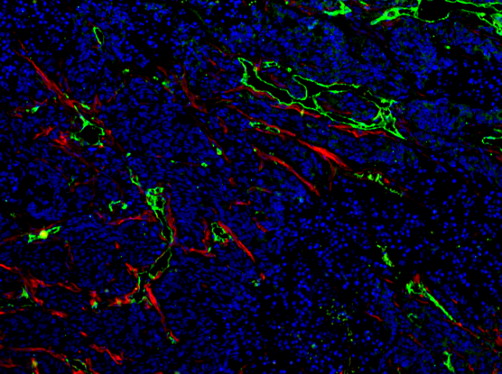
Figure S3
U87MG
SK-Hep1
Hoechst
CD31
S1PR1
CD31+S1PR1+
(U87MG, SK-Hep-1)
NUGC
A549
Hoechst
SMA
S1PR1
(NUGC, A549, HT1080, HT29)
HT1080
HT29

