Slide 1


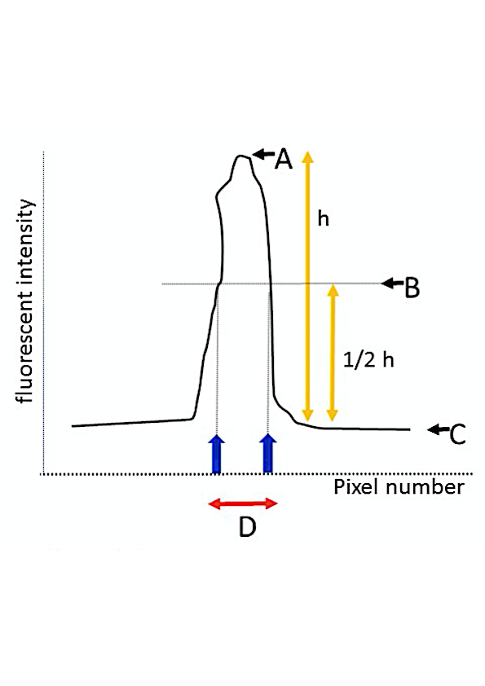
A: Fluorescence intensity peak
B: hallway point between peak and
baseline
C: baseline
D: FITC-WGA positive layer thickness
≒ GCX thickness index
Fluorescence intensity
20 μm
1 pixel=0.47 μm
a
b
Supplemental Fig. 2
Notes:
Fig.4

