Slide 1
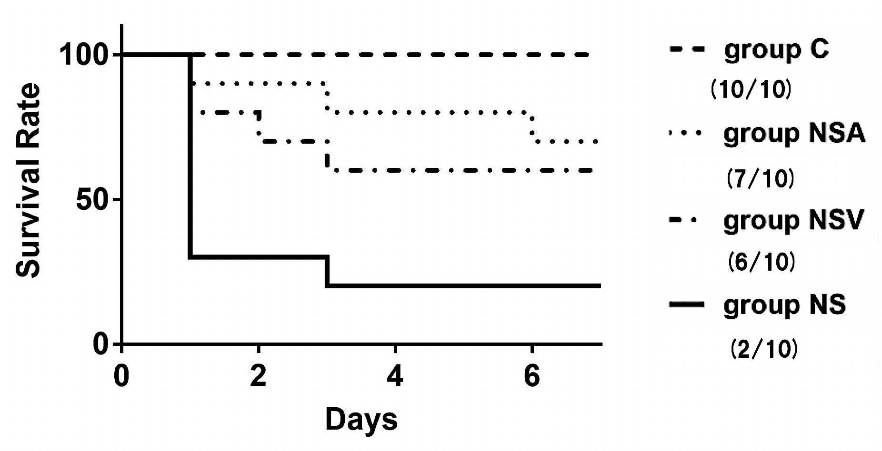
Survival Rate (%)
C
NS-A
NS-V
NS
Days
Supplemental Fig.3

