Slide 1
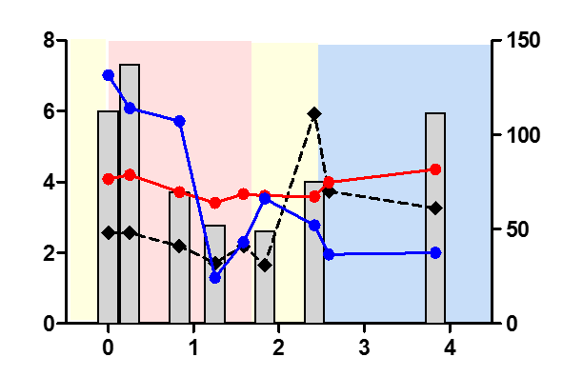
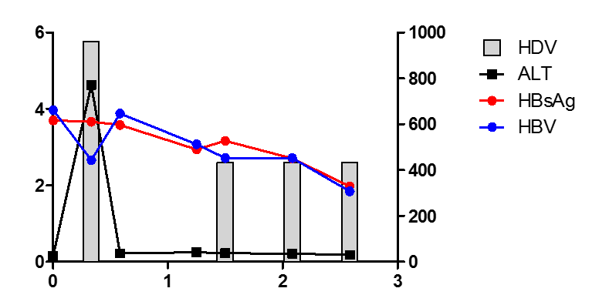
Supplementary Figure 1
A
Peg-IFNα-2a
Tenofovir
B
Peg-IFNα-2a
Entecavir
Log IU/ml
ALT (U/l)
C
Entecavir
D
Peg-IFNα-2a
time (years)
Peg-IFNα-2a
Log IU/ml
ALT (U/l)
E
Peg-IFNα-2a + Tenofovir
F
Peg-IFNα-2a
time (years)
Log IU/ml
ALT (U/l)
time (years)
Under NUC treatment
Under IFN
(+/-NUC) treatment
No treatment
HDV RNA
ALT
*
HDV RNA
below detection
HBsAg
HBV DNA

