Slide 1
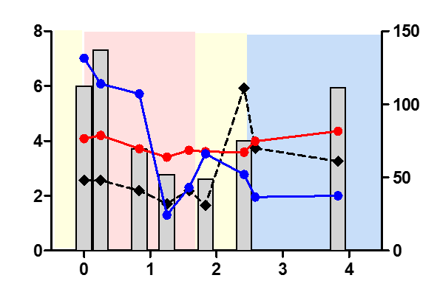
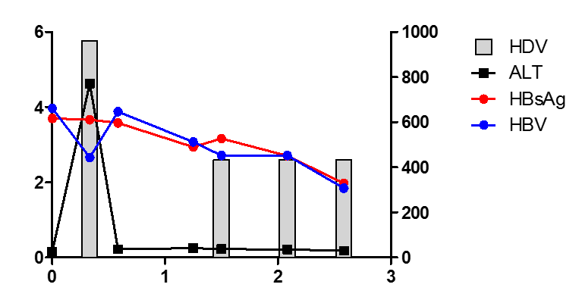
Supplementary Figure 2
A
Peg-IFNα-2a
Tenofovir
B
Peg-IFNα-2a
Tenofovir
Log IU/ml
Peg-IFNα-2a +
Tenofovir
time (years)
C
Peg-IFNα-2a
Tenofovir
D
Peg-IFNα-2a
Log IU/ml
E
Peg-IFNα-2a
time (years)
Log IU/ml
ALT (U/l)
time (years)
Under NA treatment
Under IFN
(+/-NA) treatment
No treatment
HDV RNA
ALT
*
HDV RNA
below detection
HBsAg
HBV DNA

