Slide 1
Figure S1. CRS-induced reduction in the number of adult hippocampal NSCs is prevented in homozygous Atg7-NSC cKO mice (n = 3 per group). n.s., not significant.

Slide 2
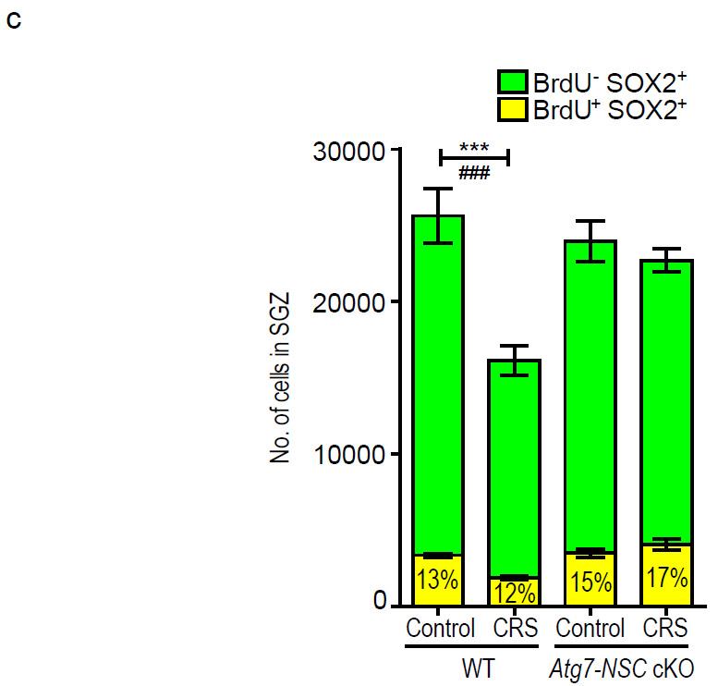
Figure S2. Reduction in the number of adult hippocampal NSCs by 3-week CRS is prevented by Atg7 deletion. (a) Timeline of the experiment. (b) Changes in body weight (n = 6 or 7). (c) Quantification of BrdU and SOX2 positive-cells (n = 4 or 5). ***P < 0.001 for total SOX2⁺ cells. ###P < 0.01 for BrdU⁺ SOX2⁺ cells.

Slide 3
a
b
c
Figure S3. Behavioral analyses of WT and Atg7-NSC cKO mice after CRS. (a) Total distance in the open field test. (b) Total arm entries in the elevated plus maze test. (c) Swimming velocity in the MWM test. The n numbers were the same as in Fig. 3.

Slide 4
a
b
c
Figure S4. Analyses of serum CORT levels and body weight after CRS. (a) Circadian fluctuation of serum CORT levels in untreated mice (n = 3). (b) Time-course analysis of serum CORT levels (n = 3 or 4). (c) Changes in body weight (n = 10 – 14). **P < 0.01, ***P < 0.001. n.s., not significant.

Slide 5
Figure S5. Reduction in the number of adult hippocampal NSCs by CORT injection is prevented by Atg7 deletion. (a) Serum CORT levels at day 1 CORT injection (n = 5 – 7). (b and c) Quantification of GFAP⁺ SOX2⁺ (type 1), GFAP⁺ SOX2⁺ MKI67⁺ (active type 1), ASCL1⁺ SOX2⁺ (type 2a), DCX⁺ SOX2⁺ (type 2b), and DCX⁺ (type 3) NSCs 1 day (n =5) (b) and 28 days after CORT injection (n = 6) (c).**P < 0.01, ***P < 0.001. n.s., not significant.

Slide 6
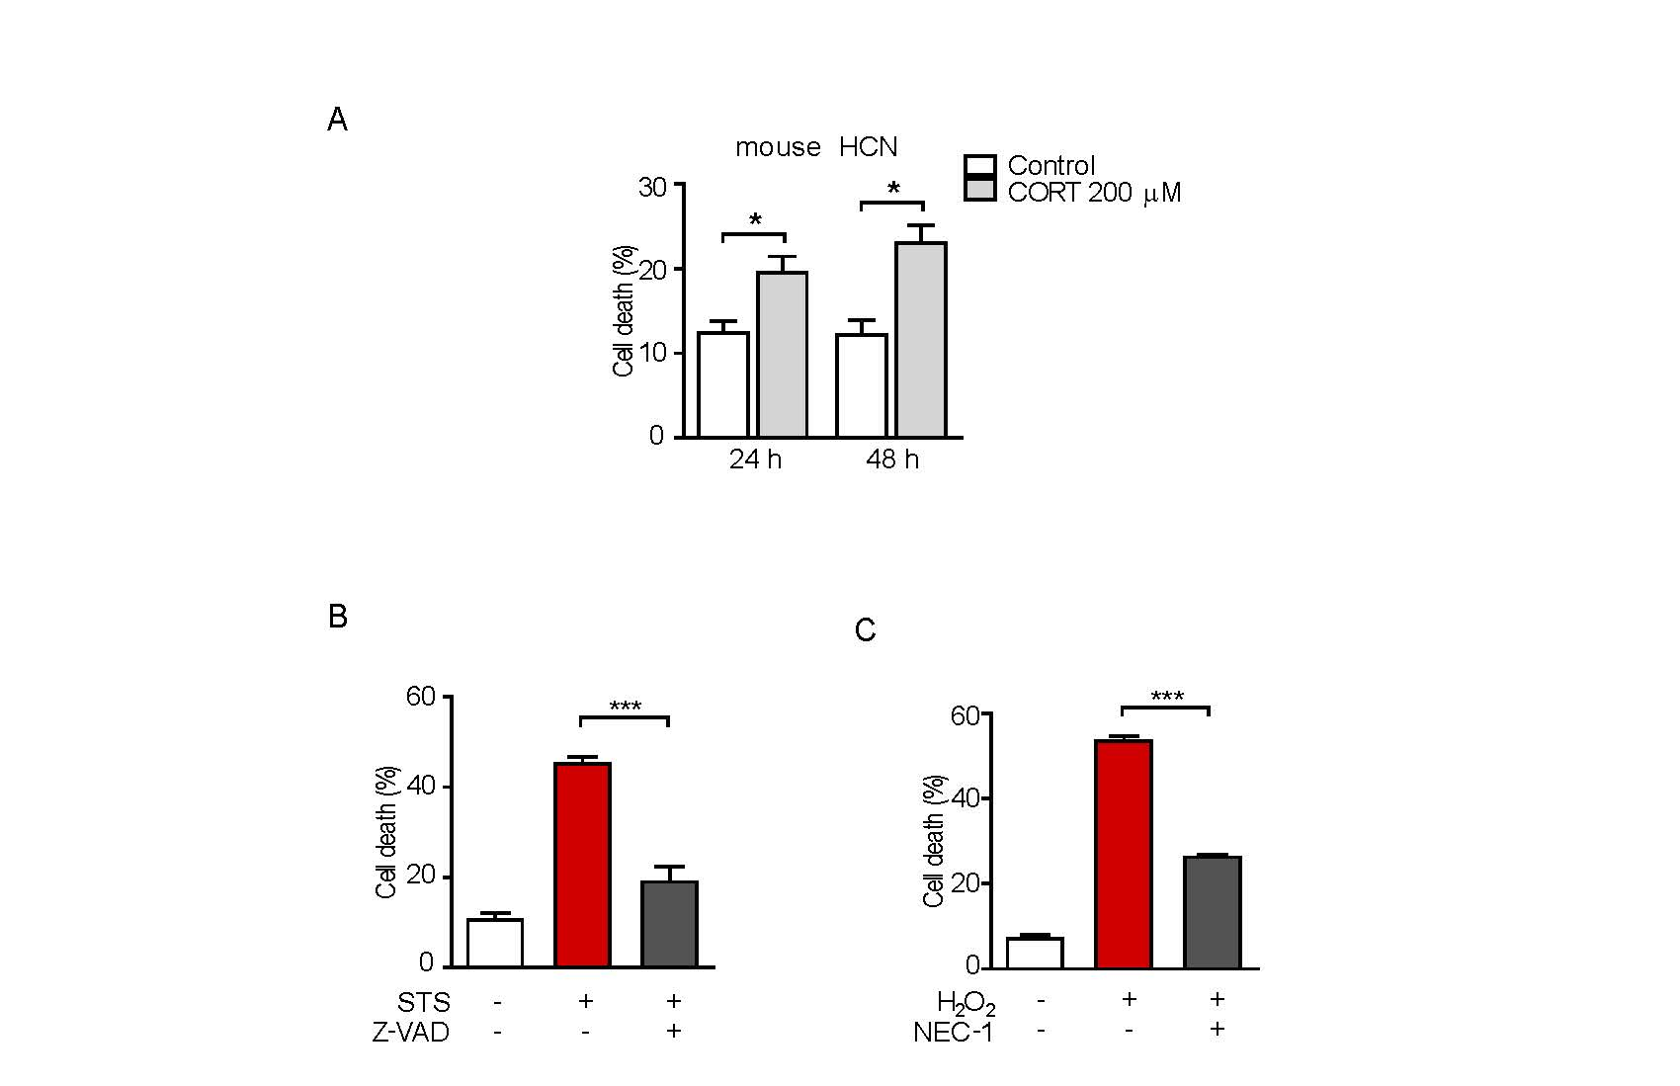
a
b
c
Figure S6. Measurement of cell death. (A) Cell death rate of mouse HCN cells after CORT treatment (n = 3). (B) Effect of Z-VAD (25 μM) on STS-induced apoptosis. Cell death was measured after STS (0.5 μM) treatment for 24 h (n = 3). (C) Effect of NEC-1 (100 μM) on H₂O₂-induced cell death. Cell death was measured after H₂O₂ (100 μM) treatment for 6 h (n = 3). *P < 0.05, ***P < 0.001.

Slide 7
shCon
shAtg7
CORT
BafA1
Figure S7. Blocking of CORT-induced autophagy flux in shAtg7 HCN cells. Analysis of autophagy flux by western blotting of MAP1LC3B after CORT treatment for 24 h. Blots are representative of three experiments with similar results.

