Slide 1
Supplemental Figure 1
a
b

Slide 2
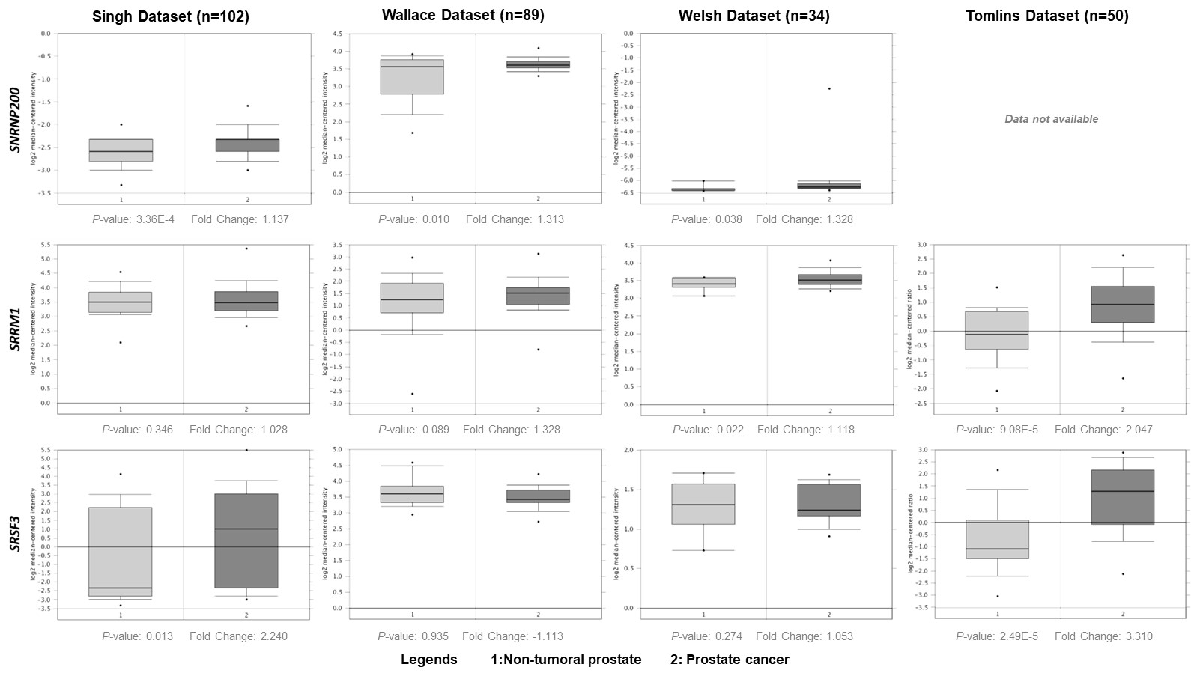
Supplemental Figure 2
Supplemental Figure 2. Expression of SNRNP200, SRRM1 and SRSF3 in Singh, Wallace, Welsh and Tomlins Dataset (n=102, n=89, n=34 and n=50, respectively). mRNA levels of selected genes in PCa samples and non-tumour prostate tissues were available at Oncomine (ThermoFisher). Data represent the log₂ median-centered intensity. P-value and fold change was indicated for each condition.

Slide 3
Supplemental Figure 3
a
b
c
SNRNP200
SRRM1
SRSF3
TUBB
TUBB
TUBB
Supplemental Figure 3. Validation of SNRNP200, SRRM1 and SRSF3 silencing. Protein levels of SNRNP200, SRRM1 and SRSF3 after siRNA transfection (si-SNRNP200, si-SRRM1 and si-SRSF3, respectively) compared to scramble transfection (n=3). Data were normalized by β-Tubulin (TUBB) protein levels. Representative images of western blot results were located at below panel. Asterisk (* p <0.05) indicates statistically significant differences between groups.

Slide 4
Supplemental Figure 4
a
b
c
Supplemental Figure 4. Proliferation rate of LNCaP, 22Rv1 and DU145 cell lines after 24-, 48- and 72 h of transfection with scramble siRNA compared to non-transfected cells (n=3). Data were represented as percent of vehicle-treated control cells (mean ± SEM).

