Slide 1
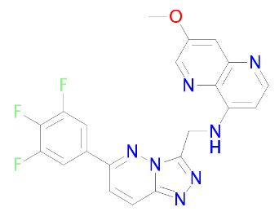
Supplemental Figure 1
A
B
S.1. Chemical structure (A) and selectivity heat map (B) for compound 22. POC= point of comparison.

