Slide 1
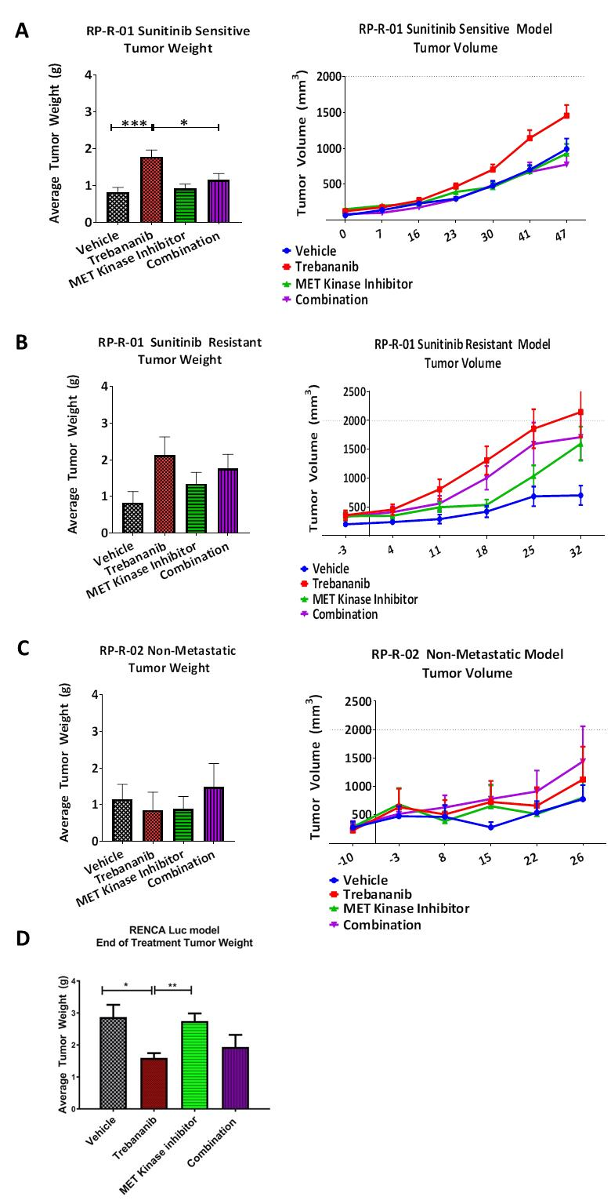
Supplemental Figure 3
S.3. Tumor growth curve and endpoint tumor weight of (A) sunitinib sensitive RP-R-01 mice in the combination cohort showed a significant reduction in growth compared to single agent trebananib alone, while the trebananib cohort had an increase in tumor growth. (B) RP-R-01 mice treated first with sunitinib until the time of resistance – defined as the point which the tumor doubled the size at the start of sunitinib treatment – showed no growth inhibition in either single agent or combination treatments. (C) RP-R-02 parental tumors in SCID mice showed no significant difference in primary tumor growth across the cohorts. (D) RENCA mice in the trebananib treated cohort show significant reduction in growth compared to vehicle control, while combination cohort did not show significant reduction. Results are given as mean + SEM. *p-value = <0.05, **p-value = <0.005, ***p-value = <0.001, ****p-value = <0.0001.

