Slide 1
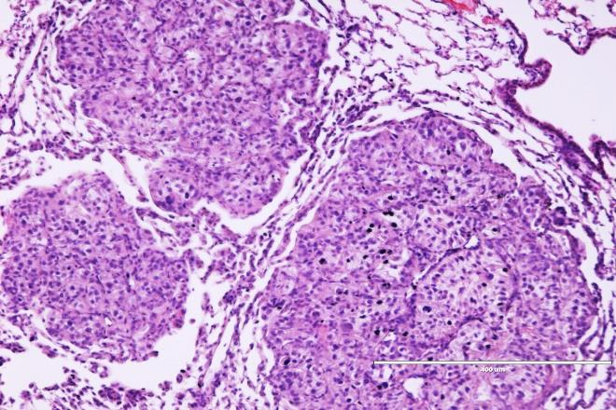
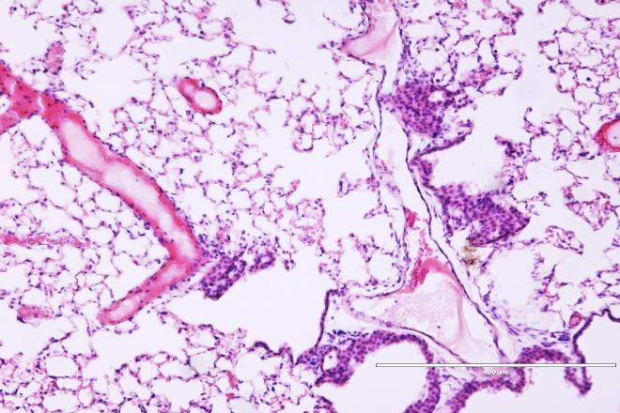
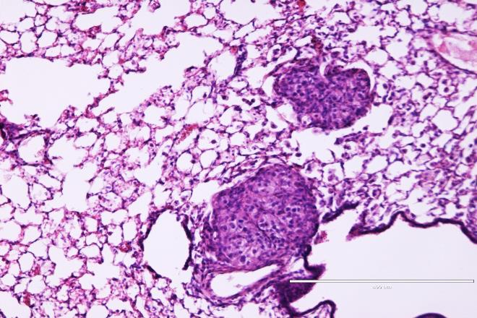
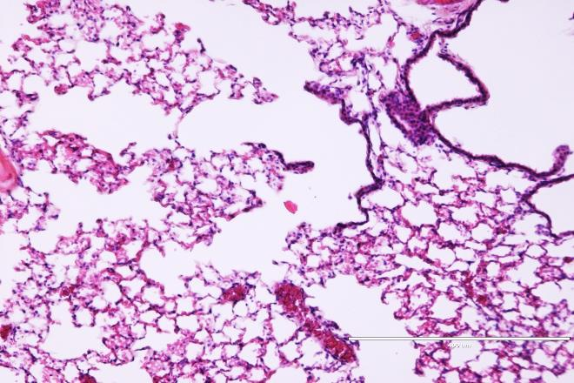
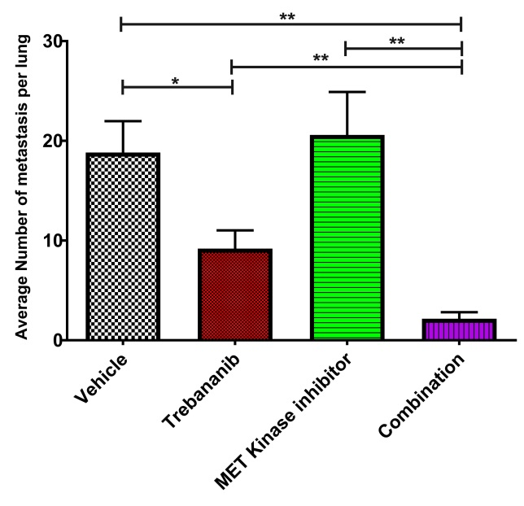
Supplemental Figure 4
A
Vehicle
Trebananib
MET Kinase Inhibitor
Combination
B
S.4. (A) Representative H&E staining of the lungs of mice in the subcutaneous survival study show a striking reduction in the presence of lung metastases in the trebananib and combination groups. (B) Similar to analysis done in figures 1D, E, analysis of the average number of lung metastases in each group (6 mice/group) showed a significant reduction in the presence of metastases in the combination group as compared to all other groups. Analysis is based the mean of the measurements per mouse.

