Slide 1
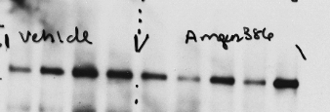



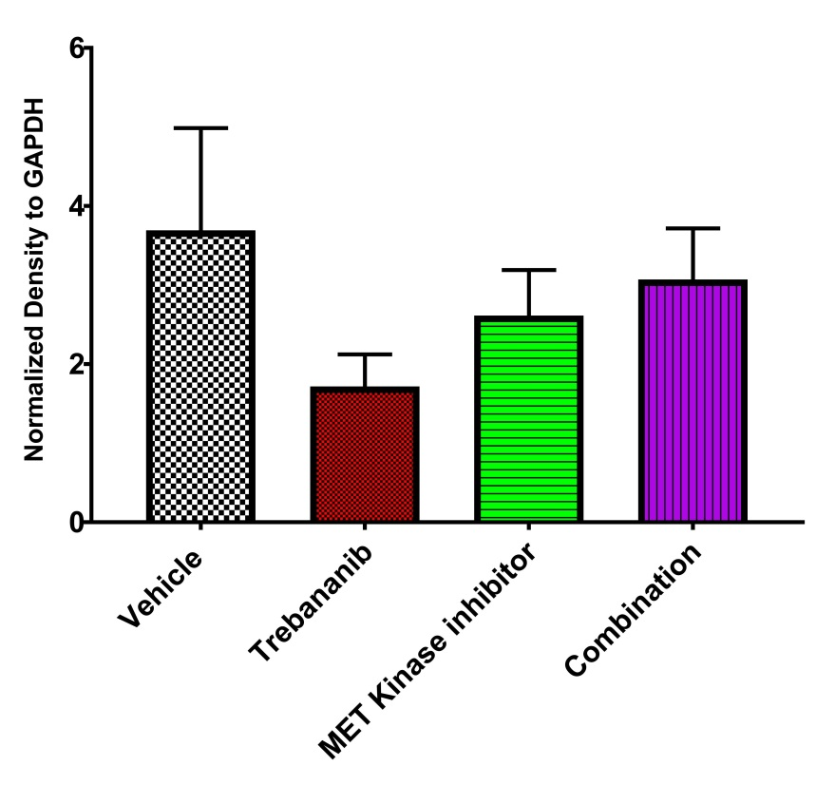
Supplemental Figure 6
E Cadherin
GAPDH
Vehicle
Trebananib
MET Kinase
Inhibitor
Combination
ns
S.6. Western blot analysis of epithelial marker E-cadherin in tumor lysates derived from mice in the subcutaneous implantation study in each treatment group (n = 4-5 mice per group). Western blot densitometry analysis of E-cadherin in all treatment groups.

