Slide 1
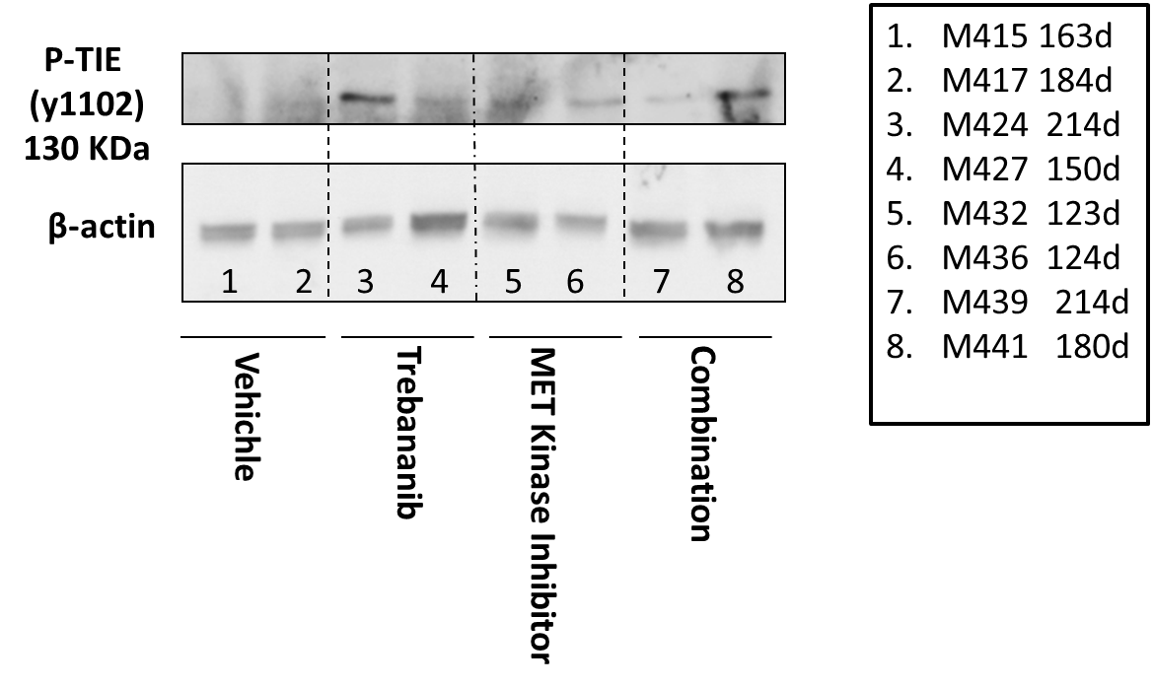
Supplemental Figure 8
S.8. Western blot results for pTie and β-actin in tumors from mice in the four treatment groups. Tie phosphorylation is upregulated in all treatment groups compared to vehicle control.

