Slide 1
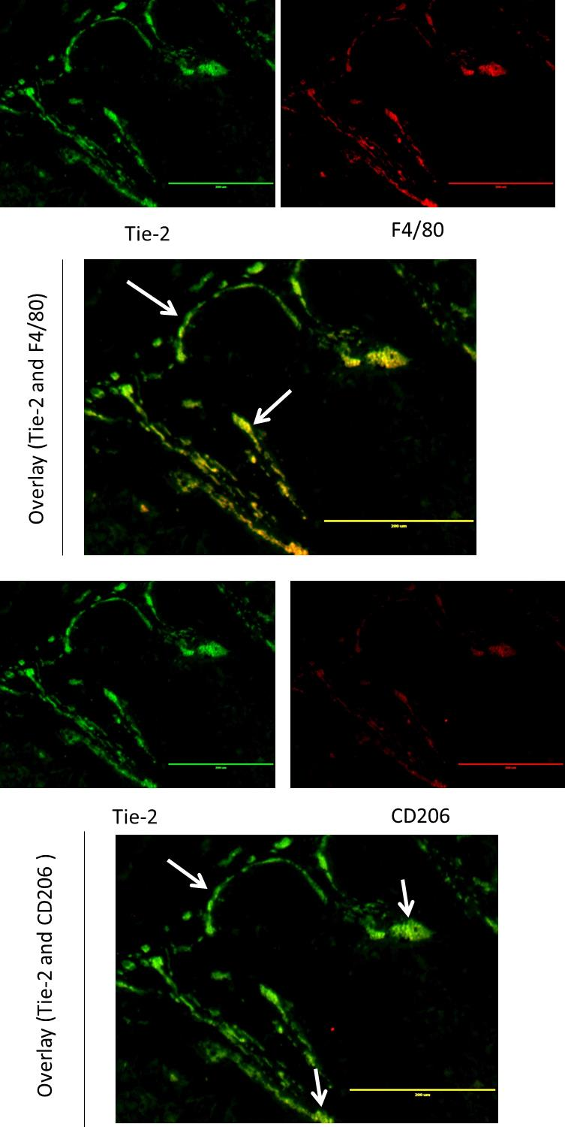
Supplemental Figure 9
S.9. Representative images of immunofluorescence staining of (A,D) TIE2 staining adjusted to green in ImageJ and (B,E) F4/80 and CD206 staining adjusted to red in ImageJ respectively and the overlap between these two channels in (C,F) where yellow areas represent complete overlap between TIE2⁺ and F4/80⁺ CD206⁺ areas respectively. Areas of overlap (yellow) are representative of areas where perivascular macrophages are present, while TIE2⁺ only areas (green) are representative of blood vessels.

