Slide 1
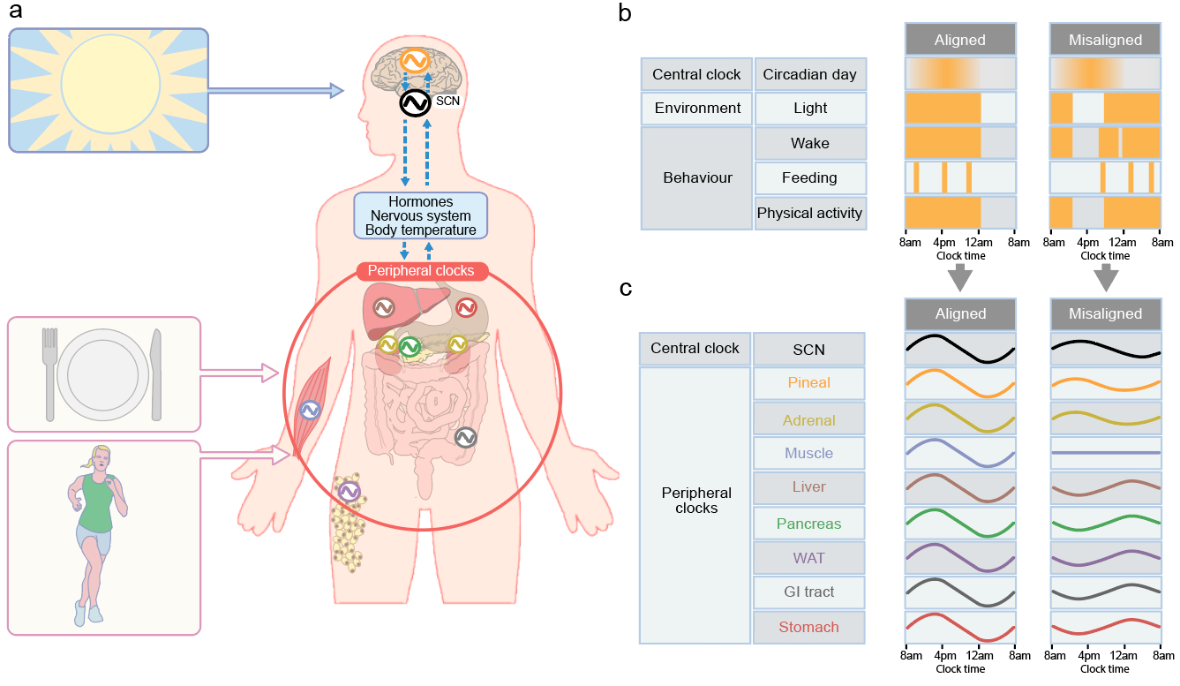
Circadian timekeeping and the alignment between environmental/behavioural rhythms and central/peripheral clocks
Mason et al (2020) Diabetologia DOI 10.1007/s00125-019-05059-6
© Springer-Verlag GmbH Germany, part of Springer Nature 2019

Slide 2
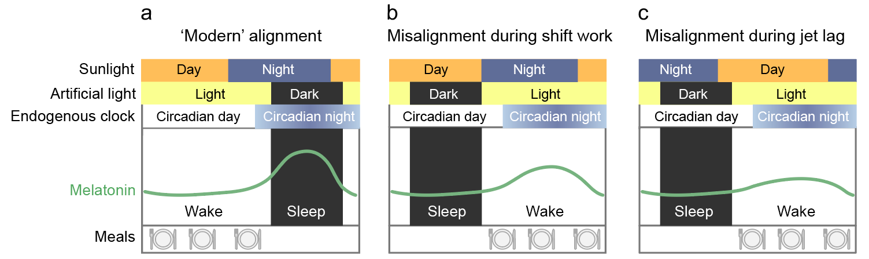
Comparison of the alignment of environmental, circadian and behavioural rhythms in a modern diurnal lifestyle
Mason et al (2020) Diabetologia DOI 10.1007/s00125-019-05059-6
© Springer-Verlag GmbH Germany, part of Springer Nature 2019

Slide 3
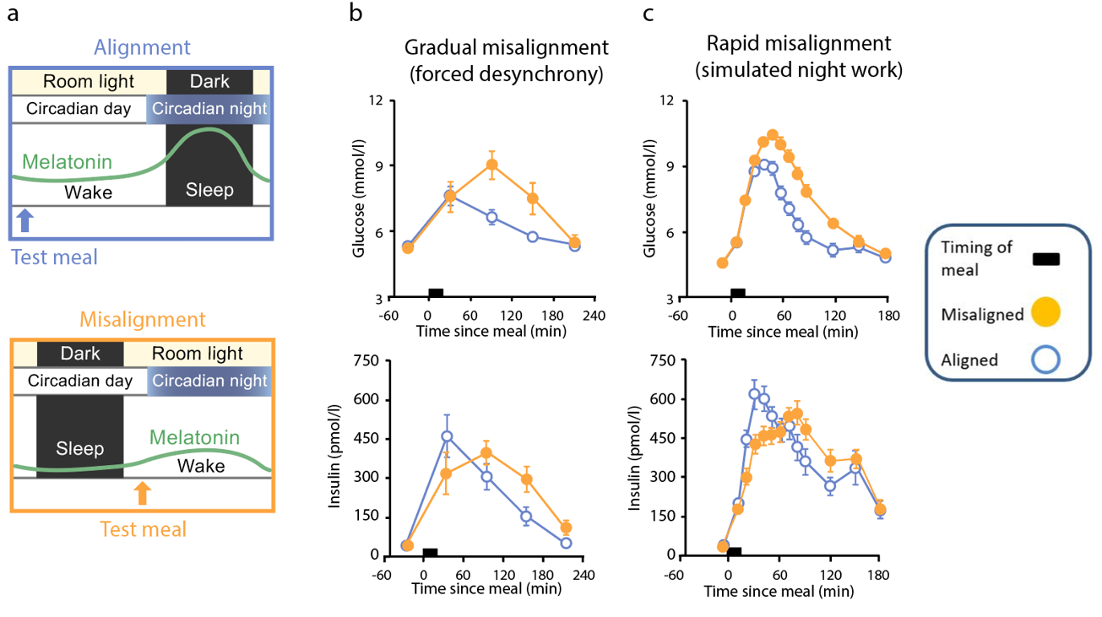
Effect of misalignment between the central clock and the behavioural/environmental cycle on glucose tolerance
Mason et al (2020) Diabetologia DOI 10.1007/s00125-019-05059-6
© (a) Springer-Verlag GmbH Germany, part of Springer Nature 2019; (b, c) Adapted from Scheer et al (2009) and Morris et al (2015), distributed under the terms of the CC BY 4.0 Attribution License (http://creativecommons.org/licenses/by/4.0/)

Slide 4
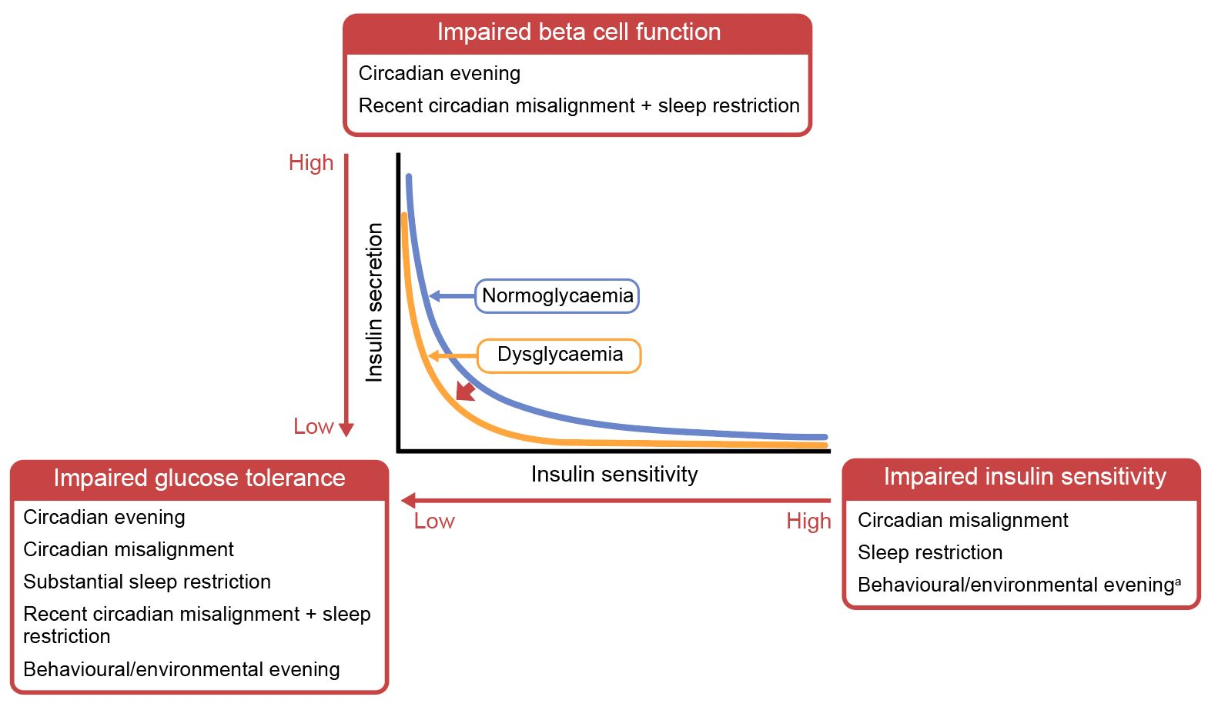
Diagram illustrating the impact of circadian and behavioural influences on glycaemic control and the potential transition to diabetes
Mason et al (2020) Diabetologia DOI 10.1007/s00125-019-05059-6
© Springer-Verlag GmbH Germany, part of Springer Nature 2019

