Slide 1
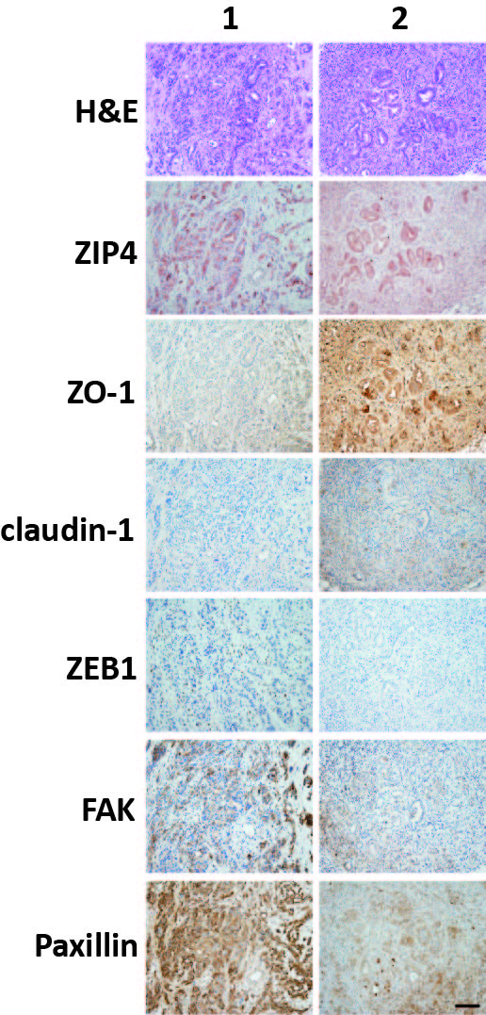
Supplementary Figure 1

Slide 2
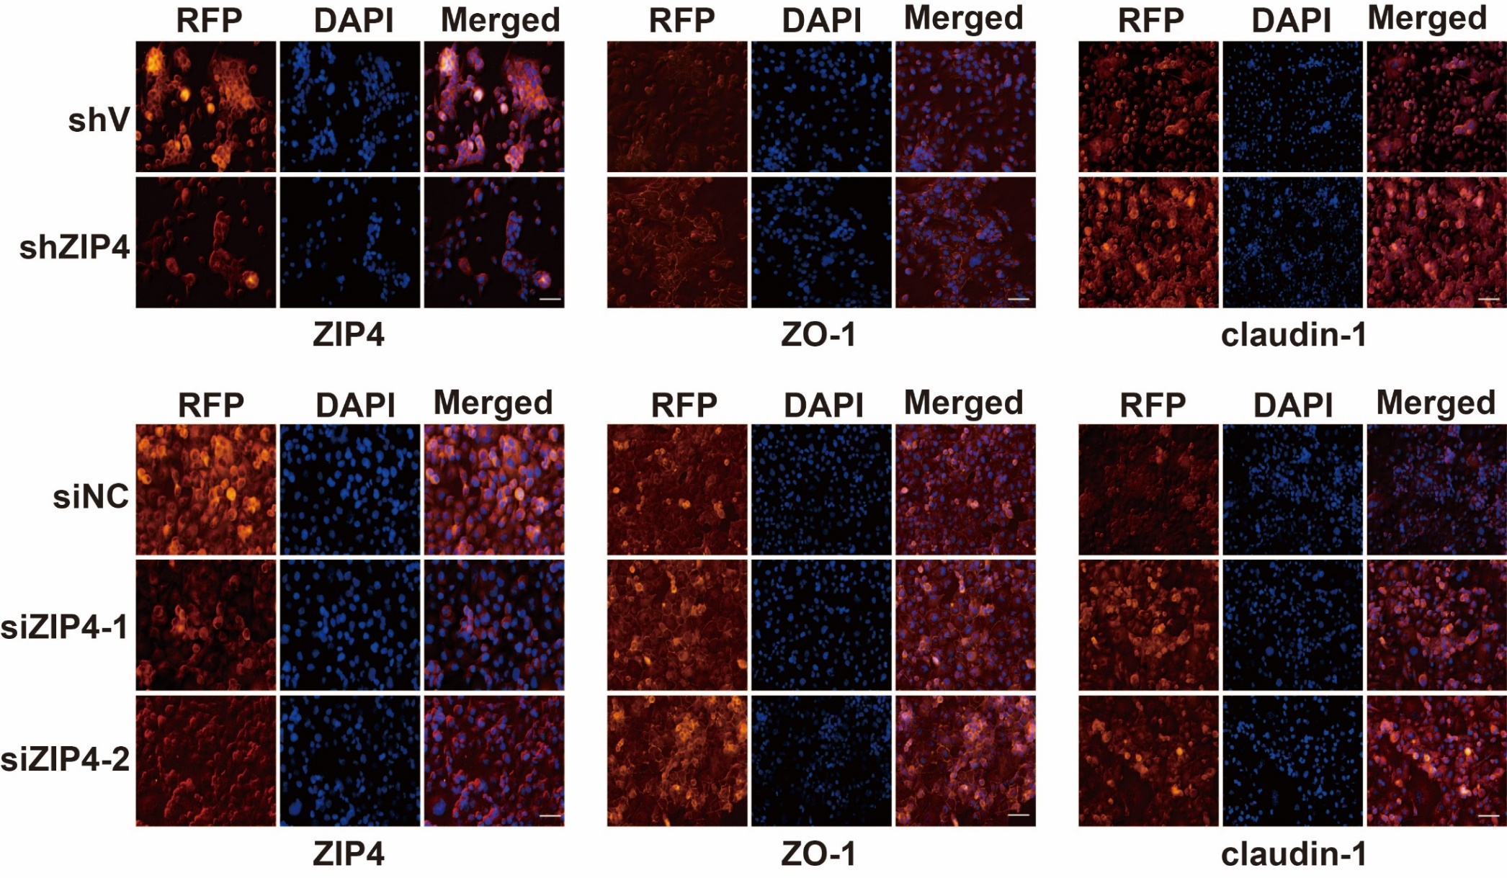
Supplementary Figure 2

Slide 3
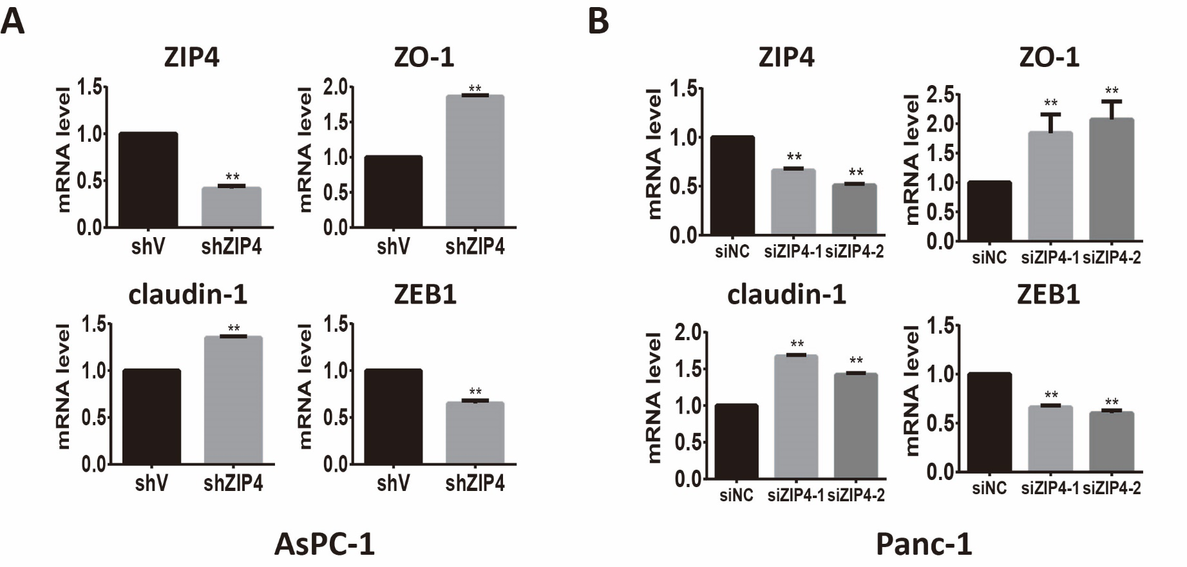
Supplementary Figure 3

Slide 4
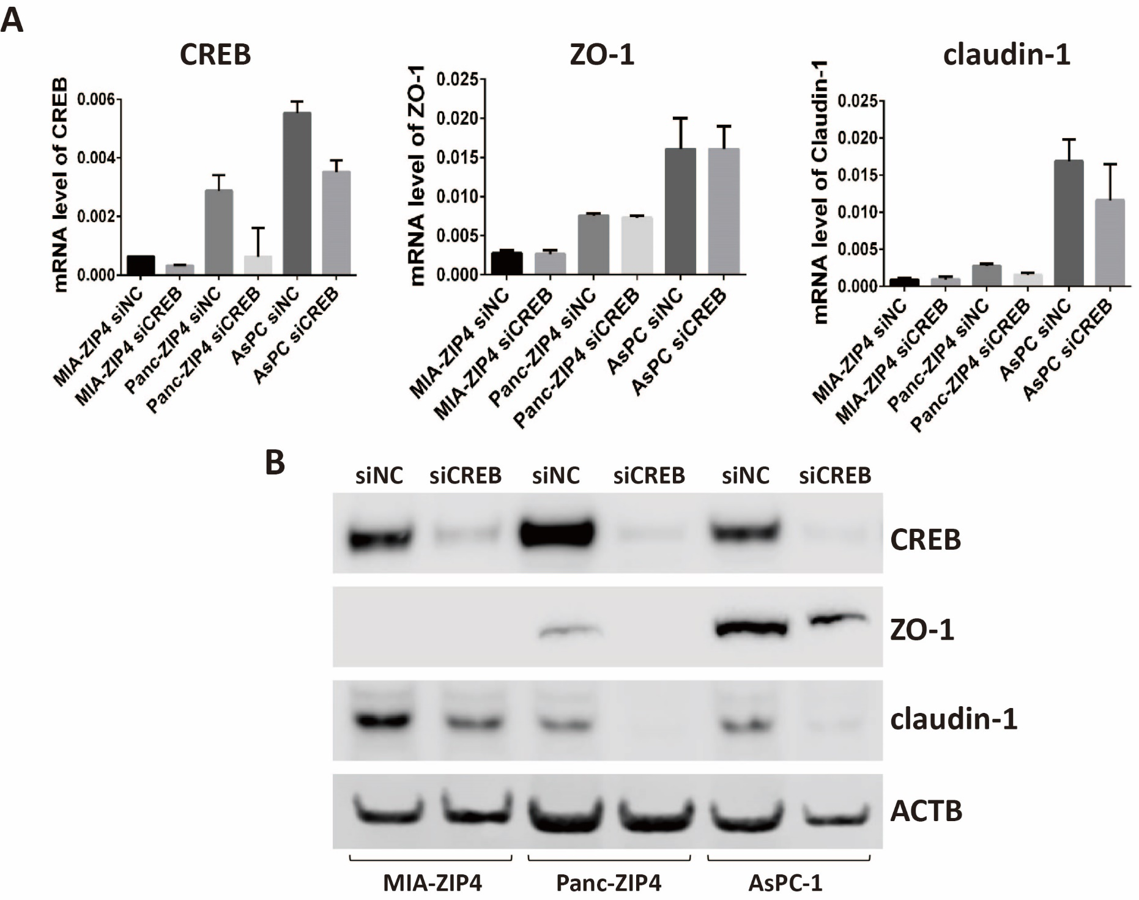
Supplementary Figure 4

Slide 5
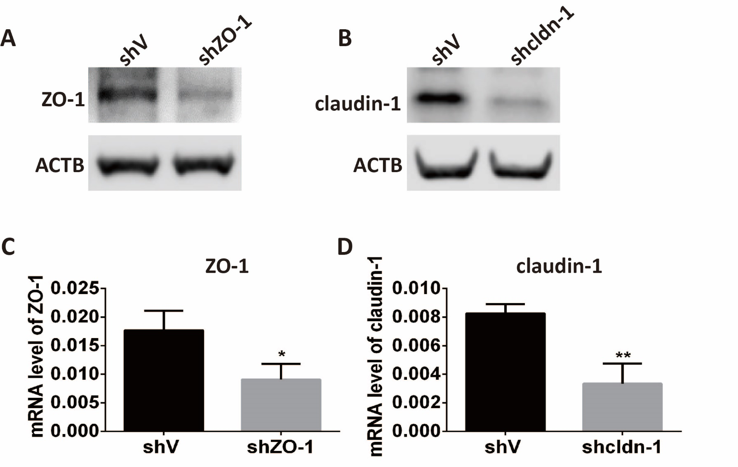
Supplementary Figure 5

Slide 6
Clinic-pathological data of patients with pancreatic adenocarcinoma (n=72)
Clinical features |  | Number
Age | <65 years | 44 (61%)
 | >65 years | 28 (39%)
Gender | Male | 46 (64%)
 | Female | 26 (36%)
Tumor differentiation | Poor | 18 (25%)
 | Moderate | 29 (40%)
 | High | 25 (35%)
Tumor stage | T1 | 3 (4%)
 | T2 | 9 (13%)
 | T3 | 60 (83%)
Tumor grade | IA | 2 (3%)
 | IB | 10 (14%)
 | IIA | 21 (29%)
 | IIB | 39 (54%)
Supplementary table 1

