Slide 1
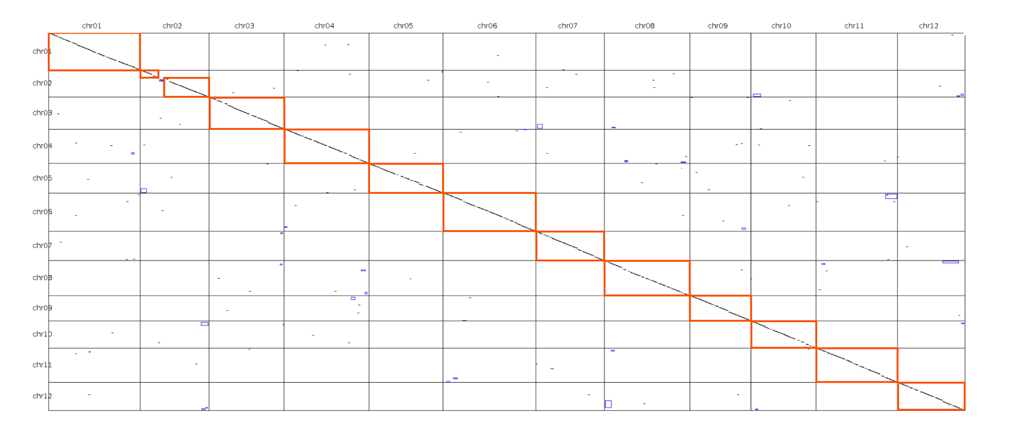
Supplementary Figure S3: Dot-plot alignment between melon assembly v3.6.1 and v4.0. Each dot represents a conserved region. Red boxes indicate syntenic blocks. Discontinuous lines on the diagonal represent synteny breaks due to deletions or insertions while interspersed blue rectangles represent relocations.
Assembly v4.0
Assembly v3.6.1

