Slide 1
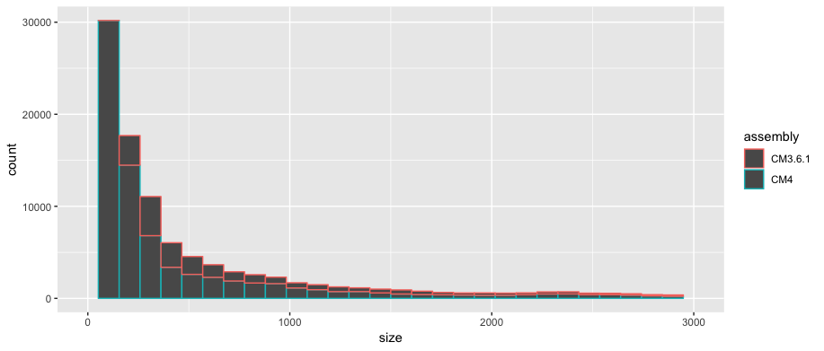
Supplementary Figure S5. Histogram of size distribution of TIR-TEs in v3.6.1 and v4.0 assemblies.

