Slide 1
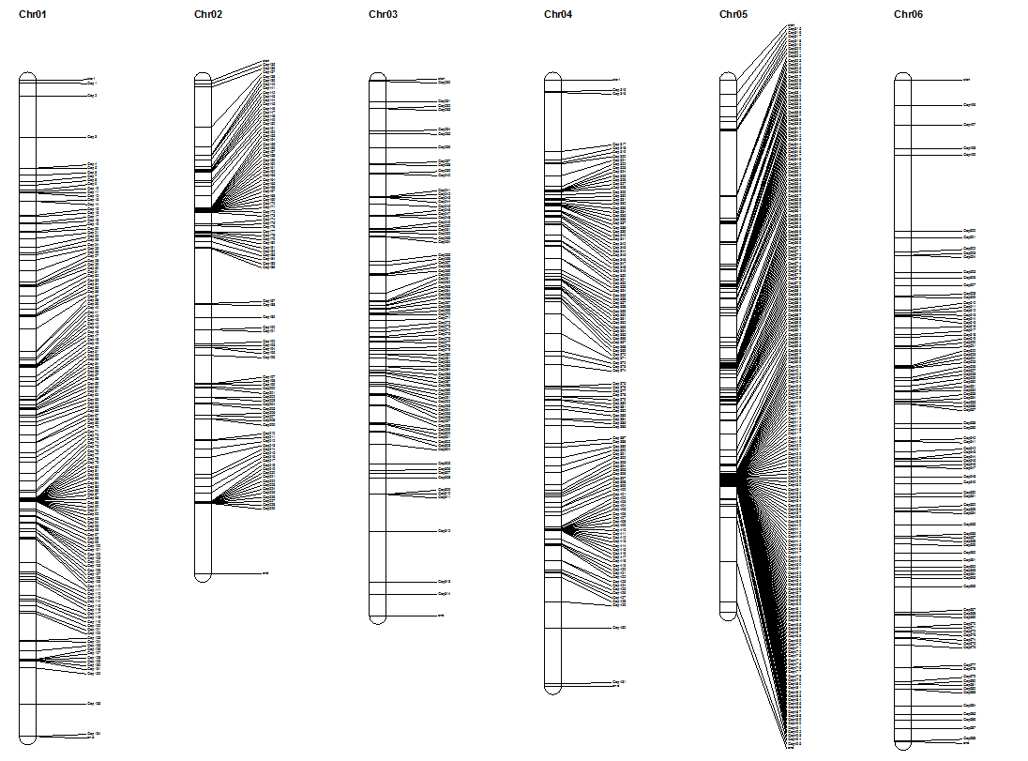
Supplementary Fig S7. Gap distribution across the 12 chromosomes of the v4.0 melon genome assembly

Slide 2
