Slide 1
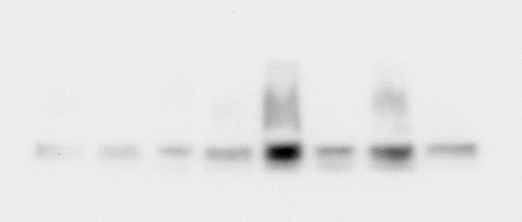
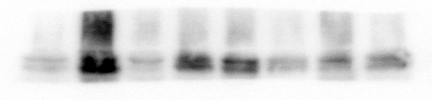
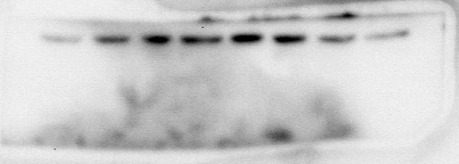
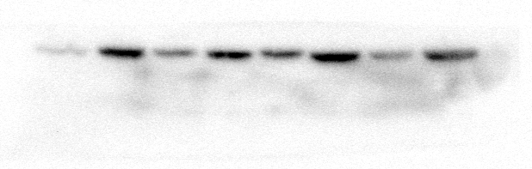
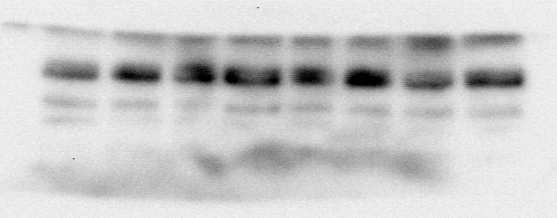
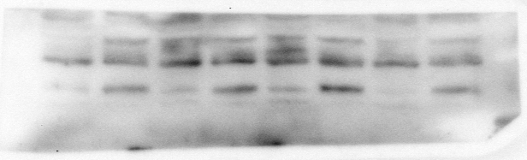
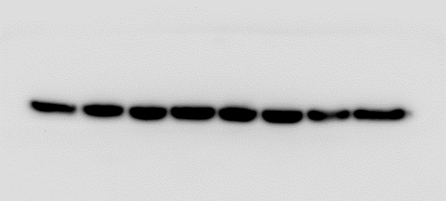
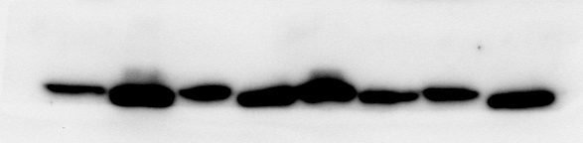
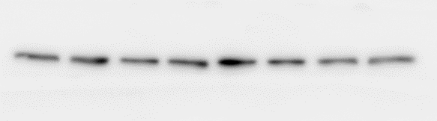
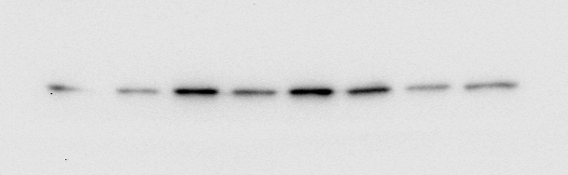
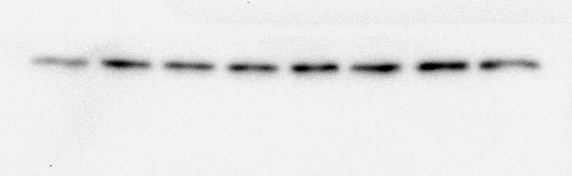
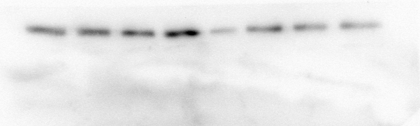
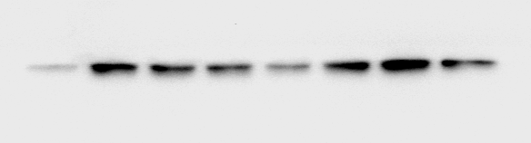
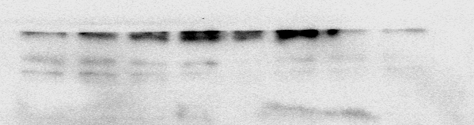
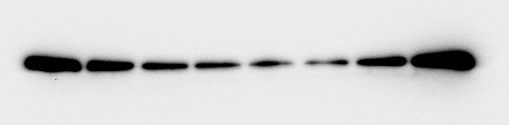
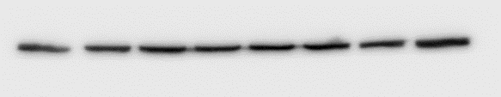
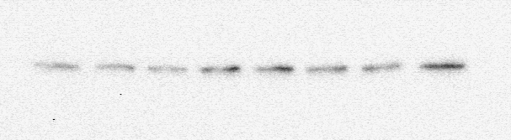
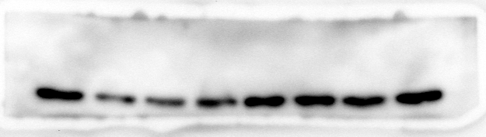
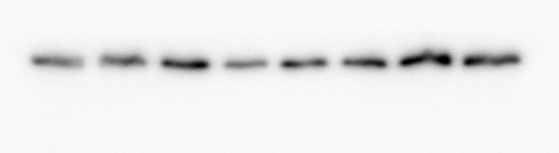
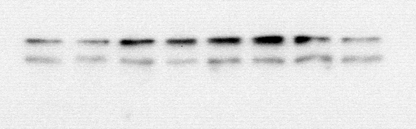
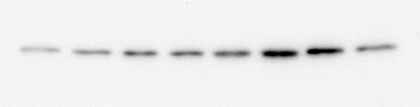
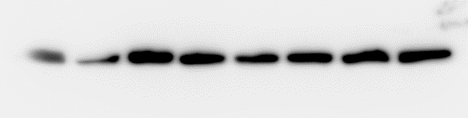
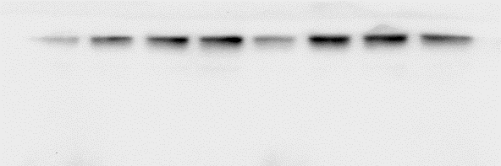
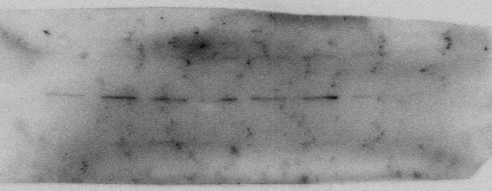
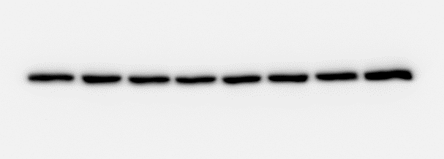
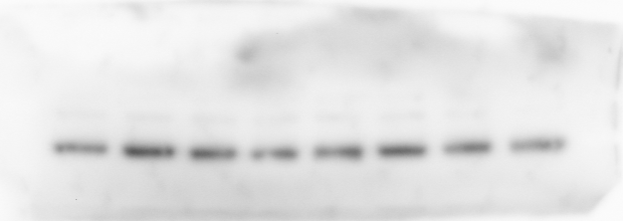
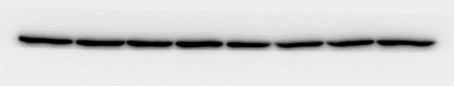
Fig. 3C
Fig. 3E
PDCD4
X
X
X
X
X
X
X
X
X
X
X
X
54 kDa
PDCD4
54 kDa
another experiments
saline
another experiments
sham
Ang II
X
X
X
TAC
X
X
X
X
X
X
X
X
c-Jun
X
43 kDa
c-Jun
43 kDa
saline
another experiments
another experiments
Ang II
sham
TAC
X
X
X
X
X
X
X
X
X
X
X
TGF-β1
X
45 kDa
TGF-β1
45 kDa
saline
Ang II
another experiments
sham
another experiments
TAC
X
X
X
X
Tubulin
X
X
X
X
X
X
Tubulin
X
X
55 kDa
another experiments
55 kDa
sham
saline
another experiments
TAC
Ang II
Fig. 4C
Fig. 4E
X
X
X
X
X
X
X
X
PDCD4
54 kDa
PDCD4
X
X
X
X
54 kDa
another experiments
another experiments
vehicle
scramble
Ang II
siPDCD4
X
X
c-Jun
X
X
X
X
X
X
43 kDa
c-Jun
X
X
X
X
43 kDa
vehicle
another experiments
scramble
another experiments
Ang II
siPDCD4
TGF-β1
X
X
X
X
X
X
45 kDa
TGF-β1
X
X
X
X
X
X
45 kDa
another experiments
scramble
another experiments
vehicle
siPDCD4
Ang II
X
X
X
X
X
X
X
Tubulin
X
X
X
55 kDa
Tubulin
X
X
55 kDa
vehicle
another experiments
scramble
another experiments
Ang II
siPDCD4
Fig. 5B
X
X
X
X
X
X
Fig. 6B
PDCD4
NC
another experiments
54 kDa
PDCD4
X
X
X
X
54 kDa
miR-21 inhibitor
vehicle
Ang II +
NC
another experiments
c-Jun
X
X
X
X
X
X
43 kDa
Ang II
Ang II +
miR-21 inhibitor
NC
another experiments
miR-21 inhibitor
c-Jun
X
X
X
X
43 kDa
TGF-β1
X
X
X
X
X
X
45 kDa
another experiments
Ang II +
NC
vehicle
another experiments
NC
Ang II
Ang II +
miR-21 inhibitor
miR-21 inhibitor
Tubulin
X
X
X
X
X
X
55 kDa
TGF-β1
X
X
X
X
45 kDa
another experiments
NC
another experiments
miR-21 inhibitor
vehicle
Ang II +
NC
Ang II
Ang II +
miR-21 inhibitor
Fig. 6C
X
X
X
p-TAK1
X
82 kDa
Tubulin
X
X
X
X
55 kDa
vehicle
Ang II +
NC
another experiments
another experiments
Ang II
vehicle
Ang II +
NC
Ang II +
miR-21 inhibitor
Ang II
Ang II +
miR-21 inhibitor
TAK1
X
X
X
X
82 kDa
The blots were visualized with Luminata Forte Western HRP substrate (Millipore, Billerica, MA, USA), and images were obtained by CCD camera system (Light-Caapture II, Atto Co., Tokyo, Japan).
We loaded the same samples (same amount) on different gels because PDCD4 and tubulin, and c-Jun and TGF-β had similar molecular weight, respectively.
vehicle
Ang II +
NC
another experiments
Ang II
Ang II +
miR-21 inhibitor
Tubulin
X
X
X
X
55 kDa
vehicle
Ang II +
NC
another experiments
Ang II
Ang II +
miR-21 inhibitor

