Slide 1
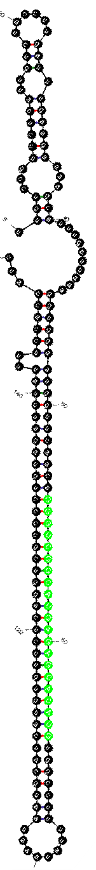
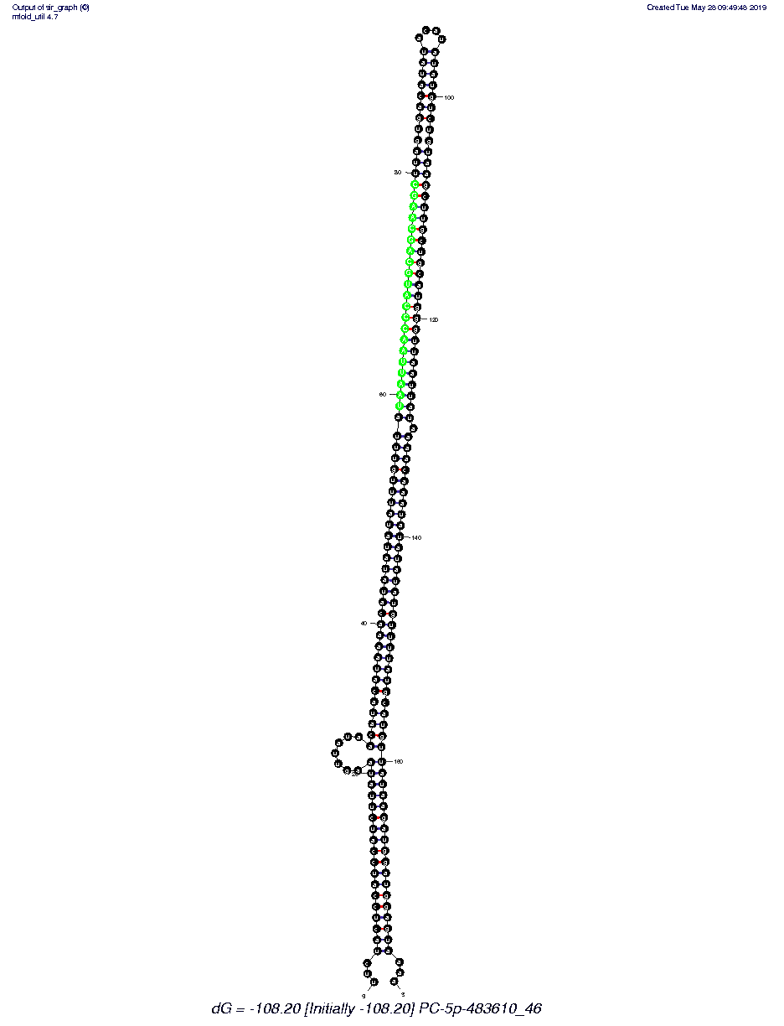
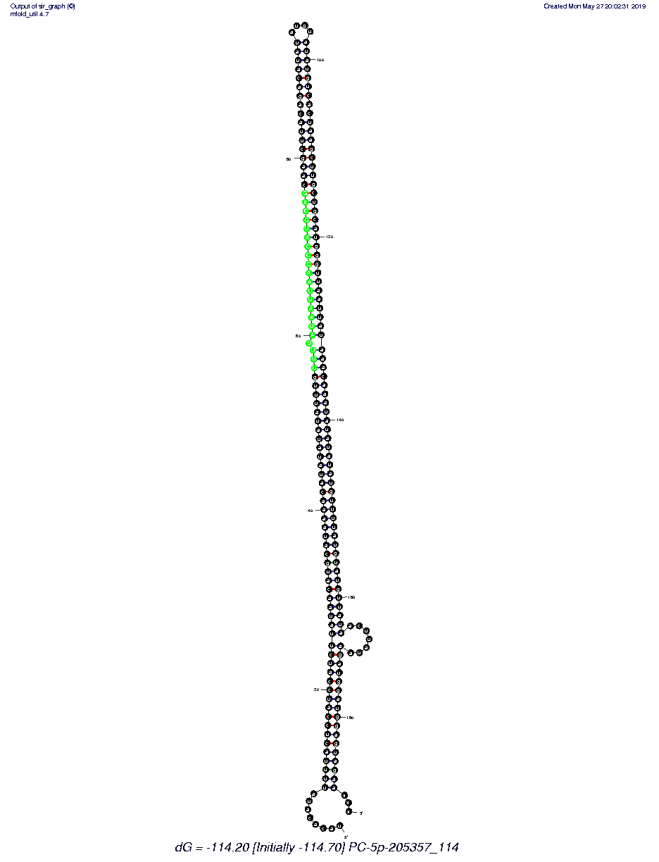
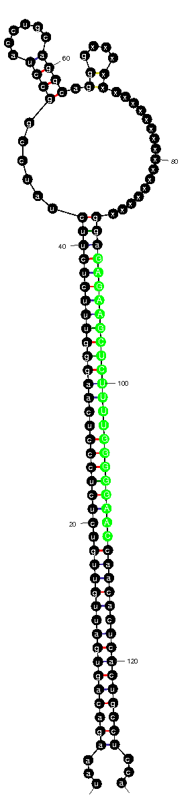
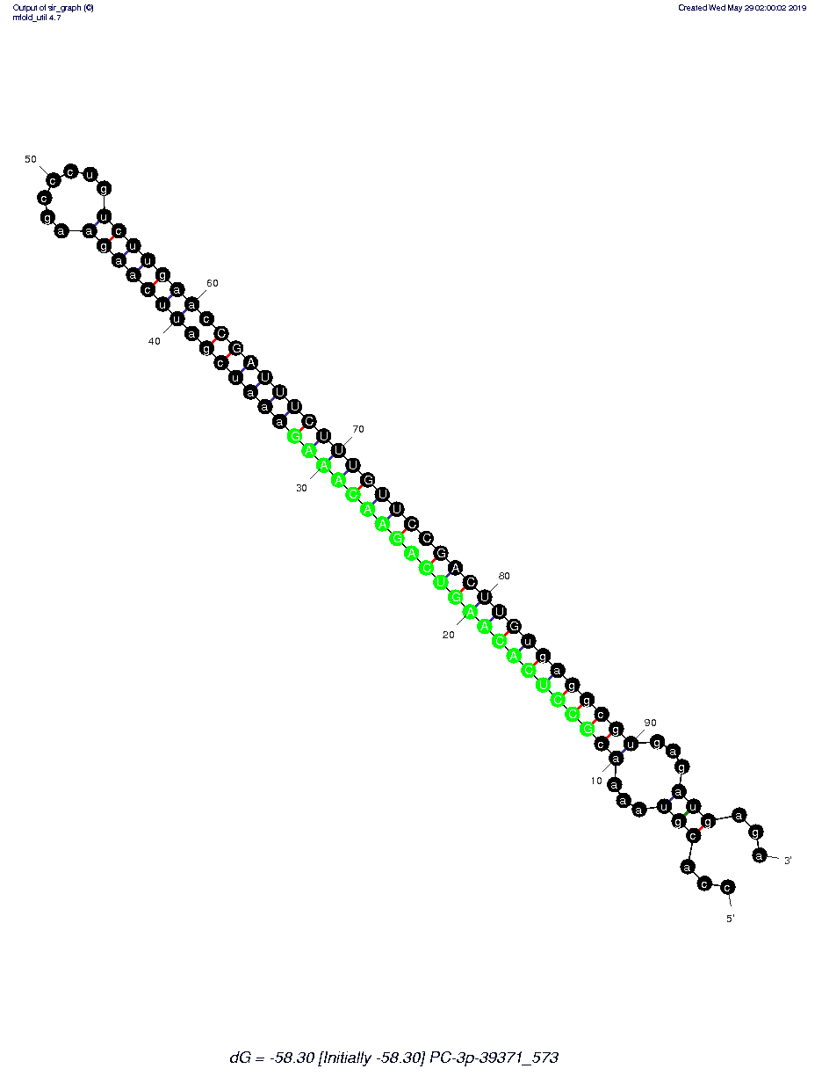
20
100
100
80
80
5'
40
60
50
120
3'
120
60
60
140
60
40
60
40
140
140
30
70
100
40
40
120
80
20
80
160
20
160
20
10
90
20
120
180
PC-3p-1207_6855
3'
3'
100
5'
3'
5'
5'
5'
3'
PC-5p-32123_688
PC-3p-1207_6855
PC-3p-39371_573
PC-5p-205357_114
PC-5p-483610_46
Fig. S4

