Slide 1
Keratinocyte footprint assay discriminates anti-laminin-332 pemphigoid from all other forms of pemphigoid diseases
Giurdanella F, Nijenhuis AM, Diercks GFH, Jonkman MF, Pas HH
Center for Blistering Diseases, Dept of Dermatology, University of Groningen University Medical Center Groningen, the Netherlands
British Journal of Dermatology. DOI: 10.1111/bjd.18129

Slide 2
Introduction
What’s already known?
Anti-laminin-332 mucous membrane pemphigoid (MMP) is a severe form of pemphigoid and patients may have an increased risk of malignancies.
The diagnosis of anti-laminin-332 MMP is complicated by the lack of specific commercial tests for anti-laminin-332 antibodies and can be confirmed only in specialized laboratories.
Keratinocytes in culture need laminin-332 for adhesion and migration and therefore deposit it on the bottom of the culture dish.

Slide 3
Objective
To develop a sensitive and specific laboratory assay to determine anti-laminin-332 autoantibodies in patient serum.

Slide 4
Methods (1)
KFA on air-dried frozen keratinocytes substrate:
  Keratinocytes were grown on 12 mm diameter glass coverslips in 500 µl low calcium medium in a 1.9 cm² well, and after 3 days of culture they were rinsed three times with PBS, air-dried and stored at -80 ºC until use.
  On day of assay, coverslips were taken out of the freezer and incubated with 10% patient serum in PBS PBS-ovalbumin for 1 hour at 37 ºC
  After rinsing with PBS the IgG was visualized with DyLight488-labelled goat-anti-human IgG

Slide 5
Methods (2)
Human sera:
  16 proven anti-laminin-332 MMP
  55 normal human controls
  12 EBA and 13 anti-p200 pemphigoid controls
  7 BP controls
55 patients with mucosal lesions not diagnosed as anti-laminin-332 MMP including
  30 MMP sera, from which 15 labelled the roof of salt-split skin and 15 that were negative on salt-split skin
  10 sera from patients with erosive lichen planus
  11 sera from patients with paraneoplastic pemphigus and
  2 sera from patients with erythema exsudativum multiforme.

Slide 6
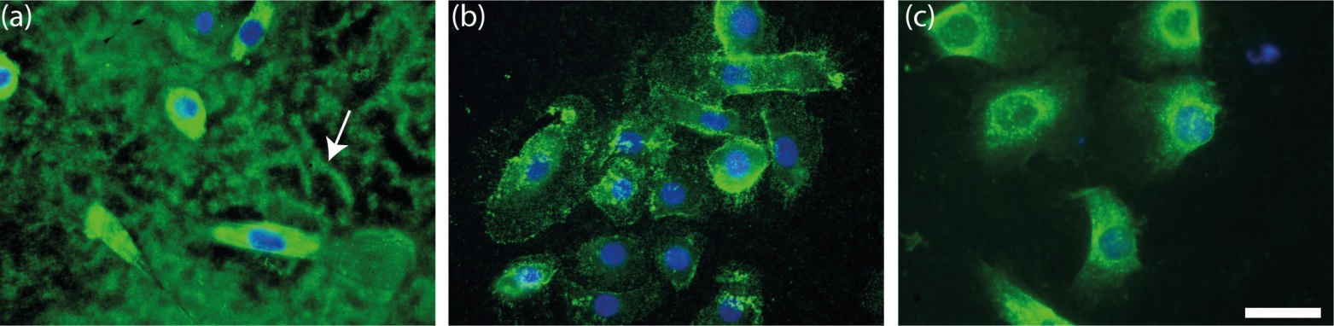
Results (1)
Laminin-332 is present on the coverslip as footprints
Air dried coverslips stained for (a) laminin-332 beta 3 subunit, (b) BP180 ectodomain, (c) type VII collagen. White arrow points to footprints

Slide 7
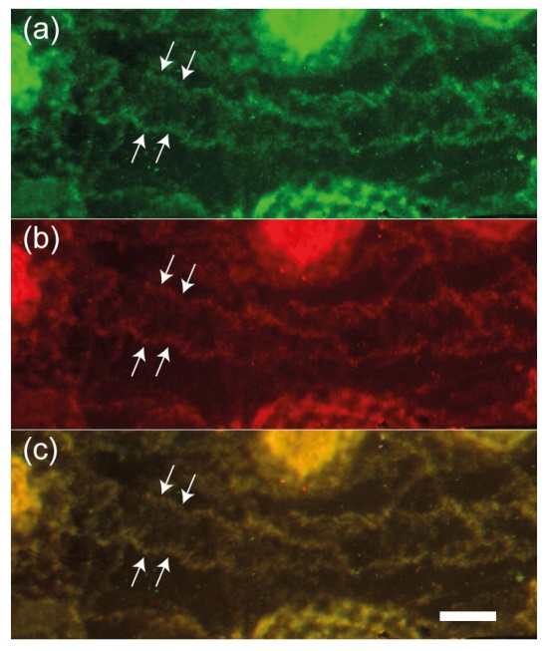
Results (2)
Patients IgG binds to deposited laminin-332
Living keratinocytes incubated with anti-laminin-332 IgG containing patient serum. Double staining for (a) human IgG, (b) laminin-332 gamma 2 subunit, (c) merged panel showing complete colocalization. White arrows point to footprints.

Slide 8
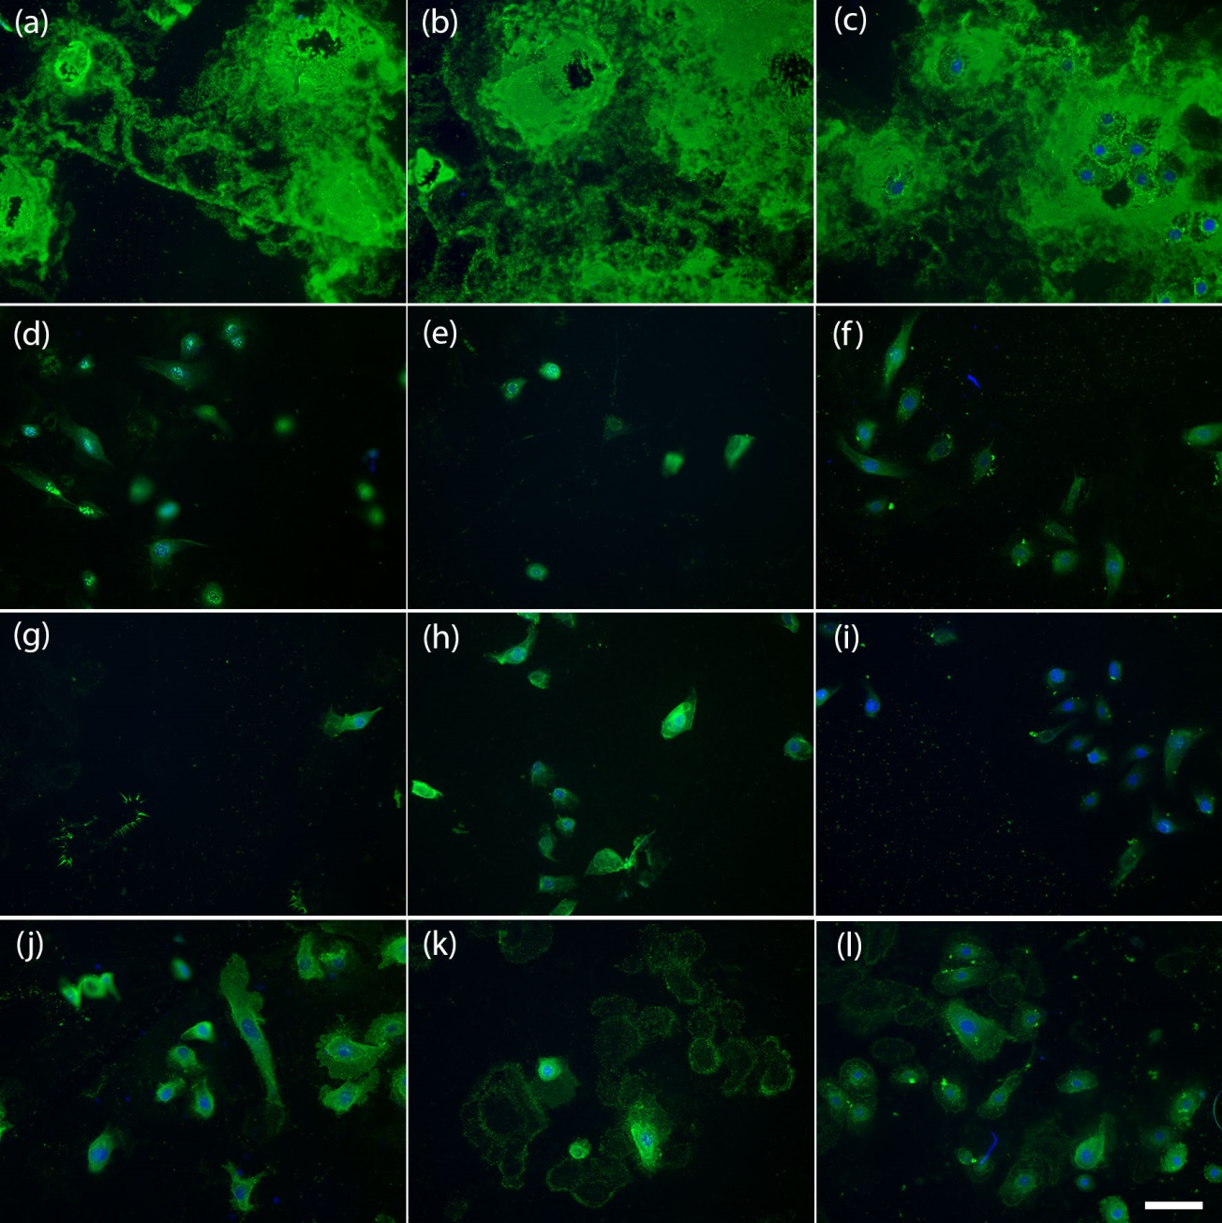
Results (3)
Keratinocyte footprint assay
(a-c) anti-laminin-332 pemphigoid
(d-f) EBA
(g-i) anti-p200 pemphigoid
(j-l) BP

Slide 9
Results (4)
All 16 anti-laminin-332 MMP tested positive.
All 55 normal human controls tested negative.
12 EBA and 12 anti-p200 pemphigoid controls tested negative.
7 BP controls tested negative.

Slide 10
Results (5)
51 of the 55 patients with mucosal lesions not diagnosed as anti-laminin-332 MMP tested negative
The KFA found additional anti-laminin-332 IgG in:
  1 patient who also had anti-p200 antibodies,
  1 patient with PNP,
  1 patient whose IgG bound both roof and floor of salt-split skin,
  1 patient whose IgG bound the roof, and
  1 patient of which the serum was negative on salt-split skin.

Slide 11
Discussion (1)
Laminin-332 is a unique component of the footprints left by cultured keratinocytes on the coverslips
The footprints are only recognized bye sera from anti-laminin-332 MMP patients but not by sera from patients with other pemphigoid diseases.
Due to the fact that a typical pattern is visualized also weak signals can easily be recognized.
Based on the results with the different patient groups the assay can be classified as highly specific and sensitive.

Slide 12
Discussion (2)
Due to its sensitivity the KFA also found concomitant anti-laminin-332 autoantibodies in a small percentage of patients who also had other antibodies (p-200, BP180, PNP, unclassified).
Such combined antibody responses have been described before.
It remains to be determined if these antibodies contribute to the clinical pattern.

Slide 13
Discussion (3)
The DDx of pemphigoid diseases can be best approached using a combination of immunofluorescence analysis on a skin biopsy and serological tests to identify the target antigen(s).

Slide 14
Conclusions
What does this study add?
The keratinocyte footprint assay detects anti-laminin-332 autoantibodies in patient serum using the native laminin-332 produced by cultured keratinocytes.
The keratinocyte footprint assay is a fast and specific assay to confirm or rule out the presence of anti-laminin-332 autoantibodies.

Slide 15
Call for correspondence
Why not join the debate on this article through our correspondence section?
Rapid responses should not exceed 350 words, four references and one figure
Further details can be found here

