Slide 1
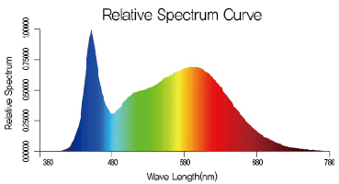
Suppl. Fig. 1. Jung et al.

Slide 2
A
B
C
D
E
F
Suppl. Fig. 2. Jung et al.

Slide 3
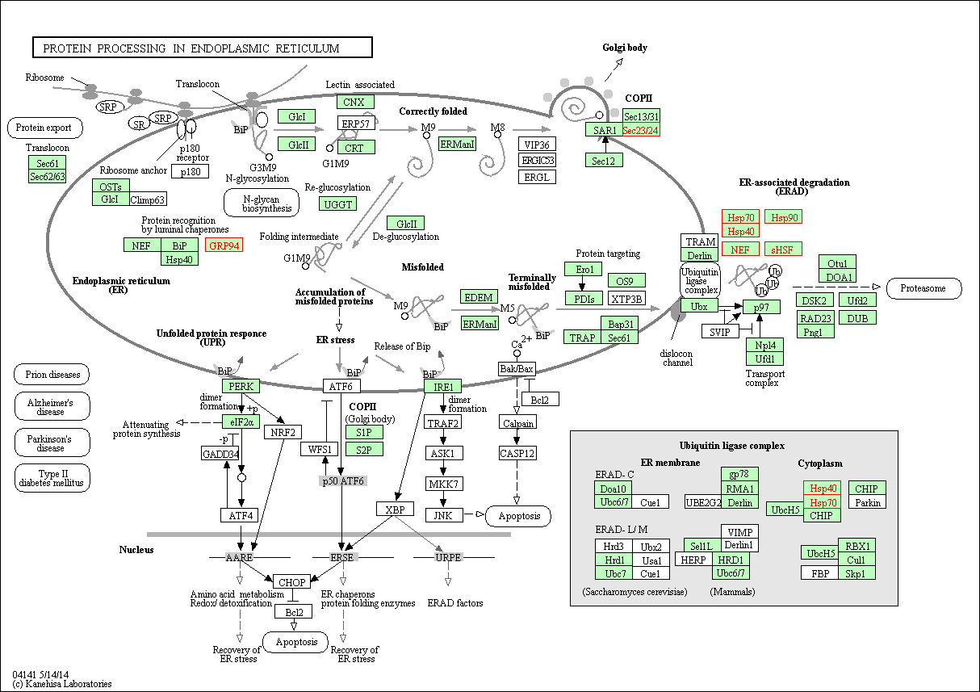
HSP70 : AT1G16030, AT5G02500
HSP40 : AT5G22060
NEF : AT3G09350
HSP90 : AT5G52640
sHSF : AT1G07400, AT1G52560, AT1G53540,
AT4G27670, AT5G12020, AT5G37670,
AT5G51440
AT4G32640
AT3G07770
HSP40 : AT5G22060
HSP70 : AT1G16030, AT5G02500
Suppl. Fig. 3. Jung et al.

Slide 4
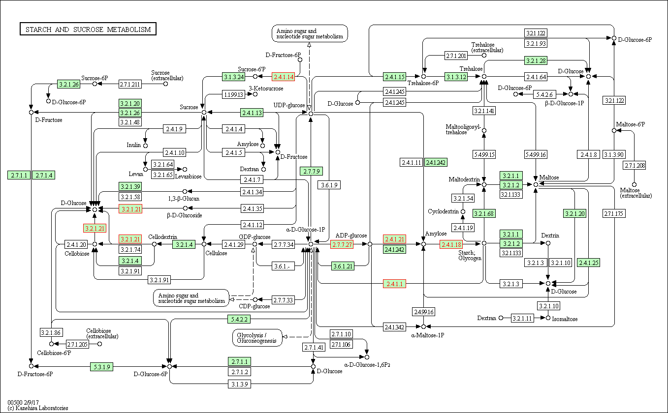
AT4G10120
AT5G24550
AT1G27680
AT4G39210
AT5G24300
AT5G03650
AT3G29320
Suppl. Fig. 4. Jung et al.

