Slide 1
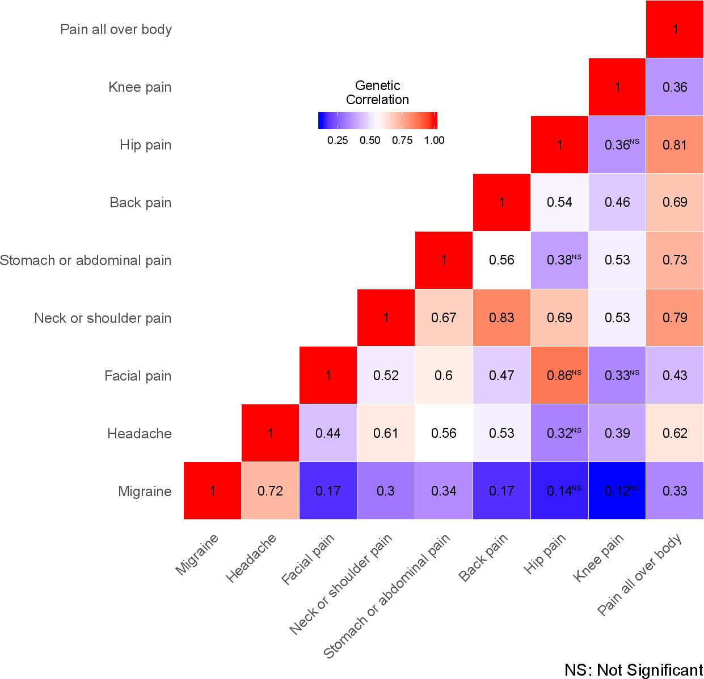
Supplementary Figure 1: The heatmap of the genetic correlations among eight pain phenotypes (UK Biobank) and migraine (23andMe)

