Slide 1
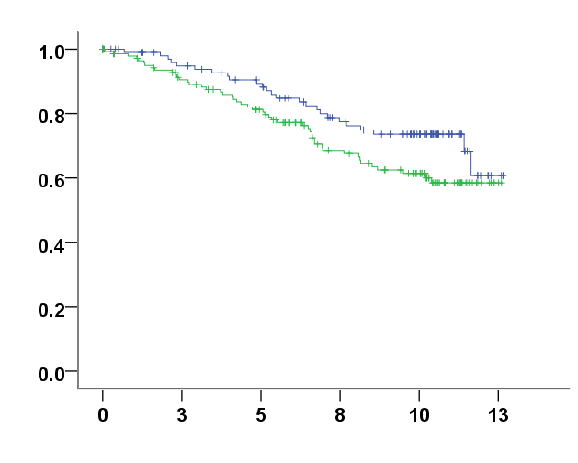
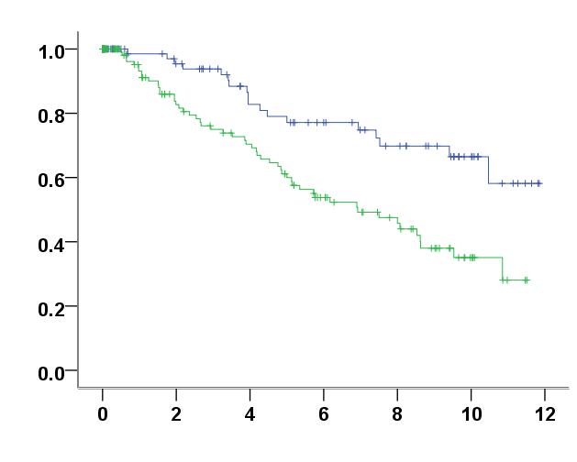
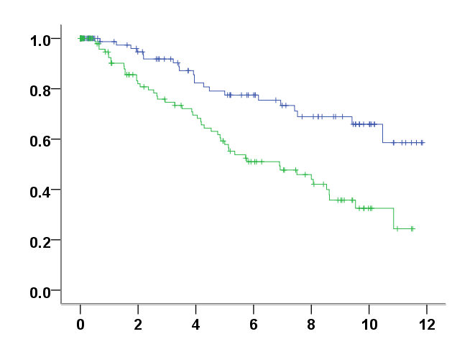
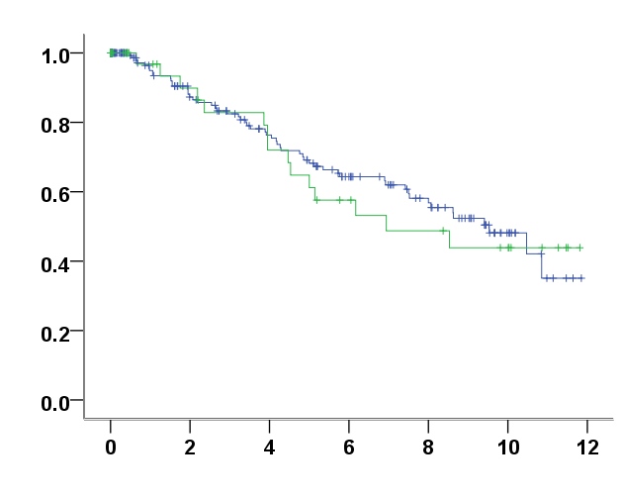
A
Whole cohort
B
Whole cohort
p=0.073
p=0.001**
Overall Survival
Relapse-Free Survival
Total PPARγ
Total PPARγ
n=106 (IRS＜3.5)
n=144 (IRS＞3.5)
n=106 (IRS＜3.5)
n=144 (IRS＞3.5)
Time (Years)
Time (Years)
C
Whole cohort
D
Whole cohort
p=0.000217***
p=0.795
Relapse-Free Survival
Relapse-Free Survival
Cytoplasmic PPARγ
Nuclear PPARγ
n=119 (IRS＜3.5)
n=131 (IRS＞3.5)
n=204 (IRS＜0.5)
n=46 (IRS＞0.5)
Time (Years)
Time (Years)
Figure S1

Slide 2
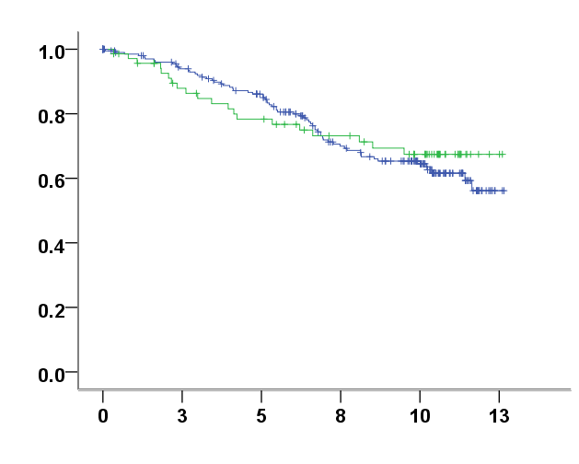
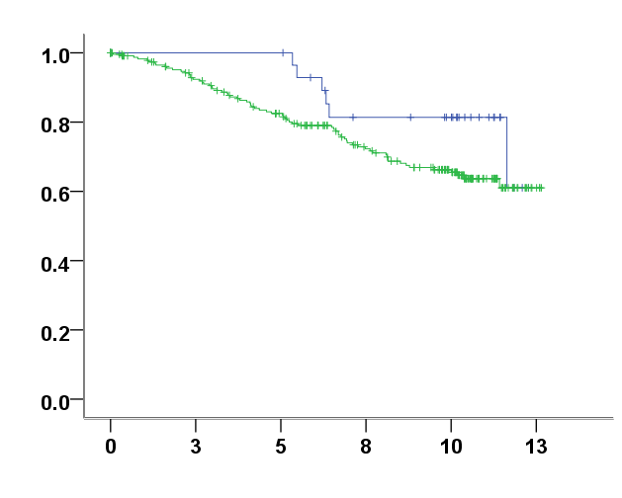
A
B
p=0.707
p=0.134
Overall Survival
Overall Survival
COX-1
COX-2
n=214 (IRS＜0.5)
n=70 (IRS＞0.5)
n=32 (IRS＜1.5)
n=239 (IRS＞1.5)
Time (Years)
Time (Years)
Figure S2

