Slide 1
Impact of mutations in DNA methylation genes on genome-wide methylation landscapes and downstream gene activations in pan-cancer
Additional file 1
Chai-Jin Lee, Hongryul Ahn, Dabin Jeong, Minwoo Pak, Ji Hwan Moon and Sun Kim
Supplementary figures

Slide 2
Figure S1. Case ratio of 7 DNA methylation modifiers mutations in each TCGA 33 projects

Slide 3
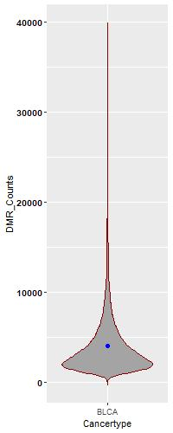
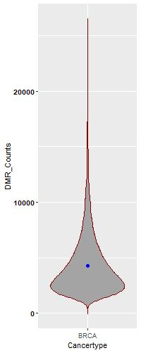
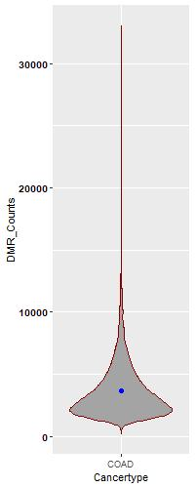
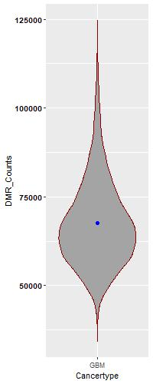
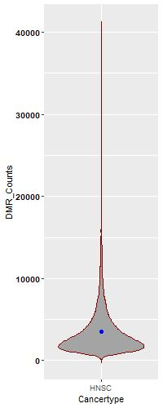
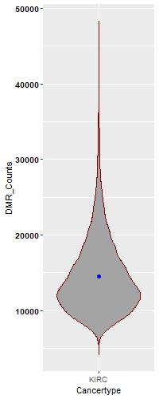
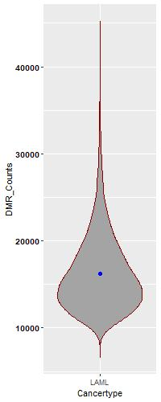
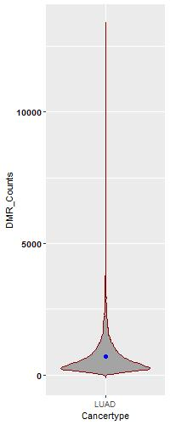
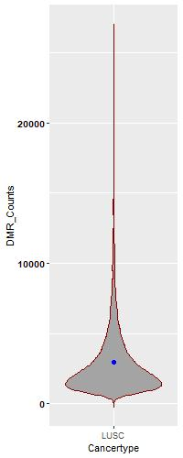
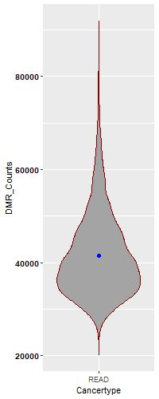
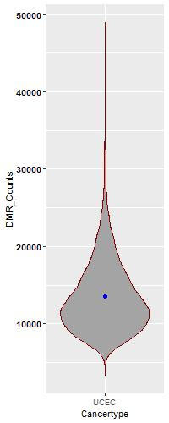
0.0684
0.0203
0.0001
0.1571
0.0349
0.2628
0.0185
Figure S2. Violin plot result of DMR analysis.
Violin plot of DMR numbers by DMR analysis of 10,000 times random sampling. BRCA, HNSC, LUAD, BLCA, LUSC, COAD, UCEC and LAML had significant p-values. Red dot is number of DMR of seven DNA methylation modifier genes mutation sample test. Blue dot is the average of 10,000 times random sampling results.
BLCA
BRCA
COAD
GBM
HNSC
KIRC
LAML
0.0001
0.1732
0.0001
0.0001
7 DNA methylation related gene
mutated sample group
Mean
LUAD
LUSC
READ
UCEC

