Slide 1

Figure S1.

Slide 2

Figure S2.

Slide 3

Figure S3.

Slide 4
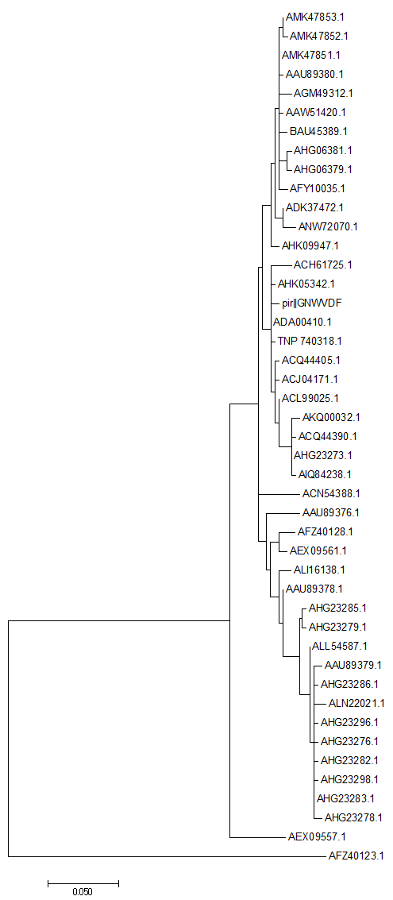
Figure S4.

Slide 5

Figure S5.

Slide 6

Figure S6.

Slide 7
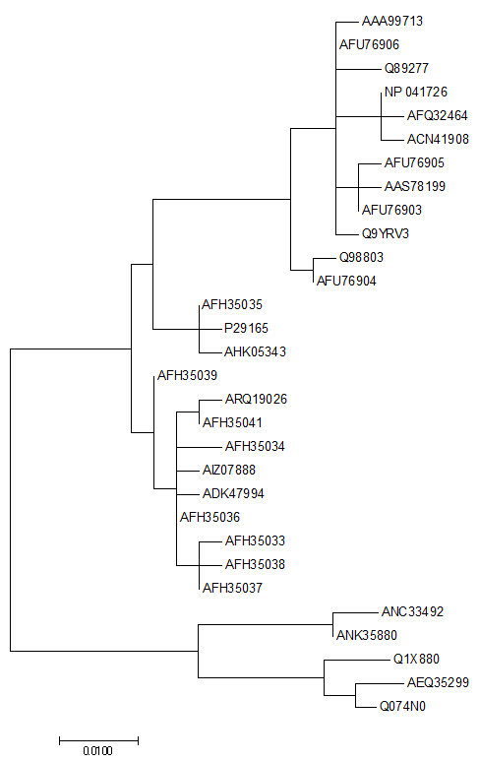
Figure S7.

Slide 8
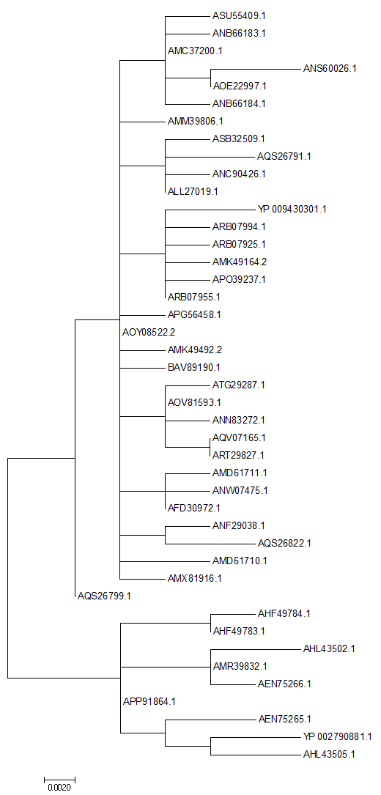
Figure S8.

