Slide 1
The Use of Serial Cardiac F-18 FDG-PET Imaging to Diagnose, Monitor, and Tailor Treatment of Cardiac Sarcoidosis Patients with Arrhythmias: A Case Series and Review
July 2019
EHJ-CR-D-19-00209

Slide 2
Introduction
The goal of this case series is to demonstrate the utility of scans to monitor disease status and response to therapy.
Therefore, this case series presents four patients with varying manifestations of cardiac FDG-PET-confirmed cardiac sarcoidosis
      3 with documented post-treatment serial follow-up scans
      1 with direct pathological confirmation of cardiac sarcoidosis correlating with inflammation noted on FDG-PET scanning.
EHJ-CR-D-19-00209

Slide 3
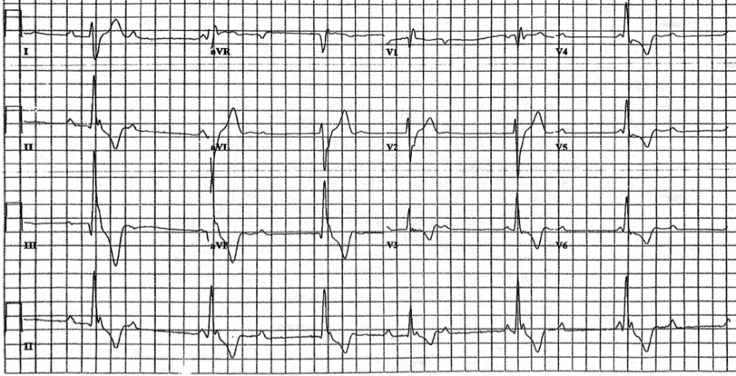
Case Presentation
Patient 1:
56 year old man with lightheadedness
Complete Heart Block
LVEF = 35%
Scan number | Months post initial scan | Immuno-suppresant | Standard Uptake Value (SUV) | LVEF (%) | MBF (ml/g/min) | % Scarring
1 (initial) | 0 | - | 9.9 | 35 | 1.12 | 0%
2 | 12 | Methotrexate | - | 52 | 1.08 | 0%
3 | 20 | - | 4.2 | 48 | 0.91 | 0%
4 | 26 | 20 mg Prednisone | - | 54 | 1.05 | 0%
12 Lead ECG noting sinus rhythm with high-grade AV block and wide escape rhythm (with one probable narrower, conducted complex)
Vertical long axis view images comparing 13N-ammonia perfusion scan (top) with 18F-FDG scan (bottom) beside fused transaxial images of 18F-FDG scan. Perfusion-metabolism mismatch is visible in the basal anterior and basal antero-lateral walls in scans A and C. Scans B and D show no active sarcoidosis
EHJ-CR-D-19-00209

Slide 4
Case Presentation
Patient 2
55-year-old man experienced three episodes of syncope
Complete heart block
LVEF = 20-25%
Pacemaker upgraded to BiV-ICD
Follow up scan showed decreased SUV
Horizontal long axis view images comparing 13N-ammonia perfusion scan (top) with 18F-FDG scan (bottom) beside fused coronal images of 18F-FDG scan.
EHJ-CR-D-19-00209

Slide 5
Case Presentation
Patient 3
50 year old man w/ pulmonary sarcoidosis, cardiomyopathy, VT requiring ICD
LVEF = 20%
7 scans over 4 years
Scan number | Months post initial scan | Prednisone (mg daily) | Mycohpenelate mofetil (mg twice daily) | SUV | LVEF (%) | MBF (ml/g/min) | % Scarring
1 (initial) | 0 | - | - | 5.0 | 20 | 0.56 | 6%
2 | 5 | 60 | - | 3.4 | 17 | 0.57 | 6%
3 | 9 | 60 | - | 2.5 | 25 | 0.57 | 12%
4 | 15 | 25 | 1500 | 2.7 | 29 | 0.58 | 12%
5 | 22 | 15 | 1500 | 6.4 | 19 | 0.58 | 24%
6 | 27 | 10 | 2500 | 9.0 | 26 | 0.6 | 24%
7 | 34 | Unknown | Unknown | 3.0 | 31 | 0.61 | 29%
8 | 38 | Unknown | Unknown | 1.8 | Unknown | Unknown | Unknown
EHJ-CR-D-19-00209

Slide 6
Case Presentation
Patient 4
48 year old man w/ non-ischemic cardiomyopathy, VT requiring ICD, family history of sarcoidosis
Underwent cardiac transplantation for heart failure
Tissue pathology of the regions identified on FDG-PET (that were targeted for VT ablation) revealed multinucleated giant cells and lymphocytic infiltration, pathognomonic for sarcoidosis
Histology sample from explanted heart. Black arrow indicates a multinucleated giant cell. Lymphocytic infiltration is also visible
EHJ-CR-D-19-00209

Slide 7
Discussion
The patients’ initial presentations of heart block, heart failure, and VT represent the three most common clinical manifestations of cardiac sarcoidosis.
These cases demonstrate that cardiac sarcoidosis can follow a heterogeneous and unpredictable clinical course, making response monitoring with follow-up scans a priority, and supporting a slow taper of corticosteroids to avoid disease recurrence.
Clinicians can adjust immunosuppression in response to the quantifiable SUV on the scan rather than depending solely upon non-specific clinical symptoms which are often harder to quantify (e.g., fatigue, malaise, shortness of breath).
EHJ-CR-D-19-00209

Slide 8
Discussion
The cardiac PET-FDG scans included in this series also show interesting anatomic correlations for the patients who presented with arrhythmias (ie. heart block or VT).
Patients with some degree of heart block (Patients 1-2) had inflammation at the anterior septum, near the AV node.
Additionally, Patient 4 demonstrated a correlation between areas of inflammation on PET scan and regions with low voltage on EP study mapping, as well as on pathological examination.
EHJ-CR-D-19-00209

Slide 9
Learning Points
Cardiac sarcoidosis can follow a heterogeneous and unpredictable clinical course, making response monitoring with follow-up scans a priority.
FDG-PET scans are useful to diagnose disease, tailor therapy, and monitor the clinical course of disease, allowing treatment decisions to be based on quantitative level of inflammation seen on FDG-PET.
Areas of inflammation on PET scan correlate with regions with low voltage on EP study mapping, as well as on pathological examination.
EHJ-CR-D-19-00209

