Slide 1
Ventricular Fibrillation Associated with Vasospastic Angina Pectoris in Fabry Disease : a Case Report
June 2019
EHJ-CR-D-19-00124

Slide 2
Introduction
Fabry disease (FD) is an X-linked lysosomal storage disorder resulting from a deficiency in alpha-galactosidase A.
The major causes of death in FD are life-threatening arrhythmias such as ventricular tachycardia or ventricular fibrillation.
Myocardial fibrosis was suggested to be related to life-threatening arrhythmias in patients with FD.
EHJ-CR-D-19-00124

Slide 3
Case Presentation
History and Examination Findings
A 43-year-old man was referred to our cardiology department because he wanted to evaluate the abnormal 12 leads ECG findings of a medical examination.
He complained of dizziness.
His mother had apical hypertrophy, and died of heart failure.
Clinical status:
BP: 102/77mmHg, HR 38 beats/min.
No heart murmurs.
EHJ-CR-D-19-00124

Slide 4
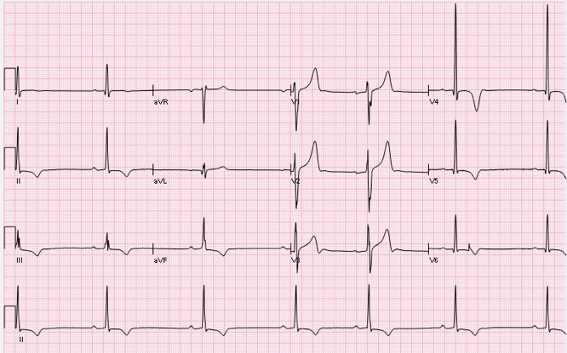
Case Presentation
Investigations
Laboratory findings:
Creatinine 72.5 μmol/L
eGFR 81.5 ml/min/1.7m²
BNP 34.9 pg/ml
Troponin I <0.02 ng/ml
Urine protein positive
Plasma α-GAL A activity 0.5 nmol/hour/ml
(Reference ranges : 53.9- 91.9 μmol/L)
(Reference ranges : 60 ml/min/1.7m² or over)
(Reference ranges : under 18.4 pg/ml)
(Reference ranges : 0.04 ng/ml or under)
ECG findings:
Sinus bradycardia with high voltage and inverted T- waves in the inferolateral leads.
(Reference ranges : over 4.0 nmol/hour/ml)
EHJ-CR-D-19-00124

Slide 5
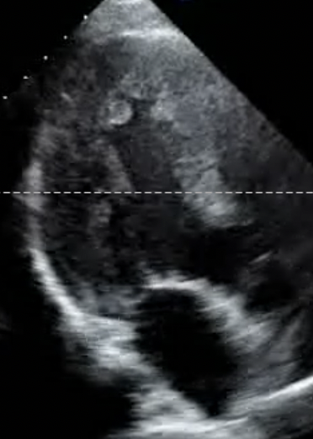
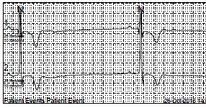
Case Presentation
Investigations
Echocardiography findings:
Left ventricular EF 65%
Apical hypertrophy
Holter ECG findings:
Sinus arrests for over 5 seconds
Echocardiography revealed left ventricular apical hypertrophy (red arrows) in 3 chamber apical view
EHJ-CR-D-19-00124

Slide 6
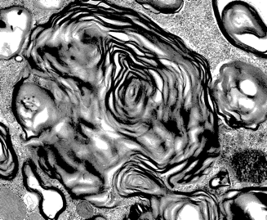
Case Presentation
Investigations
His plasma alpha-galactosidase A activity were reduced.
Endomyocardial biopsy findings:
lamellate deposits within
cardiomyocytes
Cardiac MRI findings:
no late gadolinium enhancement (LGE)
Endomyocardial biopsy assessed using an Electron microscope showed lamellate deposits within cardiomyocytes that suggested FD.
Cardiac MRI showed the absence of LGE in short-axis view.
EHJ-CR-D-19-00124

Slide 7
Case Presentation
Investigations
Figure 1
A) At baseline, ECG did not exhibit early repolarization pattern.
B) ECG obtained just before VF showed ST elevation in the inferior leads (arrows).
C) Before the onset of ventricular tachycardia, monitoring ECG showed marked ST elevation (broad arrows).
EHJ-CR-D-19-00124

Slide 8
Case Presentation
Investigations
Figure 2
A), B) No organic coronary stenosis was found in the coronary arteries in control coronary angiography.
C), D) Coronary artery spasms were found in the right and left coronary arteries in a spasm provocation test (red arrows).
EHJ-CR-D-19-00124

Slide 9
Case Presentation
Management
Implantation of a pacemaker for sick sinus syndrome.
Initiation of enzyme replacement therapy (ERT) after the diagnosis of Fabry disease.
VF developed during the fifth administration of ERT.
Implantation of a implantable cardiac defibrillator.
Initiation of a calcium antagonist after the diagnosis of vasospastic angina pectoris (VSA).
EHJ-CR-D-19-00124

Slide 10
Discussion
VF that developed in a patient with FD without LGE is a rare situation.
VSA was thought to be associated with the development of VF in this case.
VSA should be considered in patients with FD without LGE who experienced unexplained VF.
EHJ-CR-D-19-00124

Slide 11
Learning Points
Myocardial fibrosis is associated with life-threatening arrhythmias in patients with FD.
If patients with FD without myocardia fibrosis have VSA, VF could develop.
It is important to examine whether patients with FD without myocardia fibrosis have VSA.
EHJ-CR-D-19-00124

Slide 12
References
1.Weidemann F, Ertl G, Wanner C, Krämer J. The Fabry cardiomyopathy-diagnostic approach and current treatment. Curr Pharm Des. 2015;21(4):473-8
2.Krämer J, Niemann M, Störk S, Frantz S, Beer M, Ertl G, et al. Relation of burden of myocardial fibrosis to malignant ventricular arrhythmias and outcomes in Fabry disease. Am J Cardiol. 2014 Sep 15;114(6):895-900
EHJ-CR-D-19-00124

