Slide 1
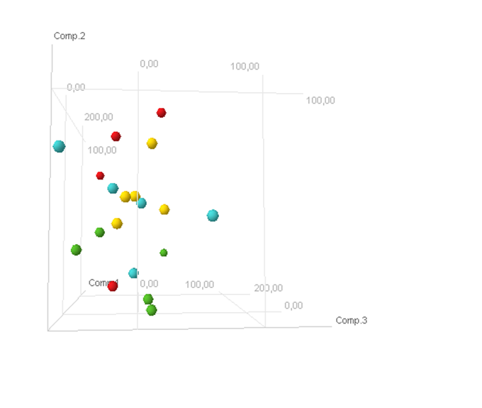
Sham + placebo
5/6 Nx + placebo
5/6 Nx + telmisartan
5/6 Nx + linagliptin

