Slide 1
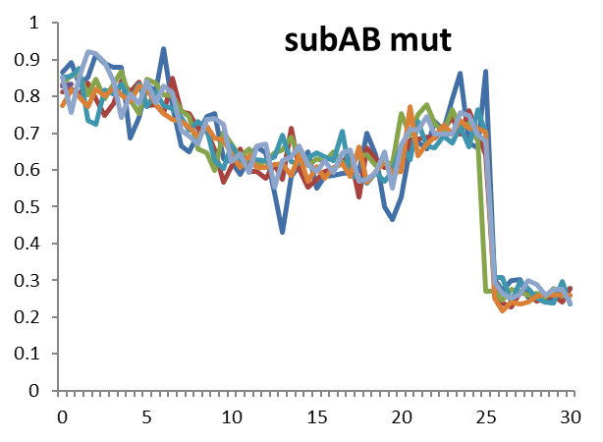
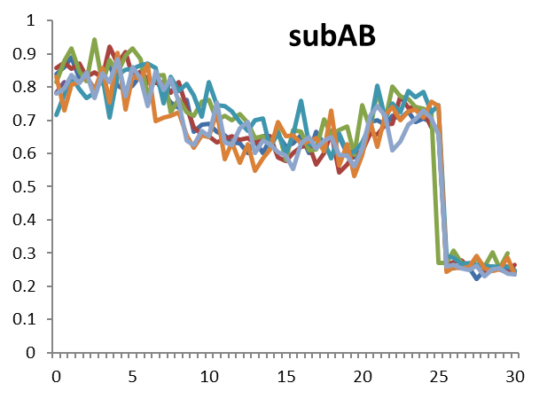
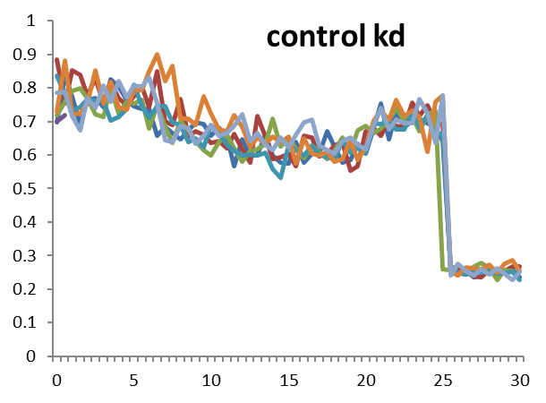
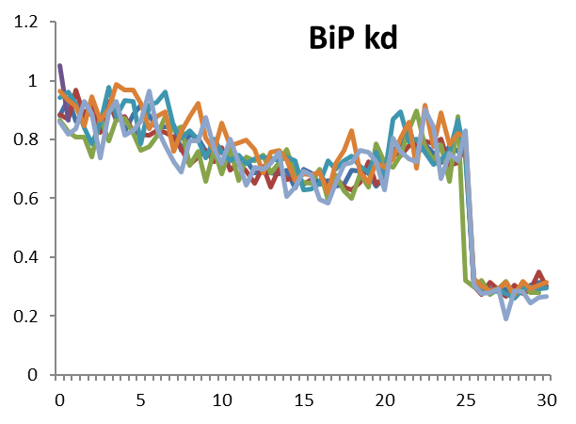
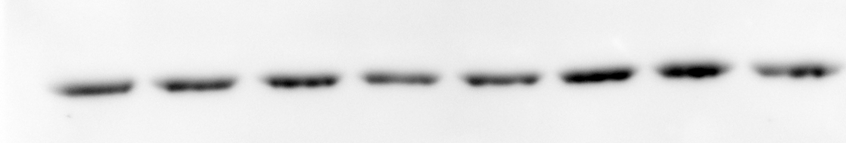
Figure S4
A
SubAB
SubAB mut
B
control
BiP kd
100
100
0 30 60 120 0 30 60 120 [min]
75
BiP
75
BiP
actin
actin
37
37
DTT
DTT
C
CsA
CsA
Dia
Dia
DTT
DTT
CsA
Dia
CsA
Dia

