Slide 1
A
C
B
D
E
Supplemental Figure 1. LCMV-specific CD4+ T cell responses in the brain are reduced in CD1dKO mice. C57BL/6 and CD1dKO (CD1d1^{tm1Luc}) mice (n=3-5 mice/group) were infected either i.c. with 1x10³ p.f.u. (A, B) or i.p. with 3x10⁵ p.f.u. (C, D) LCMV Armstrong 3. Mice were injected i.p. with 0.25 mg of anti-CD8 depleting antibody (clone 2.43) 2 days before and 2 days after viral infection. LCMV-infected mice were sacrificed on day 8 post-infection and either brains were harvested and single cell suspensions generated using a Percoll gradient (A, B), or single cell suspensions were generated from spleens (C, D), stained for CD4, CD44, CD16/32, and IA^{b}gp-61 tetramer, and analyzed by flow cytometry. Graphs show: A, C the frequency of CD4⁺ CD16/32⁻ cells that are CD44hi gp61-tet⁺, and B, D the total number of cells that are CD4⁺ CD16/32⁻ CD44hi gp-61tet⁺ (±SE). Shown in E are the total cell counts of the spleens of mice shown in C, D. A-B, Data are representative of more than three independent experiments. **p ≤ 0.01, *** p ≤ 0.001 (Student’s t test).
Raynor et al. Supplemental Figure 1
Notes:
A)
B) Data is from new experiment: 24July15
C) Data from 17May13

Slide 2
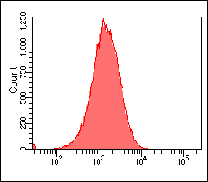
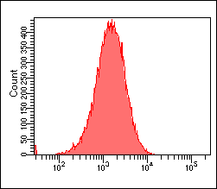
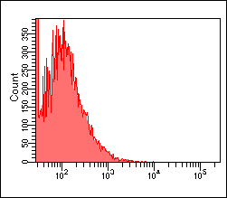
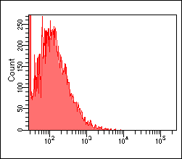
BL/6
BL/6.NKC¹²⁹
CD1d1^{tm1Luc}
CD1d1^{tm1.1Aben}
CD1d
Supplemental Figure 2. Both lines of CD1d-deficient mice lack expression of CD1d. C57BL/6, BL/6.NKC¹²⁹, CD1d1^{tm1Luc}, and CD1d1^{tm1.1Aben} mice were infected i.c. with 1x10³ p.f.u. LCMV Armstrong 3. Mice were injected i.p. with 0.25 mg of anti-CD8 depleting antibody (clone 2.43) 2 days before and 2 days after viral infection. Single spleen cell suspensions were generated and stained with anti-CD1d antibody and analyzed by flow cytometry.
Raynor et al. Supplemental Figure 2
Notes:
A)
B) Data is from new experiment: 24July15
C) Data from 17May13

Slide 3
A
B
C
Supplemental Figure 3. Mice with the NKC¹²⁹ cluster have increased numbers of NK cells. A. Groups of C57BL/6, BL/6.NKC¹²⁹, CD1d1^{tm1Luc}, and CD1d1^{tm1.1Aben} mice (n=4/group) were infected i.c. with 1x10³ p.f.u. LCMV Armstrong 3. Mice were injected i.p. with 0.25 mg of anti-CD8 depleting antibody (clone 2.43) 2 days before and 2 days after viral infection. Mice were sacrificed on day 8 after infection and single cervical lymph node cell suspensions were generated and stained with Dx5 and NKp46 antibodies and analyzed by flow cytometry. Results show the total numbers of NK cells assessed by NKp46 (right panel) or Dx5 (left panel) staining. *p ≤ 0.05 (Student’s t test). B. Groups of C57BL/6, BL/6.NKC¹²⁹, CD1dKO (CD1d1^{tm1.1Aben}), and CD1dKO.NKC¹²⁹ (CD1d1^{tm1Luc}) mice (n=4/group) were infected i.c. with 1x10³ p.f.u. LCMV Armstrong 3. Mice were injected i.p. with 0.25 mg of anti-CD8 depleting antibody (clone 2.43) 2 days before (removed 2 days after) viral infection. Mice were sacrificed on days 3 and 6 after infection, and single cervical lymph node cell suspensions were harvested and stained with CD4, TCRβ, CD69, NKp46, and Dx5 antibodies and analyzed by flow cytometry. Data show the percent of NKp46⁺Dx5⁺ cells (left panel) or TCRβ⁺CD4⁺ cells that were CD69⁺ (right panel) +/- SEM. C. Groups of C57BL/6, BL/6.NKC¹²⁹, CD1dKO, and CD1dKO.NKC¹²⁹ mice (n=4/group) were sacrificed and single spleen cell suspensions were harvested and stained with CD4, TCRβ, CD69, NKp46, and Dx5 antibodies and analyzed by flow cytometry. Data show the percent of NKp46⁺Dx5⁺ cells (left panel) or TCRβ⁺CD4⁺ cells that were CD69⁺ (right panel) +/- SEM. Moved the graphs around in C to match legend.
Raynor et al. Supplemental Figure 3

Slide 4
A
B
C
D
Supplemental Figure 4. Baseline NK and CD4+ T cells in BL/6, CD1dKO, and BL/6.NKC¹²⁹ mice. A-C. Groups of C57BL/6 and BL/6.NKC¹²⁹ mice (n=4/group) were sacrificed and single cell suspensions generated from spleen. Cells were stained with antibodies against TCRβ, CD4, CD44, CD62L, Dx5, and NKp46 antibodies and analyzed by flow cytometry. Results show the frequency and the total numbers of A, naïve (CD44^{low}CD62L^{hi}) and B, effector/effector memory (CD44^{hi}CD62L^{low}) CD4+ T cells; or C, NK cells (NKp46⁺ DX5⁺) +/- SEM. D. Groups of C57BL/6, BL/6.NKC¹²⁹, CD1dKO, and CD1dKO.NKC¹²⁹ mice (n=4/group) were sacrificed and single cell suspensions generated from spleen. Cells were cultured in either media, IL-12p70+IL-18 (0.1 µg/ml IL-12p70 and 1 µg/ml IL-18) or with PMA (50 ng/ml) + Ionomycin (1 µg/ml) in the presence of IL-2 (10 ng/ml) and CD107α for 5 hours. Cells were isolated, and CD107α and IFN-γ expression assessed by flow cytometry. Data show the percent of NKp46⁺Dx5⁺ cells that were either CD107α⁺ (left panel) or IFN-γ⁺ (right panel) +/- SEM. *p ≤ 0.05 (Student’s t test).
Raynor et al. Supplemental Figure 4

Slide 5
A
C
B
Supplemental Figure 5. NKC¹²⁹ mice have similar viral load and their NK cells do not exhibit increased killing of CD4+ T cells. A, B. Groups of C57BL/6 and BL/6.NKC¹²⁹mice (n=3-4/group/timepoint) were injected i.c. with 1x10³ pfu LCMV Armstrong 3. Mice were injected i.p. with 0.25 mg of anti-CD8 depleting antibody (clone 2.43) 2 days before viral infection. Mice were sacrificed on days 3 and 6 after infection and brains and cervical lymph nodes removed. Dendritic cells were isolated using anti-CD11c enrichment kits (Miltenyi Biotech), counted, frozen in media and assessed for viral load by plaque assay. Viral load in brain was determined by plaque assay after homogenizing brain tissue in dounce homogenizer. Results show the number of PFU (A) per 10⁶ DCs or (B) per gram of brain tissue. C. CD1dKO, CD1dKO.NKC¹²⁹, and CD1dKOxPfp^{-/-.}NKC¹²⁹ mice (n=4/group) were infected i.c. with 1x10³ p.f.u. LCMV Armstrong 3. Uninfected C57BL/6 mice were used as a control. Mice were injected i.p. with 0.25 mg of anti-CD8 depleting antibody (clone 2.43) 2 days before and 2 days after viral infection. Spleen cells from the above groups of mice were cultured with TCR Tg SMARTA cells that were activated with anti-CD3/anti-CD28 24 hours prior to culture with NK cells. Negative controls were activated SMARTA cells cultured alone. Prior to culture, SMARTA cells were labeled with CFSE. At 6 and 24 hours of culture, cells were stained with antibody against CD4 and an e780 labeled live/dead stain (ThermoFisher) and analyzed by flow cytometry. Results show the percent of CD4⁺ CFSE⁺ SMARTA cells that were e780⁺ (dead) +/- SD.
Raynor et al. Supplemental Figure 5

Slide 6
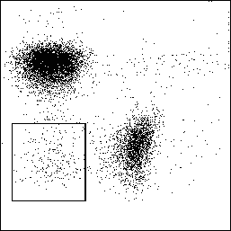
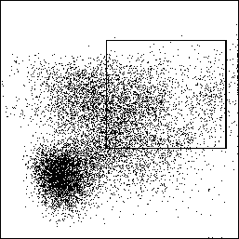
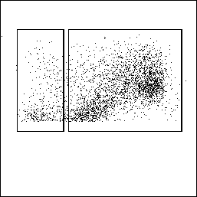
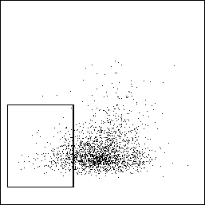
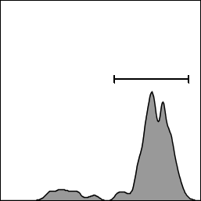
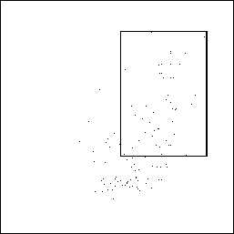
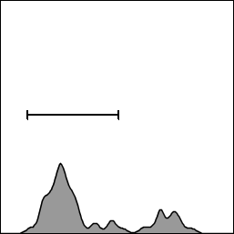
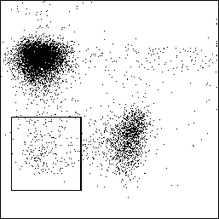
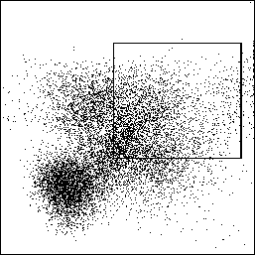
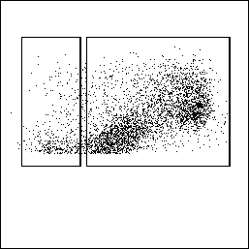
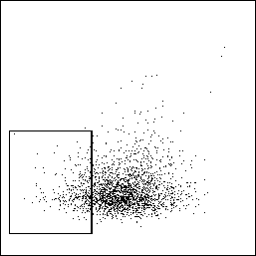
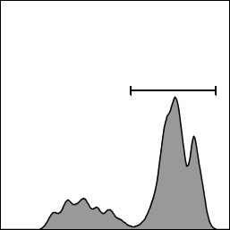
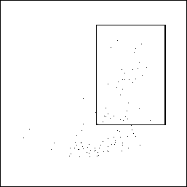
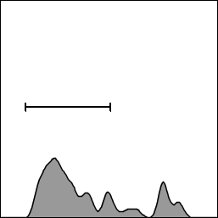
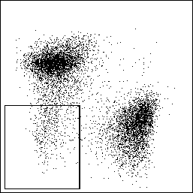
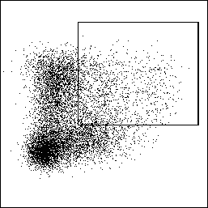
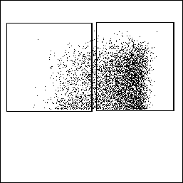
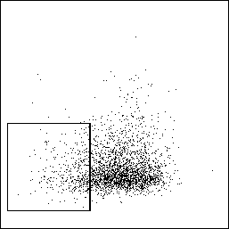
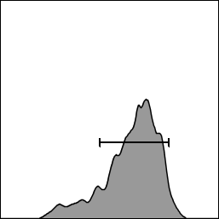
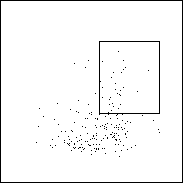
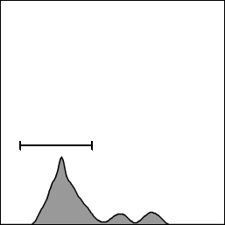
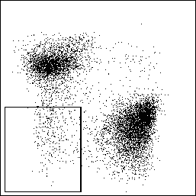
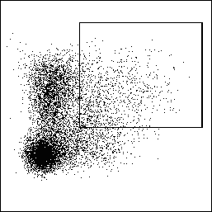
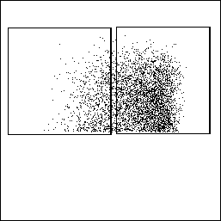
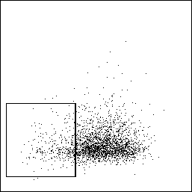
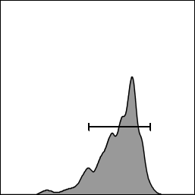
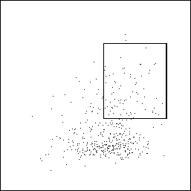
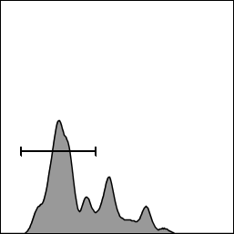
A
B
CD1dKO
cDC2
2.68%
13.1%
81.1%
CD19
CD11c
26.1%
CD11c
11.2%
87.2%
CD8a
Count
TCRb
MHC II
CD11b
Xcr1
SIRPa
mDC
cDC1
45.6%
74.5%
Day 2
CD8a
Count
Xcr1
SIRPa
CD1dKO.NKC¹²⁹
cDC2
2.86%
13.1%
74.4%
CD19
CD11c
29.3%
CD11c
9.28%
88.7%
CD8a
Count
TCRb
MHC II
CD11b
Xcr1
SIRPa
mDC
cDC1
40.0%
75.0%
CD8a
Count
Xcr1
SIRPa
CD1dKO
cDC2
5.6%
13.5%
83.6%
CD19
CD11c
15.3%
CD11c
15.9%
80.8%
CD8a
Count
TCRb
MHC II
CD11b
Xcr1
SIRPa
mDC
cDC1
17.6%
79.5%
Day 4
CD8a
Count
Xcr1
SIRPa
CD1dKO.NKC¹²⁹
cDC2
3.71%
11.8%
88.9%
CD19
CD11c
12.0%
CD11c
16.9%
79.7%
CD8a
Count
TCRb
MHC II
CD11b
Xcr1
SIRPa
mDC
cDC1
18.4%
69.3%
CD8a
Count
Xcr1
SIRPa
Raynor et al. Supplemental Figure 6

Slide 7
Supplemental Figure 6. BL/6.NKC¹²⁹ mice have a slight decrease in migratory DCs (mDCs) on day 2 and no change in cDC1, cDC2 on days 2, 4 after infection. A, B. In two independent experiments, groups of CD1dKO and CD1dKO.NKC¹²⁹ mice (n=3-4/group/timepoint) were injected i.c. with 1x10³ pfu LCMV Armstrong 3. Mice were sacrificed on day 2 (A) and day 4 (B) after infection, cervical lymph nodes removed and single cell suspensions stained with antibodies against CD11c, CD11b, CD19, TCRβ, MHC II, CD8α, XCR1 and SIRPα and analyzed by flow cytometry. Results show the gating strategy for cDC1, cDCs, and migratory DCs (mDCs). Graph shows the total number of each cell population +/- SEM. * denotes p<0.05, student t-test.
Raynor et al. Supplemental Figure 6

Slide 8
Supplemental Table 1. SNP analysis of CD1d1^{tm1Luc} mice. Tail snips from individual CD1d1^{tm1Luc} mice that were NK1.1+ (n=5), NK1.1 intermediate (n=5), and NK1.1 negative (n=6) were taken and sent to Jackson Labs for single nucleotide polymorphism (SNP) analysis. Results show the number of BL/6 versus 129 allelic SNPs that were tested across the genome (out of 347 positive SNPs), including the percentage of the genome estimated to be C57BL/6J.
Raynor et al. Supplemental Table 1

Slide 9
BL/6
Gene or SNP | Position
SNP rs3715240 | chr6: 127,855,646-127,856,146
SNP rs3023092 | chr6: 127,873,652-127,874,152
Gm38901 | chr6: 127,873,563-127,877,246
Tspan11 | chr6: 127,887,589-127,953,977
Gm15870 | chr6: 127,934,689-127,944,839
Tspan9 | chr6: 127,961,396-128,143,563
Gm26338 | chr6: 128,094,917-128,095,026
Gm44056 | chr6: 128,165,496-128,166,922
9330102E08Rik | chr6: 128,169,704-128,183,803
Gm10010 | chr6: 128,187,818-128,200,623
Tead4 | chr6: 128,224,288-128,300,813
Tulp3 | chr6: 128,321,161-128,355,851
Gm44190 | chr6: 128,348,754-128,350,154
Gm26770 | chr6: 128,356,004-128,358,837
Rhno1 | chr6: 128,357,000-128,362,812
Gm44371 | chr6: 128,359,518-128,359,984
Foxm1 | chr6: 128,362,967-128,376,146
Tex52 | chr6: 128,375,456-128,385,144
Gm44596 | chr6: 128,375,503-128,407,475
Gm43965 | chr6: 128,376,981-128,377,769
Gm15862 | chr6: 128,381,584-128,399,740
Nrip2 | chr6: 128,399,766-128,408,932
Itfg2 | chr6: 128,409,444-128,424,931
Fkbp4 | chr6: 128,430,103-128,438,677
Gm10069 | chr6: 128,438,757-128,503,281
Pzp | chr6: 128,483,567-128,526,720
A2ml1 | chr6: 128,539,827-128,581,608
Gm44009 | chr6: 128,585,625-128,588,025
Klrb1a | chr6: 128,609,227-128,622,934
Clec2h | chr6: 128,662,385-128,677,374
Gm44215 | chr6: 128,691,073-128,693,783
Klrb1 | chr6: 128,706,442-128,723,059
Klrb1c | chr6: 128,778,485-128,788,641
Gm44511 | chr6: 128,780,285-128,826,252
Klrb1b | chr6: 128,813,706-128,826,331
Gm44066 | chr6: 128,842,558-128,843,171
Gm26656 | chr6: 128,843,786-128,846,959
Gm44067 | chr6: 128,843,786-128,846,959
BC035044 | chr6: 128,849,090-128,891,126
Gm44078 | chr6: 128,862,549-128,865,194
Clec2i | chr6: 128,887,588-128,898,167
Clec2a | chr6: 128,934,381-128,984,704
Gm15987 | chr6: 128,951,204-128,975,029
Clec2f | chr6: 129,014,112-129,020,527
Klrb1f | chr6: 129,045,901-129,057,464
Gene or SNP | Position
Clec2e | chr6: 129,091,998-129,100,913
Klrb1-ps1 | chr6: 129,116,518-129,129,446
Gm26160 | chr6: 129,174,820-129,174,882
Clec2d | chr6: 129,180,615-129,186,534
2310001H17Rik | chr6: 129,208,412-129,237,948
Gm47861 | chr6: 129,238,276-129,248,328
CD69 | chr6: 129,267,325-129,275,436
4922502D21Rik | chr6: 129,322,164-129,331,796
Clec12a | chr6: 129,349,964-129,365,303
Clec12b | chr6: 129,375,515-129,385,503
Clec1b | chr6: 129,397,297-129,405,333
Clec9a | chr6: 129,408,862-129,424,763
Gm43914 | chr6: 129,418,179-129,418,772
Clec1a | chr6: 129,424,772-129,452,000
Clec7a | chr6: 129,461,591-129,472,777
Olr1 | chr6: 129,485,244-129,507,165
Tmem52b | chr6: 129,512,555-129,519,227
Gm44120 | chr6: 129,522,562-129,525,584
1700101l11Rik | chr6: 129,532,094-129,533,284
Gabarapl1 | chr6: 129,533,160-129,542,346
Gm44243 | chr6: 129,540,221-129,540,912
Klre1 | chr6: 129,577,905-129,585,827
Klrd1 | chr6: 129,591,782-129,598,469
Klrk1 | chr6: 129,610,323-129,623,864
Klrc3 | chr6: 129,639,064-129,643,337
Klrc2 | chr6: 129,647,496-129,660,584
Klrc1 | chr6: 129,666,015-129,678,973
Mir680-1 | chr6: 129,691,535-129,691,643
Gm44135 | chr6: 129,696,118-129,696,485
Klri1 | chr6: 129,697,218-129,717,132
Klri2 | chr6: 129,729,041-129,740,484
Gm156 | chr6: 129,766,568-129,784,270
Klra17 | chr6: 129,831,154-129,876,670
Gm17631 | chr6: 129,862,649-129,864,393
Klra5 | chr6: 129,898,996-129,917,650
Klra6 | chr6: 130,013,033-130,026,954
Klra4 | chr6: 130,043,731-130,067,271
Klra8 | chr6: 130,115,226-130,129,898
Gm24712 | chr6: 130,146,881-130,146,954
Klra14-ps | chr6: 130,149,106-130,160,748
Gm23552 | chr6: 130,176,753-130,176,826
Klra9 | chr6: 130,178,675-130,193,112
Klra7 | chr6: 130,218,605-130,231,687
Klra10 | chr6: 130,269,194-130,281,928
Klra13-ps | chr6: 130,291,161-130,306,432
Gm24072 | chr6: 130,320,874-130,320,947
129Sv
Raynor et al. Supplemental Table 2

Slide 10
Gene or SNP | Position
Klra3 | chr6: 130,323,289-130,337,574
Klra1 | chr6: 130,363,917-130,386,874
Klra2 | chr6: 131,219,223-131,247,362
Magohb | chr6: 131,284,388-131,293,244
Styk1 | chr6: 131,299,142-131,316,398
Ybx3 | chr6: 131,364,855-131,388,438
5430401F13Rik | chr6: 131,486,400-131,553,757
Gm6619 | chr6: 131,486,400-131,491,493
Gm22190 | chr6: 131,532,922-131,533,031
Prb1 | chr6: 132,206,795-132,210,521
Prpmp5 | chr6: 132,311,590-132,314,743
Gm8882 | chr6: 132,361,105-132,364,134
Prh1 | chr6: 132,569,842-132,572,401
Prp2 | chr6: 132,595,946-132,600,702
A630073D07Rik | chr6: 132,625,111-132,627,511
Tas2r121 | chr6: 132,700,090-132,701,007
Tas2r122 | chr6: 132,710,999-132,711,928
Tas2r115 | chr6: 132,737,054-132,737,986
Tas2r124 | chr6: 132,754,730-132,755,659
Tas2r102 | chr6: 132,762,131-132,763,174
Tas2r136 | chr6: 132,777,179-132,778,162
Tas2r117 | chr6: 132,802,901-132,803,893
Tas2r123 | chr6: 132,847,142-132,848,143
Tas2r116 | chr6: 132,855,438-132,856,355
Tas2r110 | chr6: 132,868,008-132,869,009
Tas2r113 | chr6: 132,893,011-132,893,940
Tas2r125 | chr6: 132,909,651-132,910,586
Tas2r129 | chr6: 132,951,102-132,952,064
Tas2r131 | chr6: 132,956,912-132,957,844
Tas2r109 | chr6: 132,980,015-132,980,965
Tas2r103 | chr6: 133,036,163-133,037,101
Tas2r140 | chr6: 133,054,855-133,055,793
Smim10l1 | chr6: 133,105,239-133,110,899
5530400C23Rik | chr6: 133,292,216-133,295,790
Gm5885 | chr6: 133,529,189-133,532,762
Gm5886 | chr6: 133,763,998-133,767,408
Kap | chr6: 133,849,855-133,853,667
Etv6 | chr6: 134,035,700-134,270,158
Bcl2l14 | chr6: 134,396,329-134,438,724
Lrp6 | chr6: 134,446,476-134,566,913
Mansc1 | chr6: 134,609,207-134,632,488
Borcs5 | chr6: 134,639,512-134,711,184
Dusp16 | chr6: 134,715,468-134,792,628
Crebl2 | chr6: 134,830,199-134,857,883
Gpr19 | chr6: 134,869,092-134,897,825
2810454H06Rik | chr6: 134,897,961-134,900,785
Gene or SNP | Position
Cdkn1b | chr6: 134,920,401-134,925,525
Lockd | chr6: 134,929,092-134,951,718
Apold1 | chr6: 134,982,001-134,986,836
Ddx47 | chr6: 135,011,612-135,023,776
Gprc5a | chr6: 135,065,662-135,084,709
Gprc5d | chr6: 135,105,991-135,118,283
Hebp1 | chr6: 135,137,519-135,168,215
Gm19434 | chr6: 135,188,480-135,194,959
Fam234b | chr6: 135,197,987-135,236,240
Gsg1 | chr6: 135,237,329-135,254,336
Pbp2 | chr6: 135,309,129-135,310,384
Emp1 | chr6: 135,362,931-135,383,173
SNP rs3710061 | chr6: 135,504,179-135,504,679
SNP rs3663781 | chr6: 136,086,335-136,086,835
129Sv
BL/6
Supplemental Table 2. List of genes present within the NKC.129 cluster. The table shows the gene or single nucleotide polymorphism and its chromosomal position that are in the mapped interval between 129Sv SNP rs3023092 and 129Sv SNP rs3710061 existing in the BL/6.NKC¹²⁹ mice. The bolded entries display the flanking SNPs of the chromosome 6 cluster from 129 mice in the C57BL/6 background.
Raynor et al. Supplemental Table 2

