Slide 1
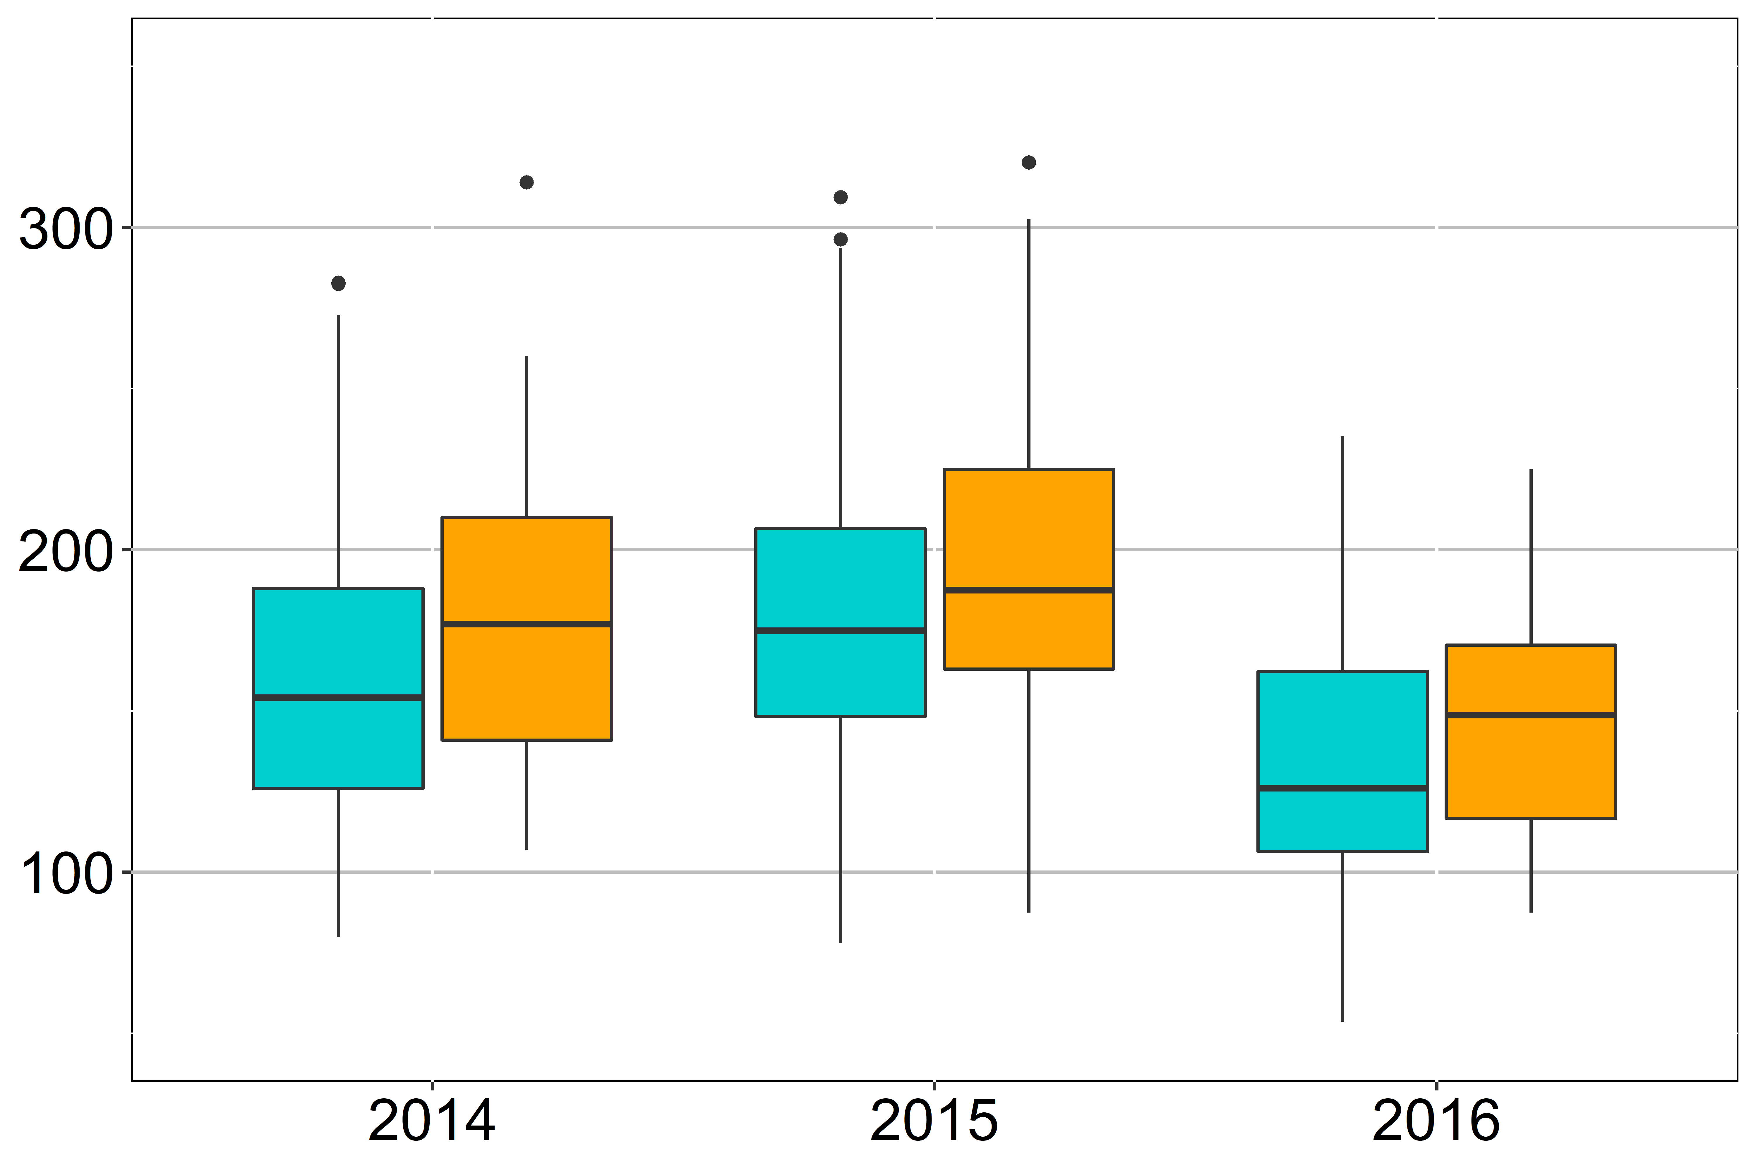
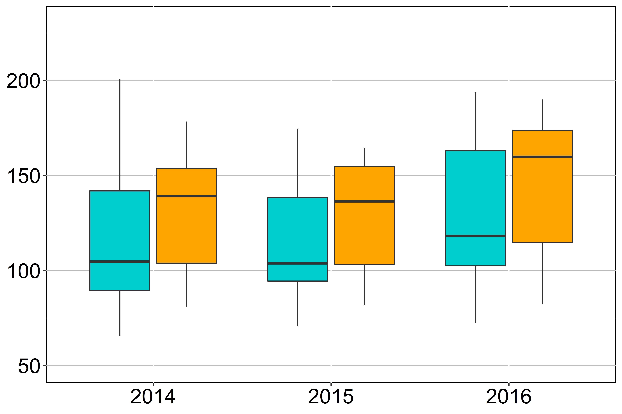
a
Position | S_2186 | Haplotype | A.A change | No.of cvs.
Protein type | CDS |  |  | Xian | Geng | aus | admixed
GNP1-P1 | T | GNP1-2,GNP-3,GNP-4,GNP1-6,GNP1-7,GNP1-10 | Val | 46 | 39 | 2 | 3
GNP1-P2 | C | GNP1-1,GNP1-5,GNP1-8,GNP1-9,GNP1-11,GNP1-12,GNP1-13,GNP1-14 | Ala | 100 | 4 | 1 | 3
b
c
Grain number per panicle
*
Plant height (cm)
**
***
*
year
year
Xian
Xian
Additional file 6: Figure S4 Protein diversity of GNP1 (a). Comparison of grain number per panicle, and plant height between two protein types in xian subpopulations in 198 panel (b–c). Cyan and orange colors indicate GNP1-P1 and GNP1-P2, respectively. The *, ** , *** denotes significance of Student’ s t test at P < 0.05, P < 0.01, and P < 0.001, respectively.

