Slide 1
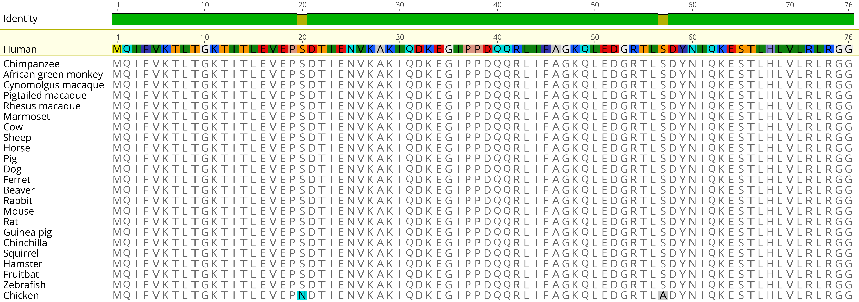
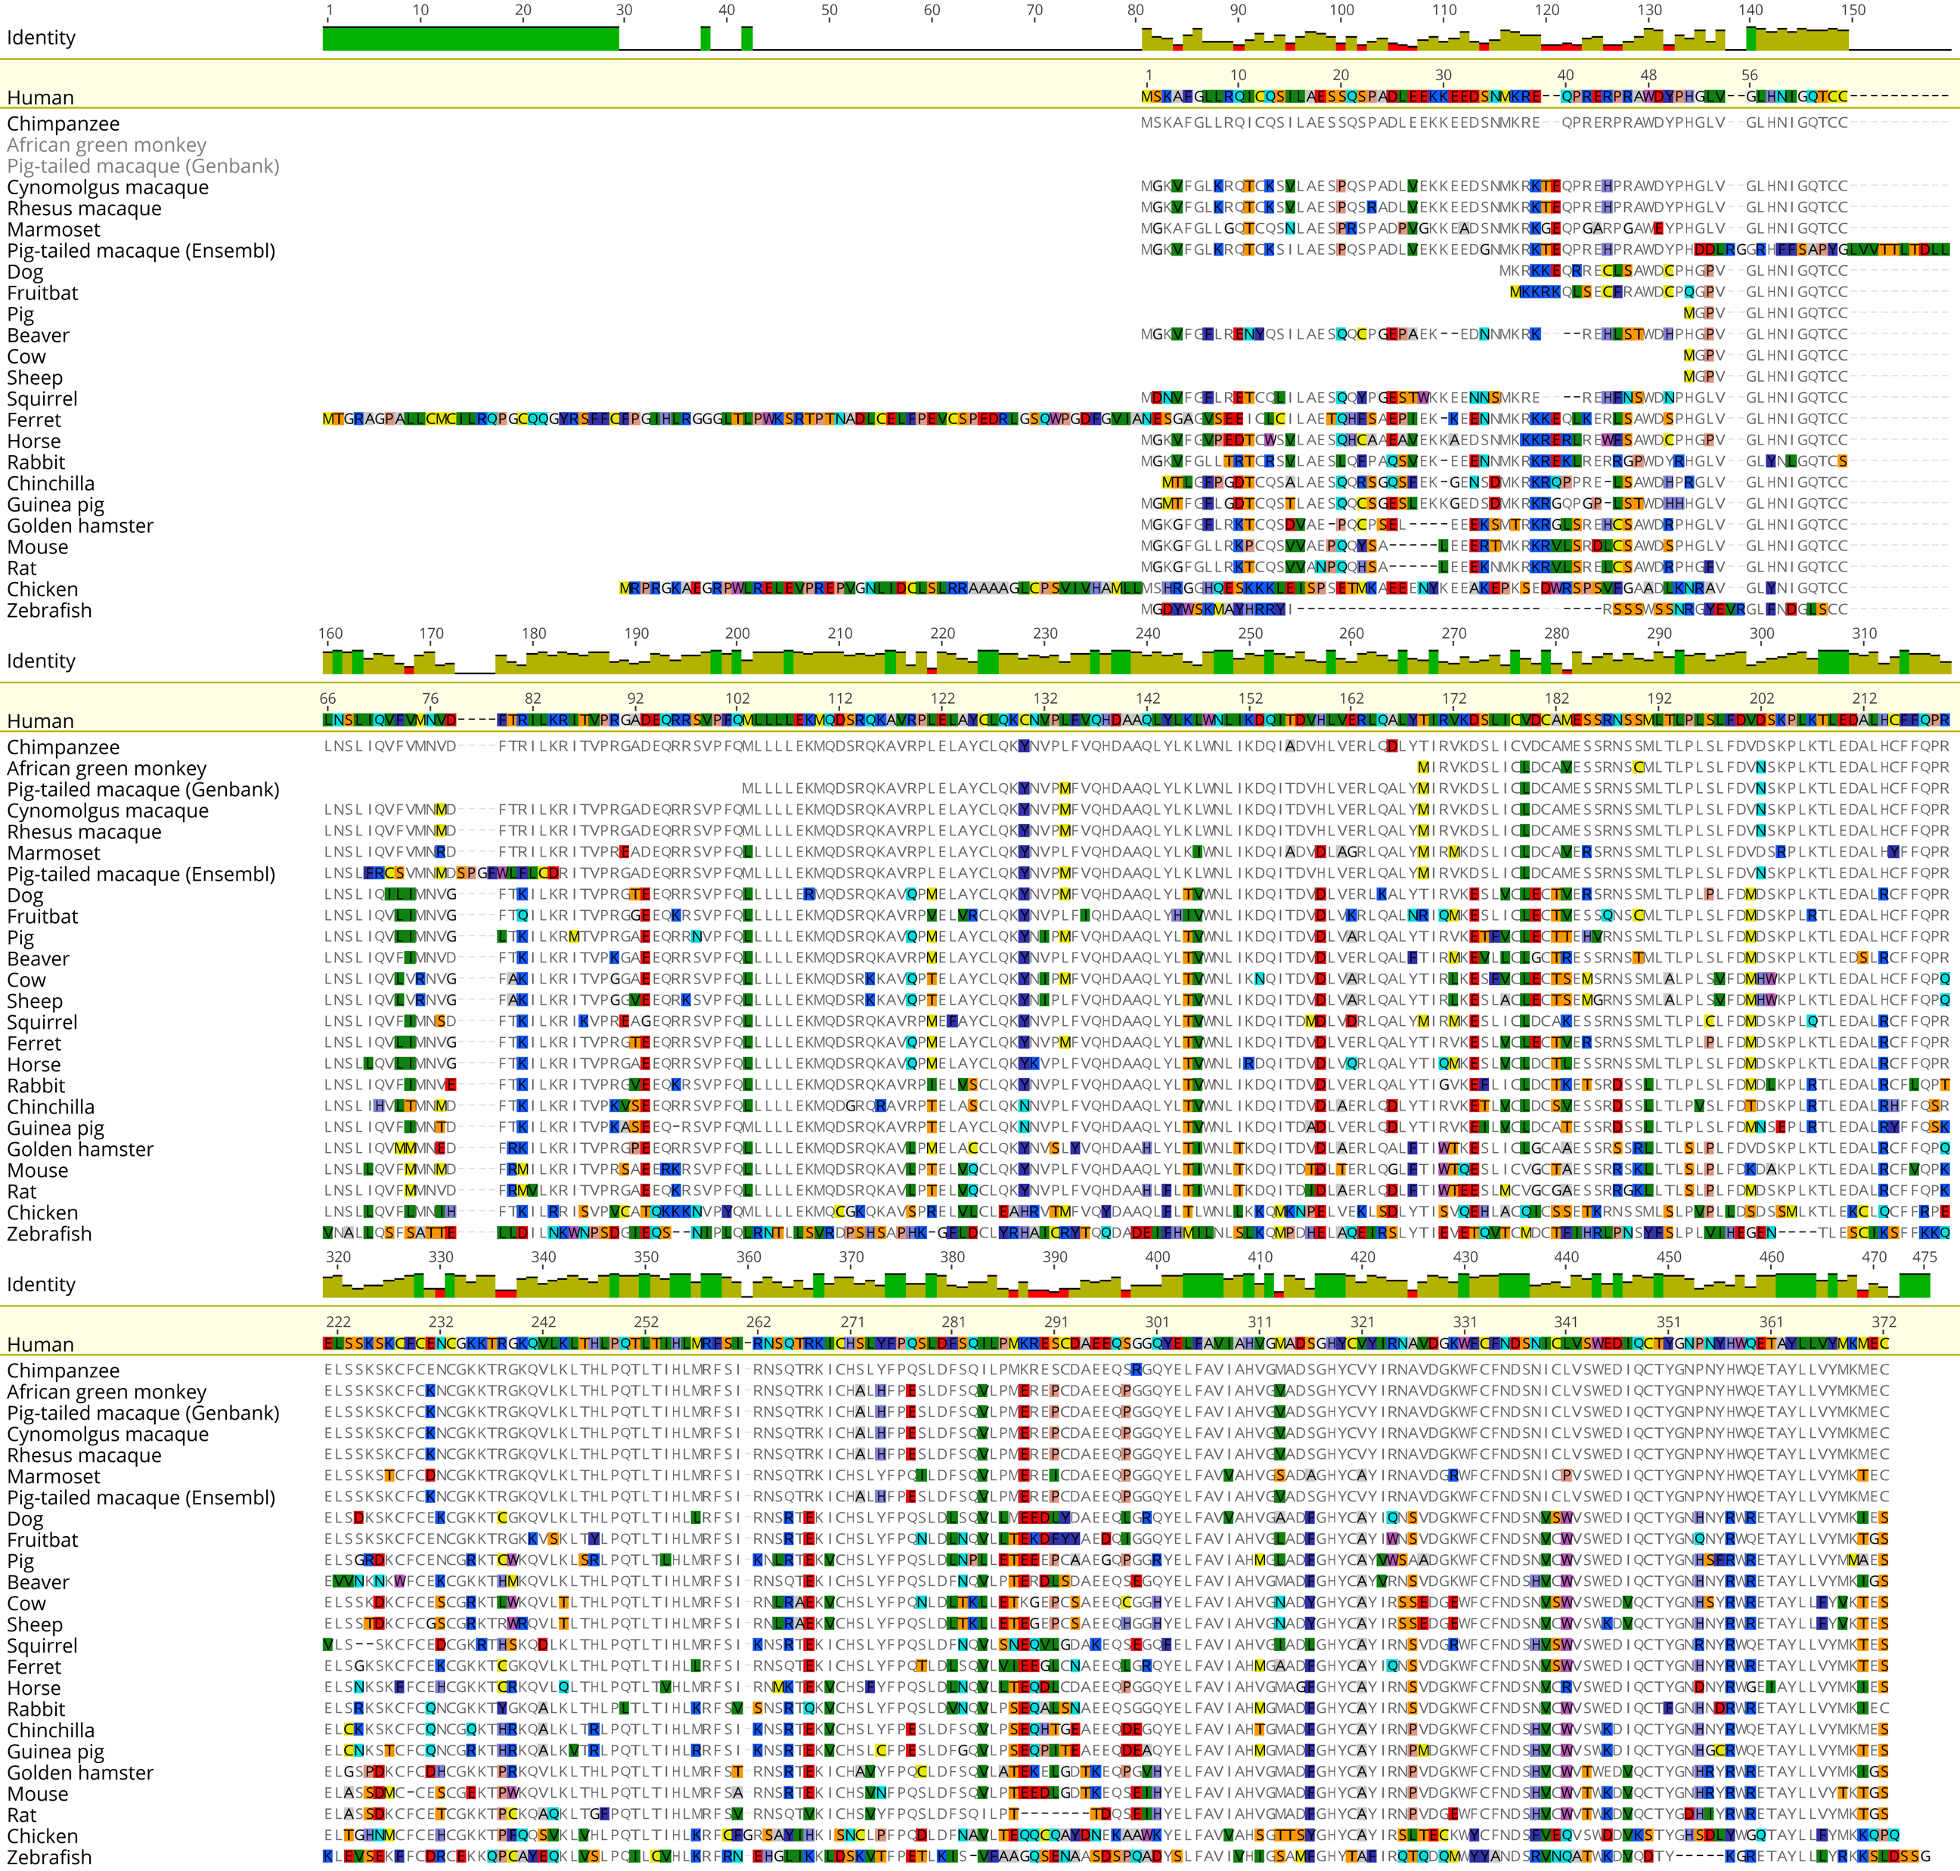
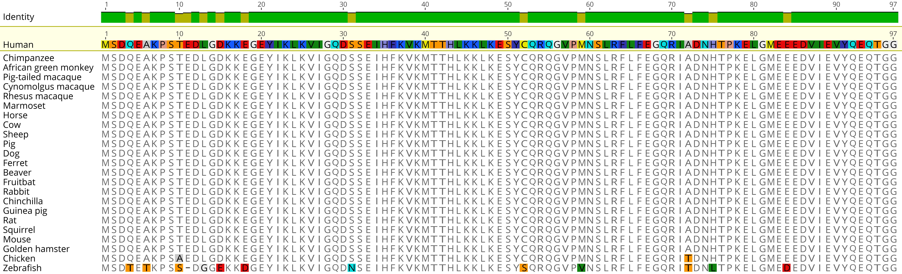
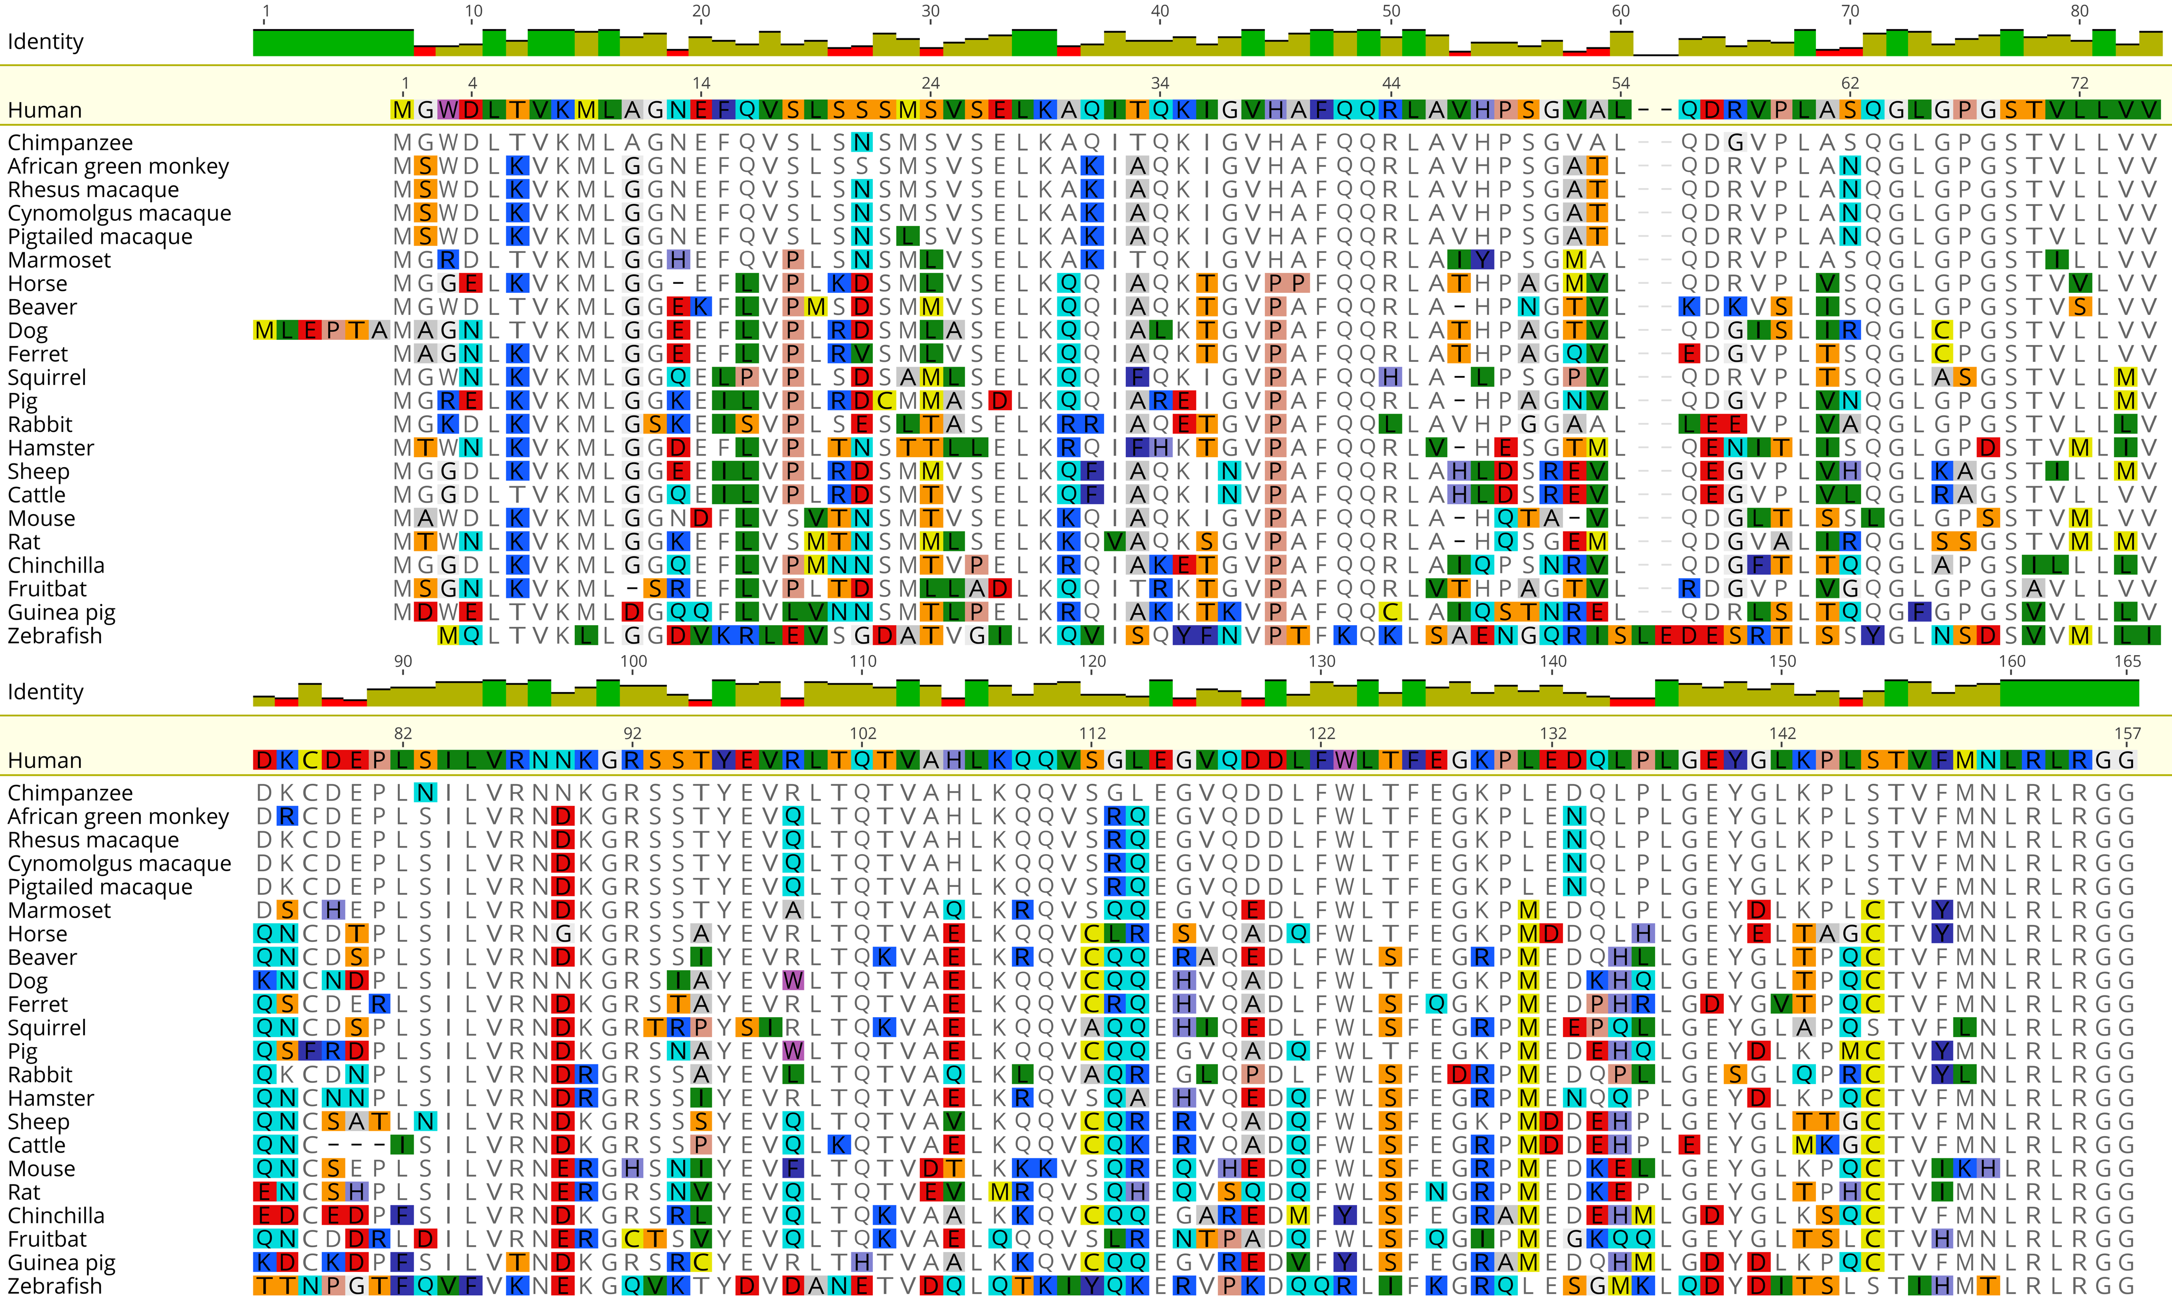
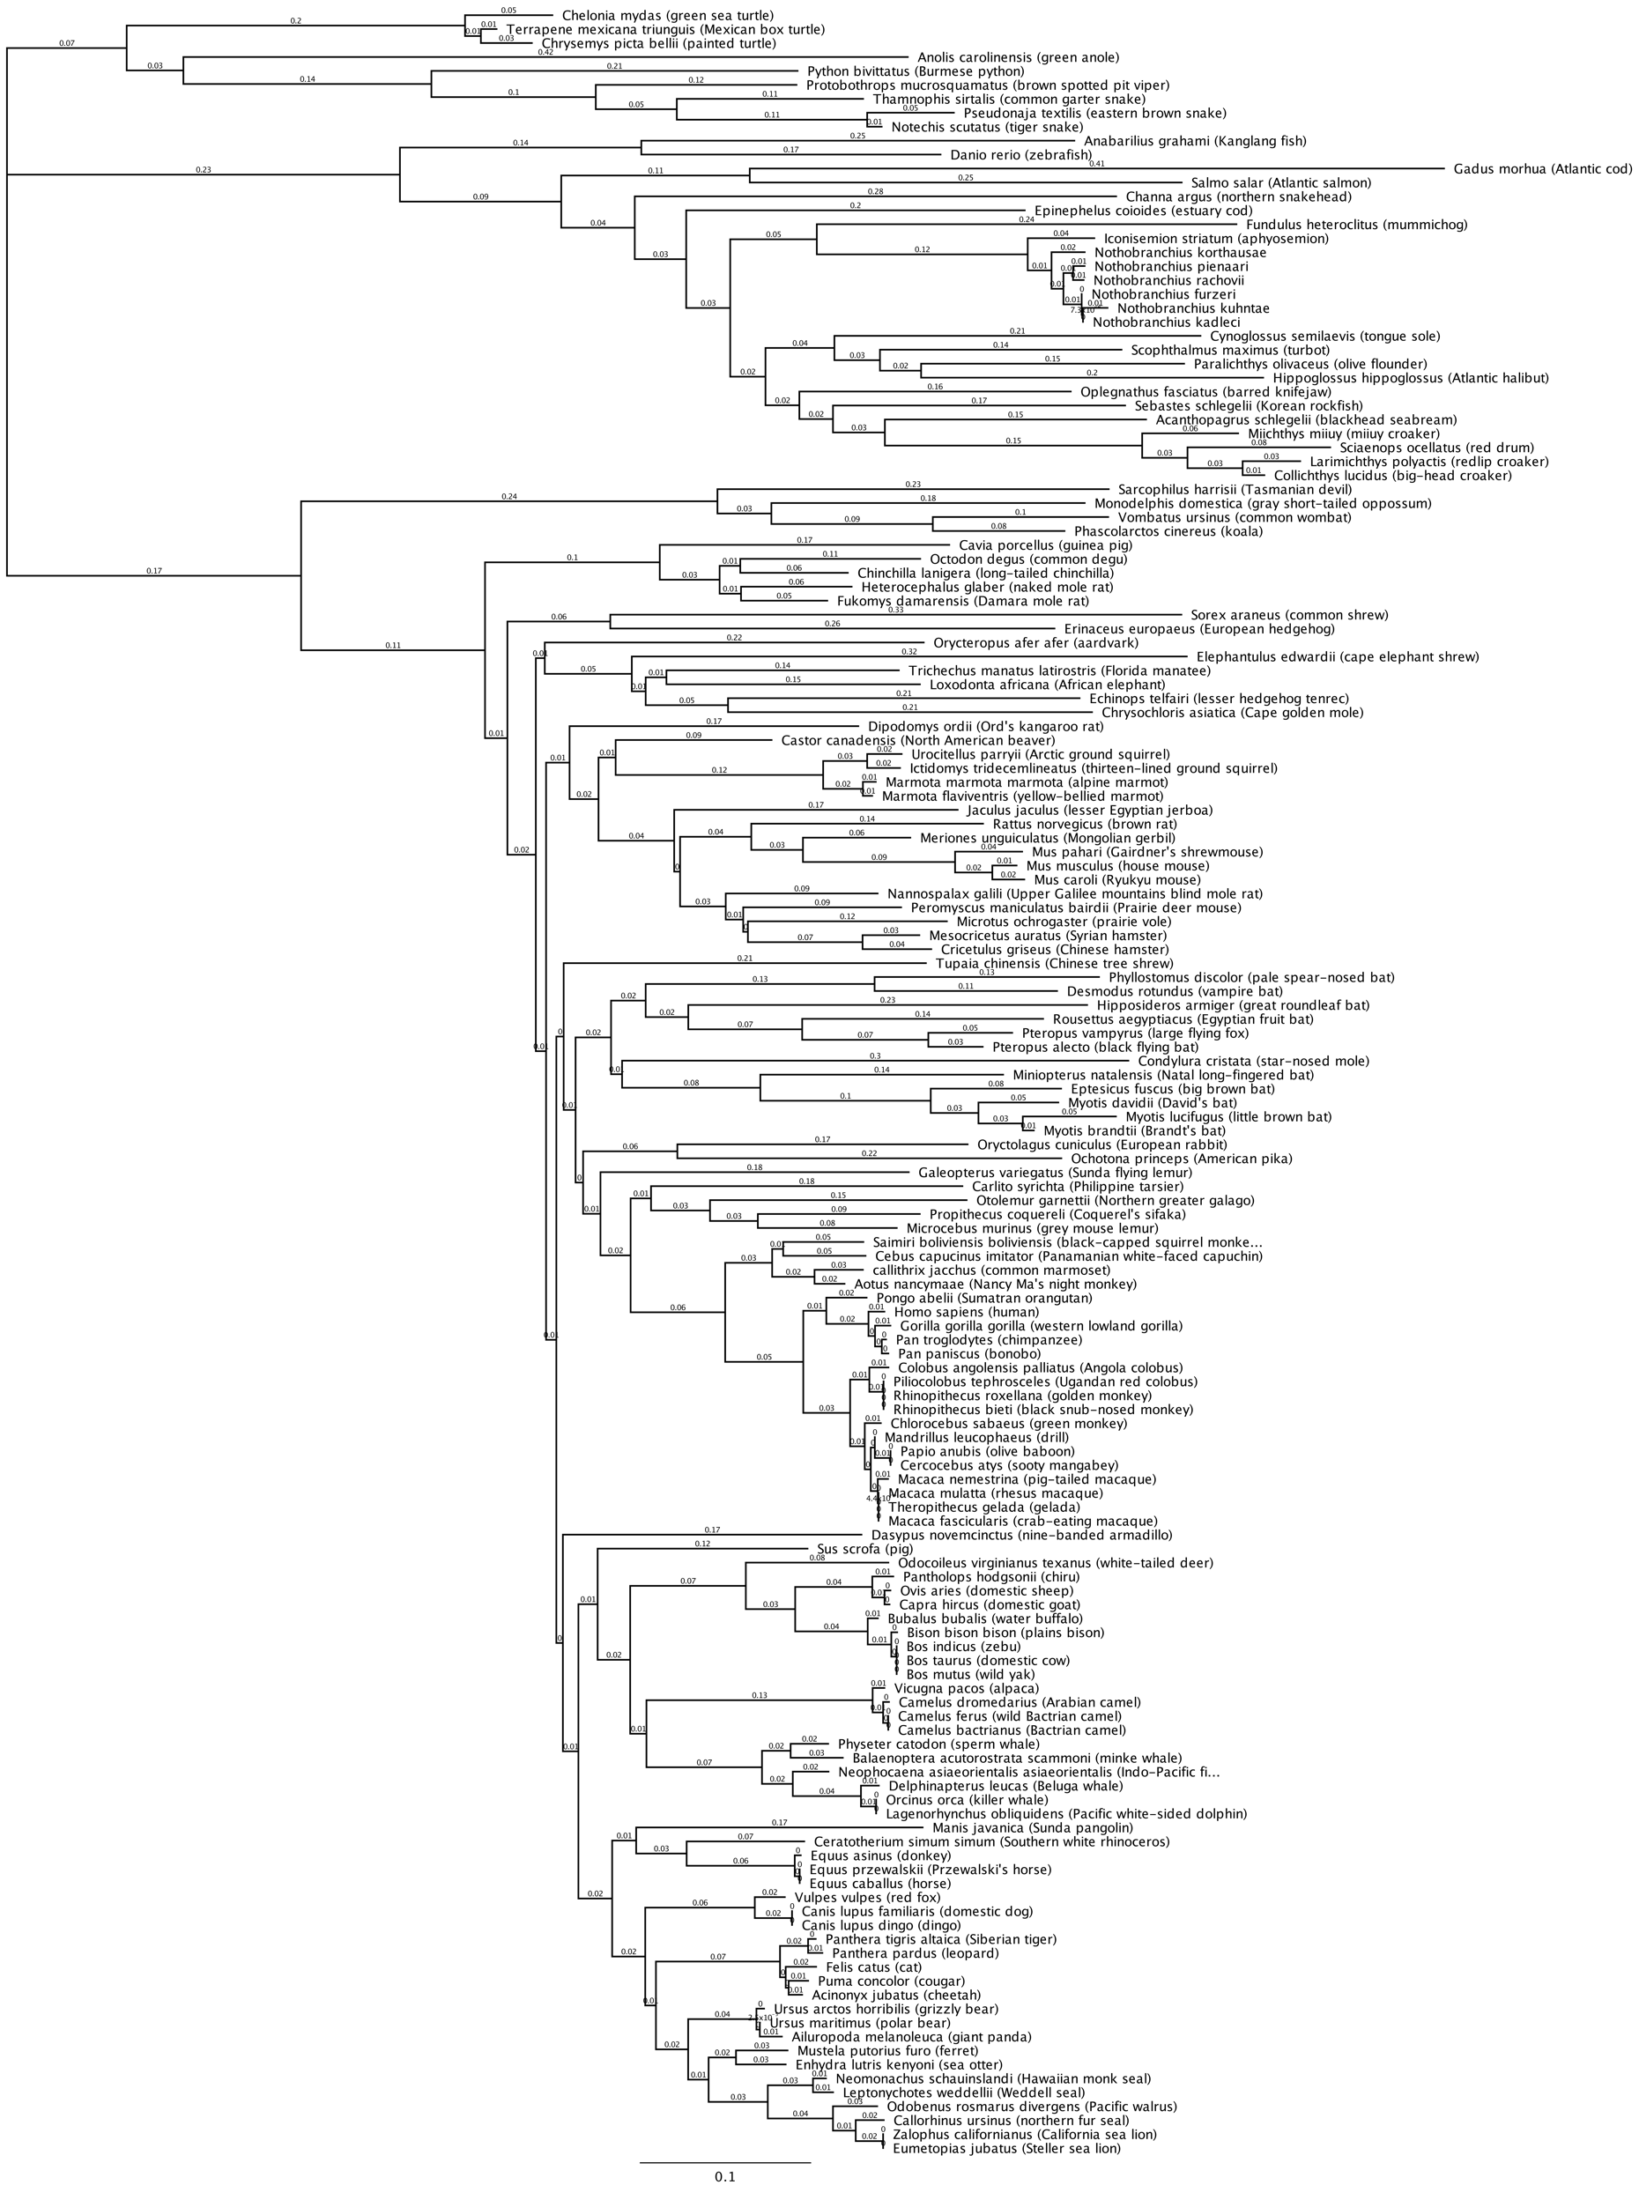
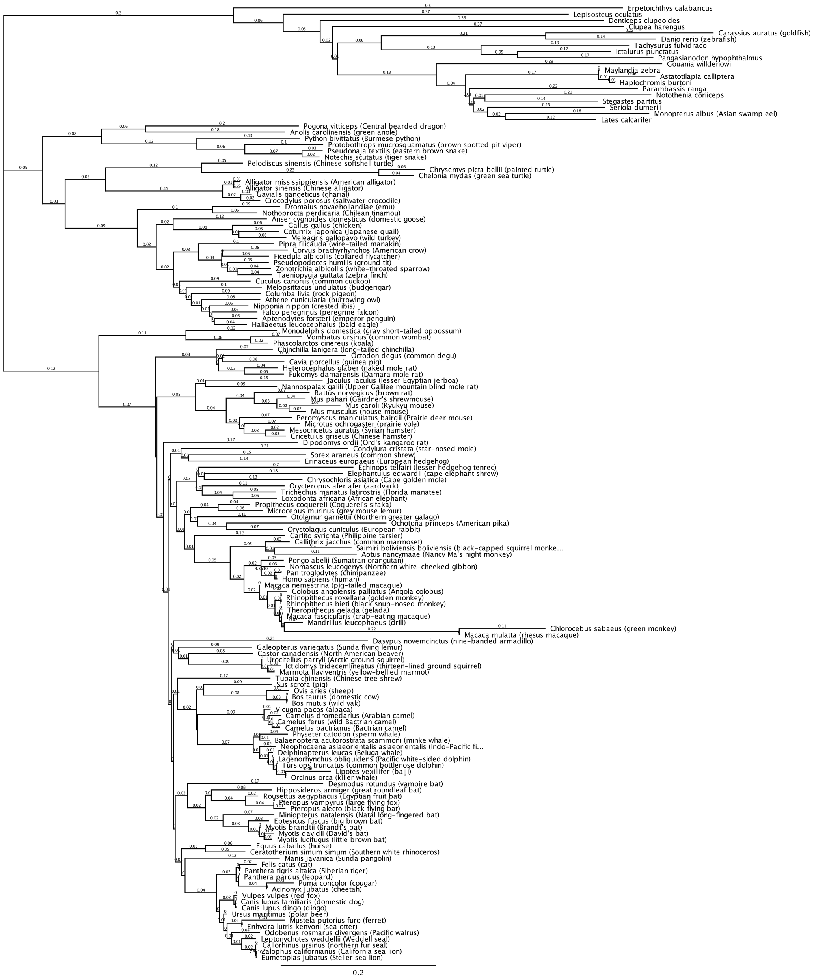




A.
B.
C.
REPTILES
D.
FISH
FISH
REPTILES
MARSUPIALS
MARSUPIAL
EUTHERIA
RODENTS
BIRDS
AFROTHERIA
MARSUPIAL
RODENTS
RODENTS
BATS
AFROTHERIA
LAGOMORPHS
LAGOMORPHS
PRIMATES
PRIMATES
MAMMALS
RODENTS
EVEN-TOED UNGULATES
EVEN-TOED UNGULATES
WHALES & DOLPHINS
WHALES & DOLPHINS
BATS
ODD-TOED UNGULATES
ODD-TOED UNGULATES
Euteleostomi ISG15: 53.3% protein identity
CARNIVORANS
Euteleostomi USP18: 55.0% protein identity
CARNIVORANS
Supplementary Figure 1 | Phylogenetic analysis of ISG15 and USP18. (A-B) Protein sequence alignment of ubiquitin (A top), SUMO-1 (A middle), ISG15 (A bottom), and USP18 (B) of indicated species were performed using MUSCLE (Multiple Sequence Comparison by Log-Expectation). Human was set as the reference sequence and any residue that disagrees with the reference was colored based on the RasMol amino acid color scheme. A graph indicating degree of cross-species amino acid identity for each residue was placed at the top of each alignment, with green, olive, and red indicating 100%, medium, and low identity, respectively. (C-D) 154 euteleostomi ISG15 (C) and USP18 (D) protein sequences were aligned using MUSCLE and the resulting alignment was used as input for constructing the phylogenetic tree of ISG15 and USP18, respectively. Species chosen for further functional analysis were marked with red stars, with the representative specie icons (phylopic.org) illustrated on the right. All phylogenetic analysis was performed by Geneious® 11.1.2.
Notes:
Supplementary Figure 1 | Phylogenetic analysis of ISG15 and USP18. (A-B) Protein sequence alignment of ubiquitin (A top), SUMO-1 (A middle), ISG15 (A bottom), and USP18 (B) of indicated species were performed using MUSCLE (Multiple Sequence Comparison by Log-Expectation). Human was set as the reference sequence and any residue that disagrees with the reference was colored based on the RasMol amino acid color scheme. A graph indicating degree of cross-species amino acid identity for each residue was placed at the top of each alignment, with green, olive, and red indicating 100%, medium, and low identity, respectively. (C-D) 154 euteleostomi ISG15 (C) and USP18 (D) protein sequences were aligned using MUSCLE and the resulting alignment was used as input for constructing the phylogenetic tree of ISG15 and USP18, respectively. Species chosen for further functional analysis were marked with red stars, with the representative specie icons (phylopic.org) illustrated on the right. All phylogenetic analysis was performed by Geneious® 11.1.2.

