Slide 1
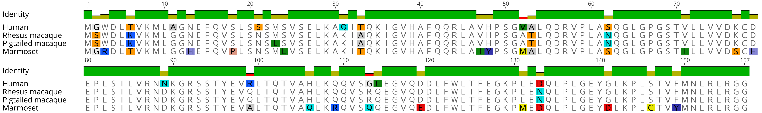
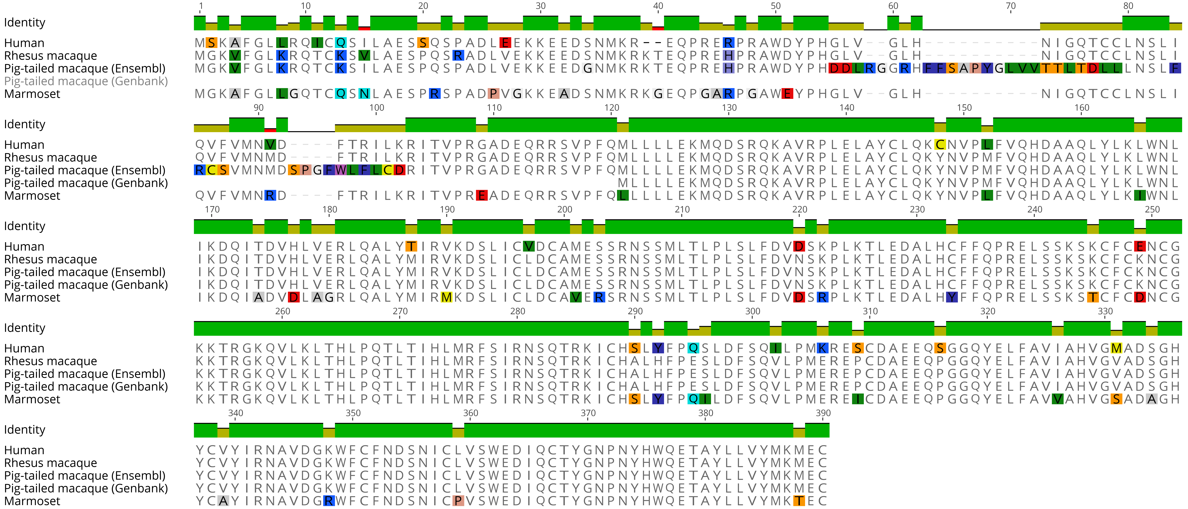
A.
B.
Supplementary Figure 2 | Protein sequence alignment of primate ISG15 and USP18. Coding sequences of ISG15 (A) and USP18 (B) from human, rhesus macaque, pig-tailed macaque, and marmoset were retrieved from Genbank/Ensembl and translated for multi-alignment using inbuilt algorithm MUSCLE in Geneious® 11.1.2. Disagreeing residues with the consensus sequence (not shown) is colored based on the RasMol amino acid color scheme. A graph that illustrates degree of cross-species amino acid identity for each residue is shown at the top of each alignment, with green, olive, and red indicating 100%, medium, and low identity, respectively.
Notes:
Supplementary Figure 2 | Protein sequence alignment of primate ISG15 and USP18. Coding sequences of ISG15 (A) and USP18 (B) from human, rhesus macaque, pig-tailed macaque, and marmoset were retrieved from Genbank/Ensembl and translated for multi-alignment using inbuilt algorithm MUSCLE in Geneious® 11.1.2. Disagreeing residues with the consensus sequence (not shown) is colored based on the RasMol amino acid color scheme. A graph that illustrates degree of cross-species amino acid identity for each residue is shown at the top of each alignment, with green, olive, and red indicating 100%, medium, and low identity, respectively.

