Slide 1
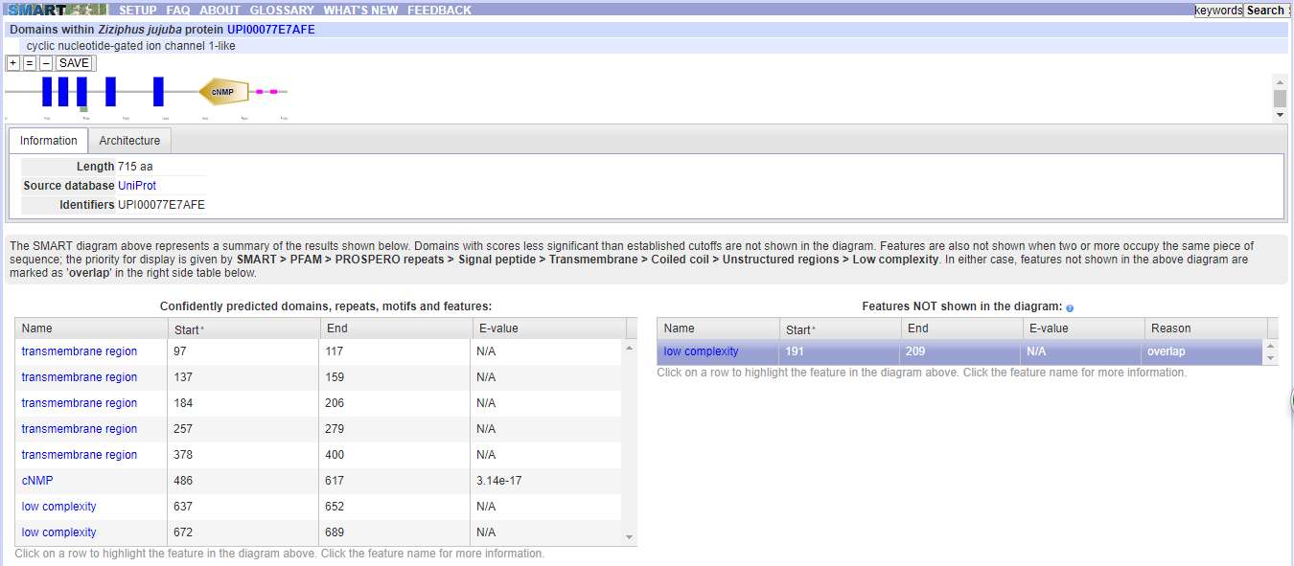
ZjCNGC1

Slide 2
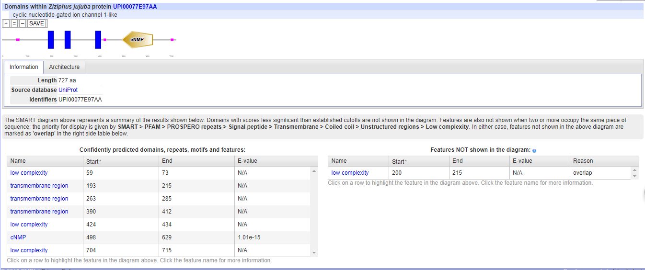
ZjCNGC2

Slide 3
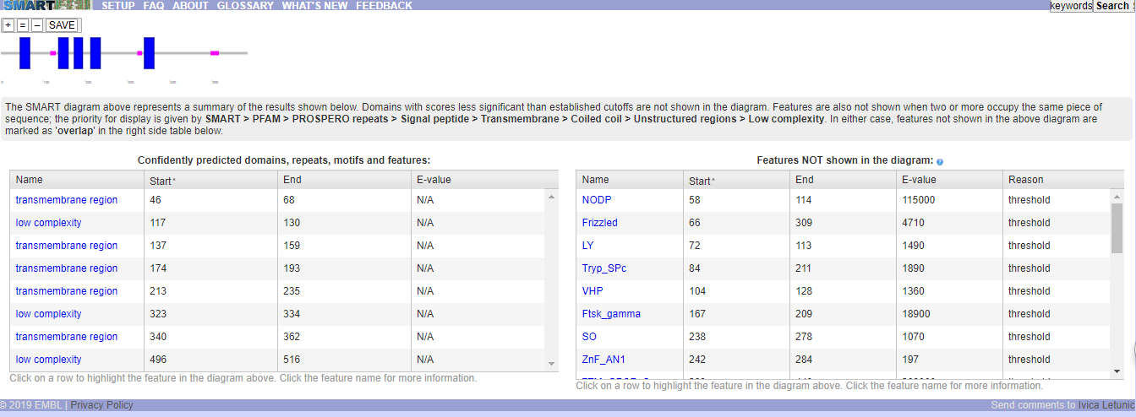
ZjCNGC3

Slide 4
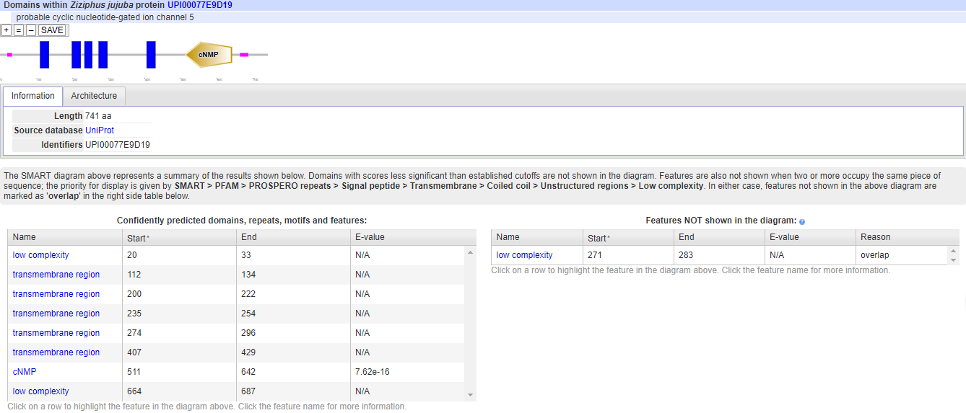
ZjCNGC4

Slide 5
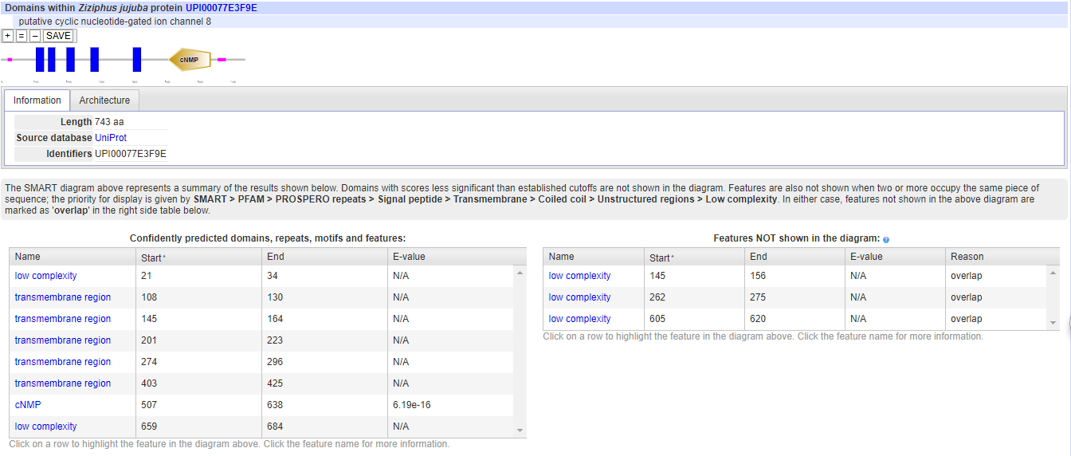
ZjCNGC5

Slide 6
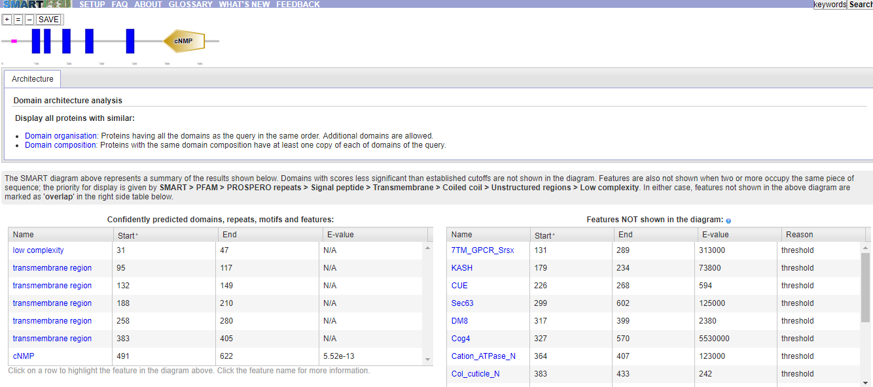
ZjCNGC6

Slide 7
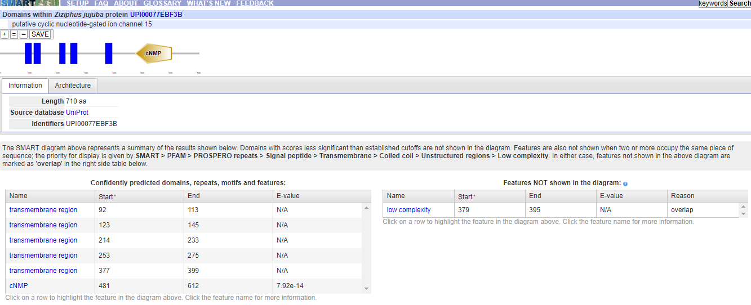
ZjCNGC7

Slide 8

ZjCNGC8

Slide 9
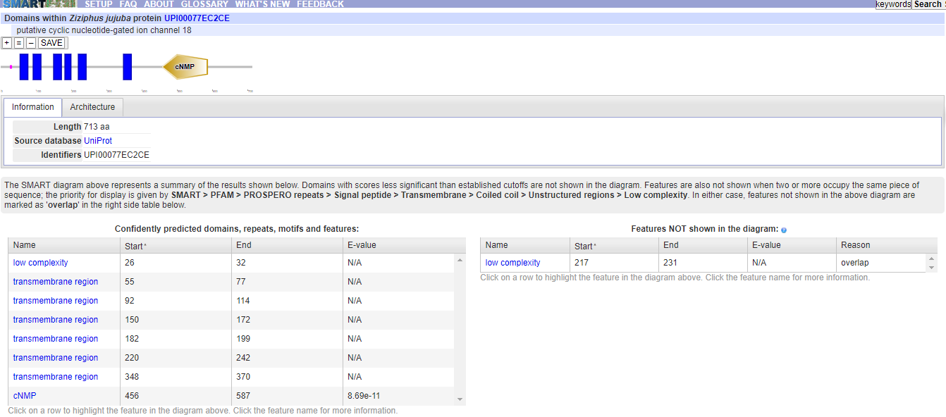
ZjCNGC9

Slide 10
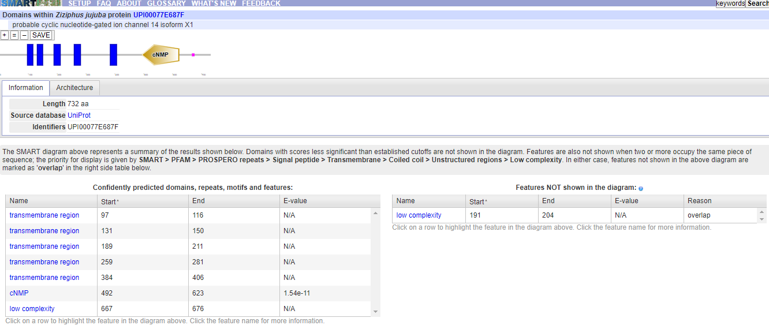
ZjCNGC10

Slide 11
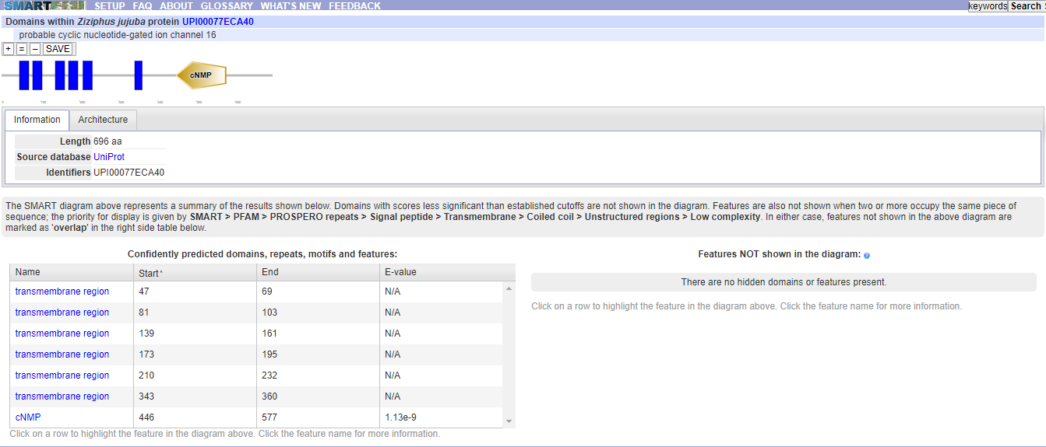
ZjCNGC11

Slide 12
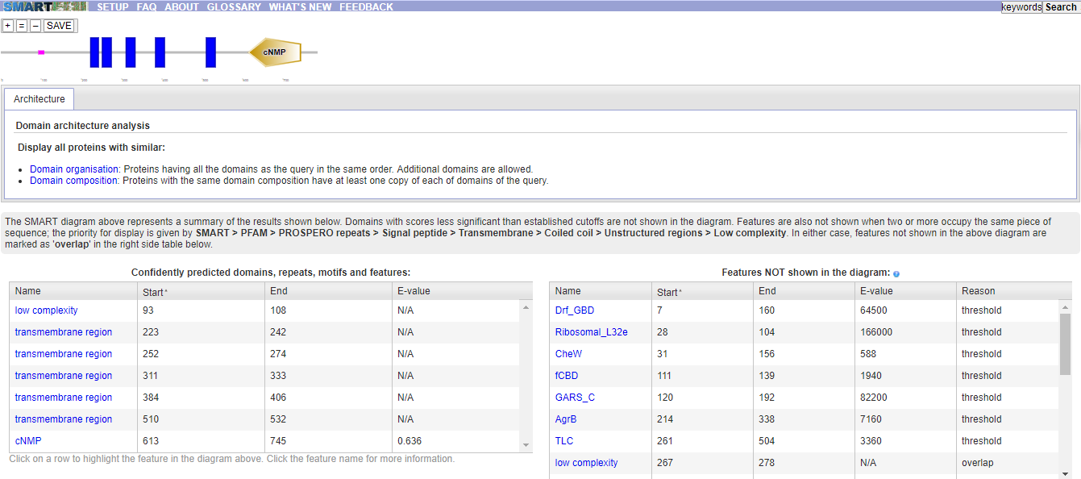
ZjCNGC12

Slide 13
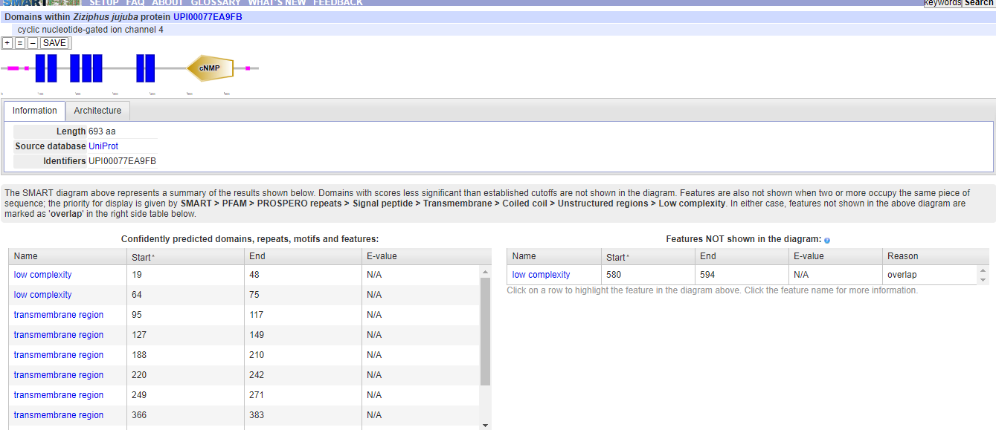
ZjCNGC13

Slide 14
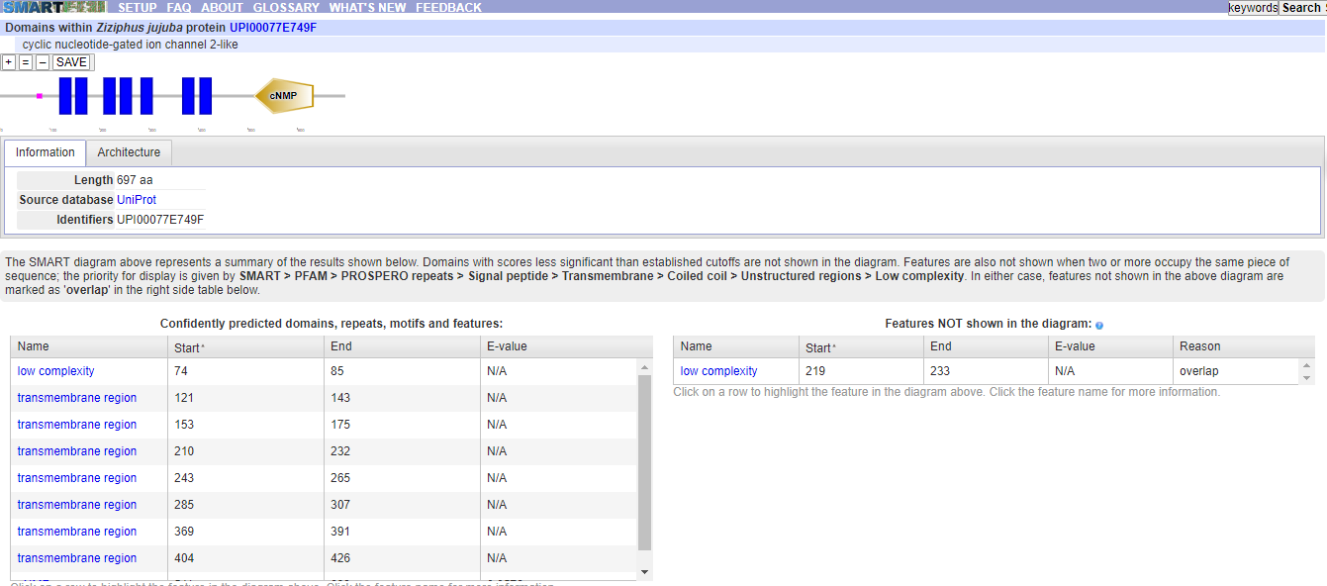
ZjCNGC14

Slide 15
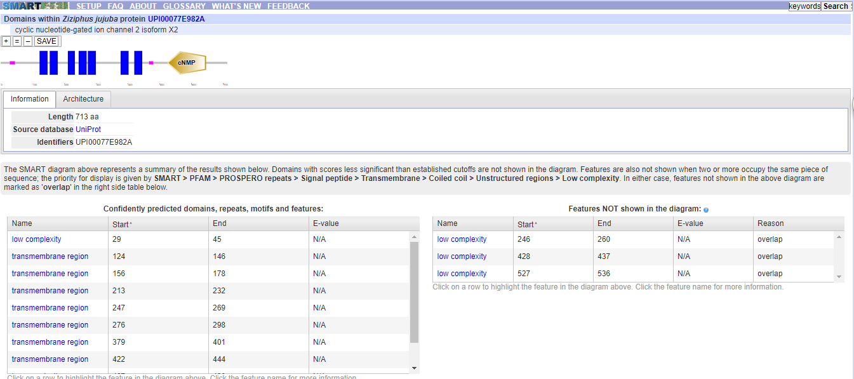
ZjCNGC15

