Slide 1
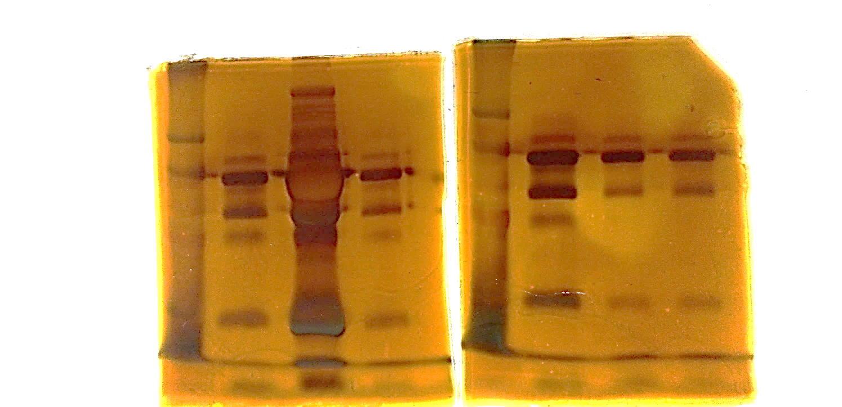
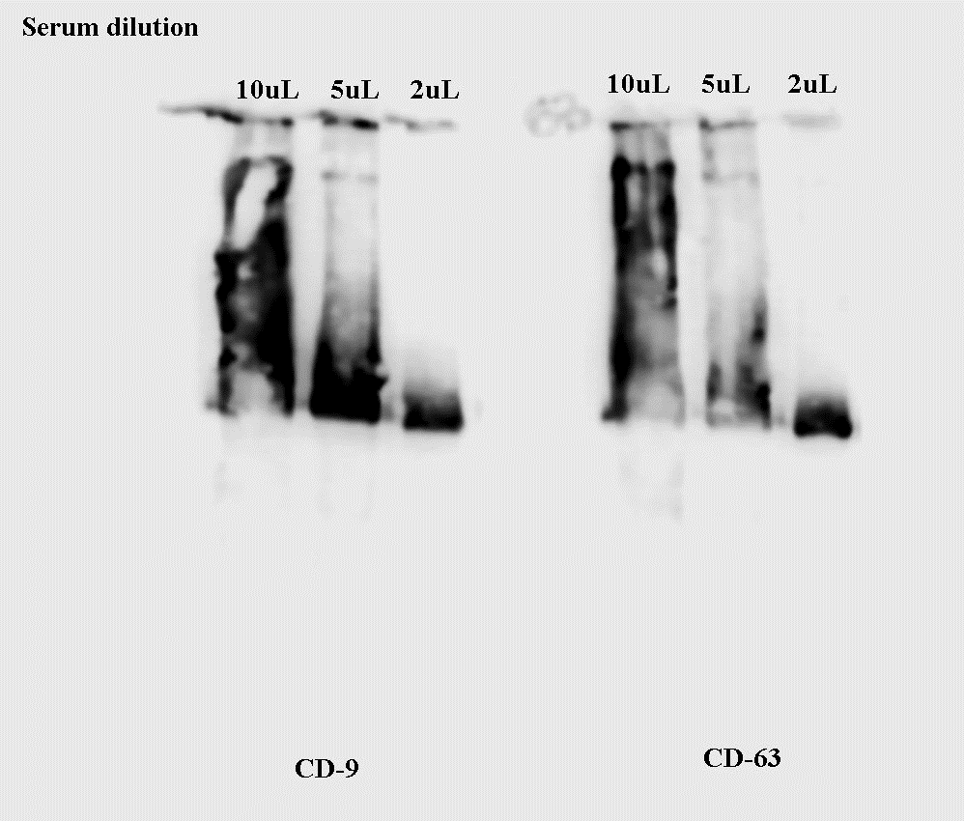
kDa 1 2 3
72 -
Electrophorese - Serum-derived EVs separated by 10% SDS-PAGE and stained by silver.
Three samples
53 -
37 -
29 -
17 -
Immunoblot:
serum-derived EVs, separated by 10% SDS-PAGE, transferred to nitrocellulose and incubated with anti-CD63 and anti-CD9 antibodies.
Three concentrations were used for standardization.

