Slide 1
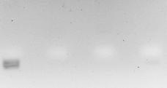
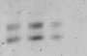
A
Kor
Kal
Tsou
NC
250
B
Kor
Kal
Tsou
NC
500
250
Supplementary Figure 1: Representative agarose electrophoreses of the first (A) and the subsequent (B) amplification of PCR products comprising the SSR-DCA18 marker by using Koroneiki (Kor), Kalamon (Kal) and Tsounati (Tsou) monovarietal olive oil DNA templates.

Slide 2
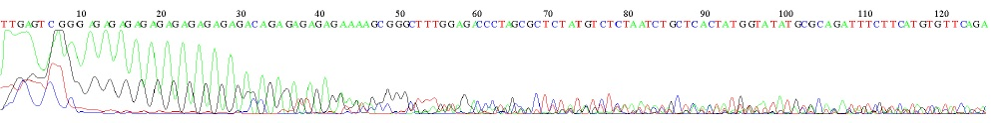
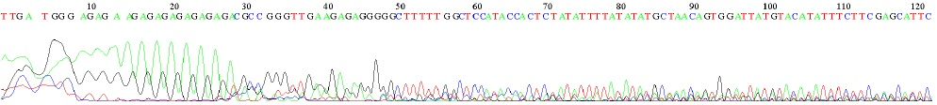
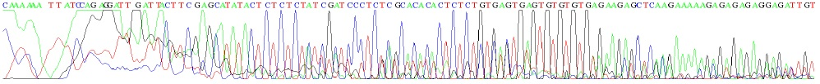
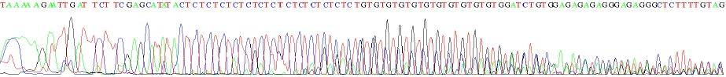
A
Kalamon - DCA3
Koroneiki - DCA3
B
Koroneiki - DCA18
Tsounati - DCA18
Supplementary Figure 2: Representative DNA sequences of SSR-DCA3 amplicon (A) and SSR-DCA18 amplicon (B) using Kalamon and Koroneiki leaf DNA as template.

Slide 3
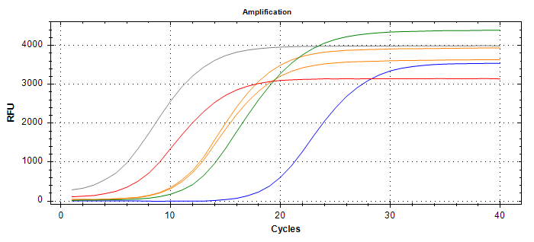
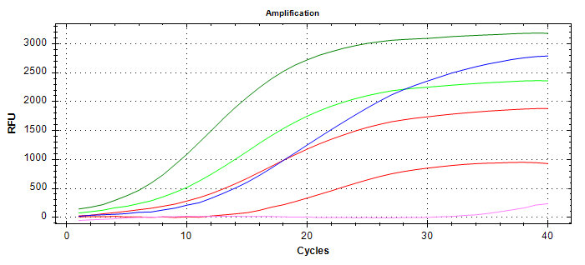


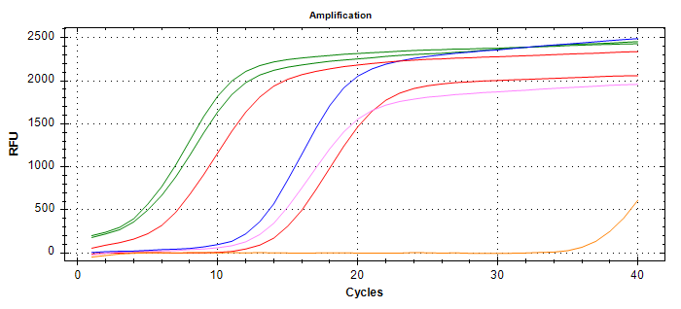

A
B
ssrOe – DCA18
SNP2
trnL-SNPs
C
Supplementary Figure 3: Representative amplification plots of the SSR-HRM and SNP-HRM reactions using amplicons comprising the (A) ssrOe-DCA18 locus, the (B) SNP2 locus and the (C) trnL-SNPs locus

