Slide 1
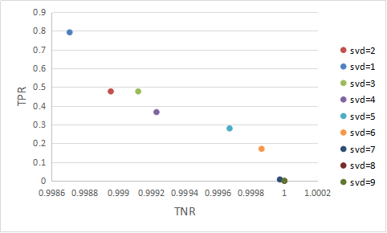
Parameter Adjustment
CoNIFER:
Fig1 Changes of detection sensitivity and specificity of CoNIFER with svd
The selected parameter：svd=1

Slide 2
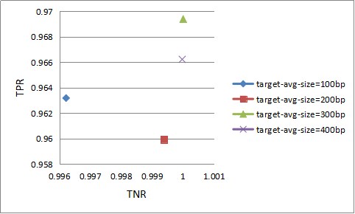
Parameter Adjustment
CNVkit:
Fig2 Changes of detection sensitivity and specificity of CNVkit with target-avg-size
The selected parameter：target-avg-size=300bp

Slide 3
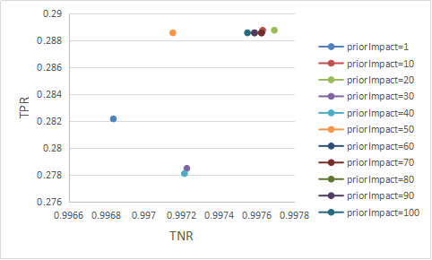
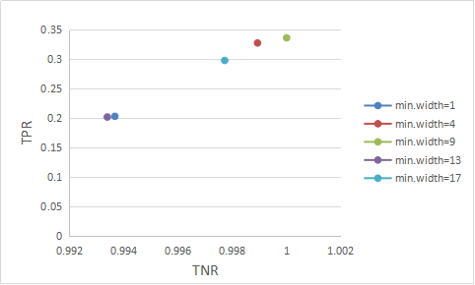
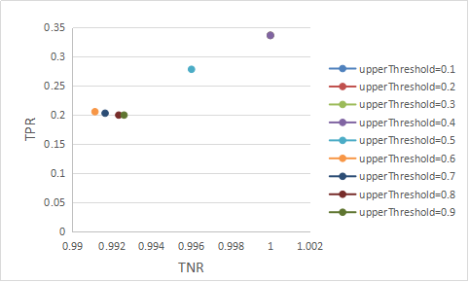
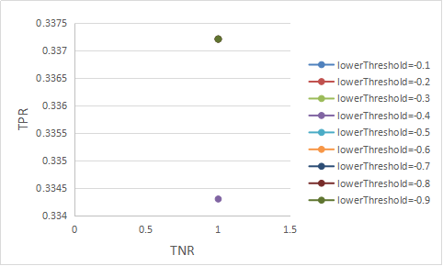
Parameter Adjustment
cn.MOPS:
Fig(a) Changes of detection sensitivity and specificity of cn.MOPS with priorImpac
Fig(b) Changes of detection sensitivity and specificity of cn.MOPS with min.width
Fig(c) Changes of detection sensitivity and specificity of cn.MOPS with upperThreshold
Fig(d) Changes of detection sensitivity and specificity of cn.MOPS with lowerThreshold
Fig3 Changes of detection sensitivity and specificity of cn.MOPS
Selected parameters：priorImpact=20，min.Width=9，upperThreshold=0.4，lowerThreshold=default

Slide 4
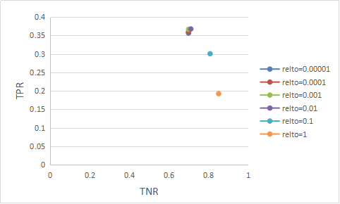
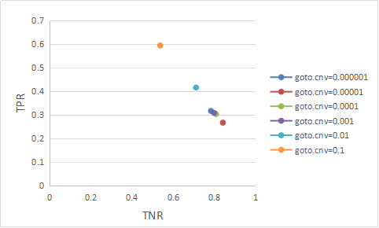
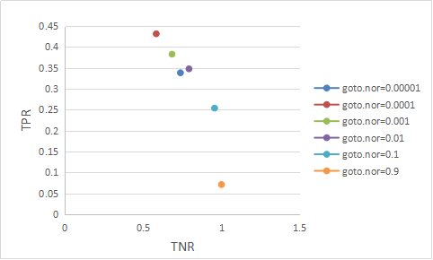
Parameter Adjustment
exomeCopy:
Fig(a) Changes of detection sensitivity and specificity of exomeCopy with relto
Fig(b) Changes of detection sensitivity and specificity of exomeCopy with goto.cnv
Selected parameters:
relto=0.01,goto.cnv=0.0001,goto.nor=0.01
Fig(c) Changes of detection sensitivity and specificity of exomeCopy with goto.nor
Fig4 Changes of detection sensitivity and specificity of exomeCopy

Slide 5
Parameter Adjustment
Summary of Final Selection Parameters :
Tools | Selected parameters
CoNIFER | svd=1
CNVkit | target-avg-size=300bp
cn.MOPS | priorImpact=20，minWidth=9，upperThreshold=0.4，lowerThreshold=default
exomeCopy | relto=0.01,goto.cnv=0.0001,goto.nor=0.01
Tab2 The selected parameters of every tools

