Slide 1
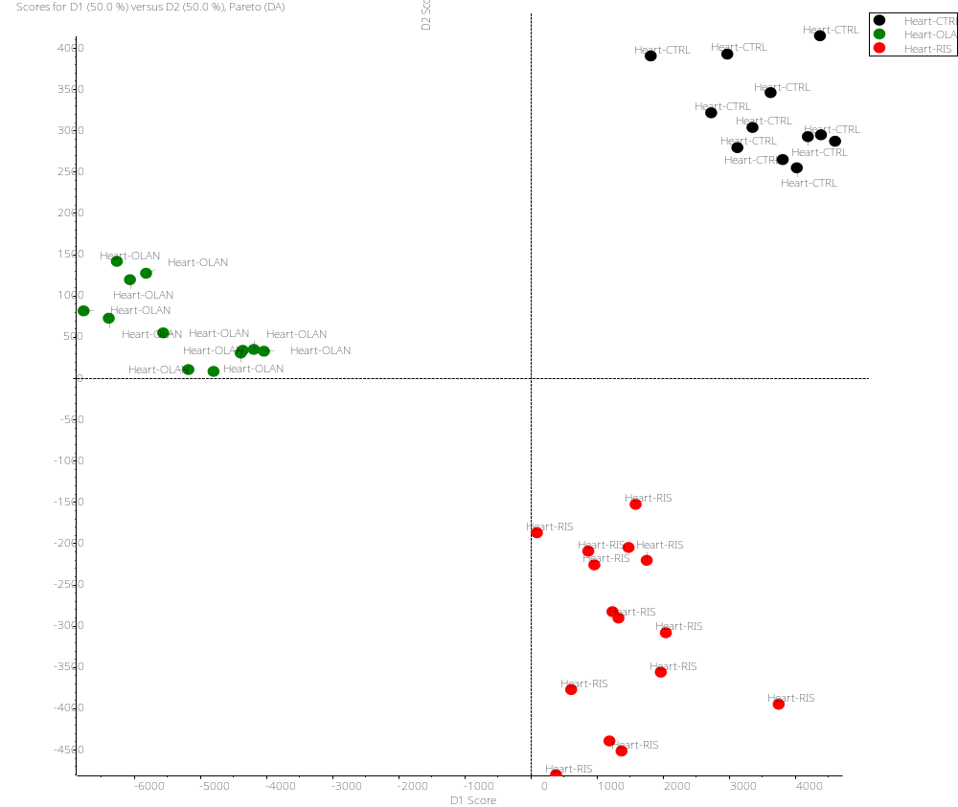
Supplemental Figure 1. Principal component analysis of hearts of C57BL/6J male mice treated 4 weeks with RIS (red), OLAN (green) or Vehicle control (CTRL) (black)

Slide 2
Supplemental Table 1. List of primers used for quantitative real-time PCR
Gene name | GenBank accession | Forward (5’-3”) | Reverse (5’-3’)
Camk2d | NM_001025439 | GTGACACCTGAAGCCAAAGACC | CCTGTGCATCATGGAGGCAACA
Mecr | NM_025297 | AGCCTACAGGATGTTGGTGGAC | CGTTGATGGTCTTTAGGCGAAGG
Mgst3 | NM_025569 | TGCTCCACCTAGCCATCAACGT | AACAGGAAGGGAGGGTACACCT
Ndufa8 | NM_026703 | TCAACGGCTGTGCGCTGAACTT | CACACTGGTCAAACTTTGCCTGC
Ndufa9 | NM_025358 | GTTTCACACCTGAATGCCAGTATG | GAACCTGTCCTCCCTTCCGAAA
Ndufa10 | NM_024197 | GAAGGTCACCTCTGCCTATCTC | CCAGGAATCGTACACCAACACC
Ndufb8 | NM_026061 | CGCCAAGAAGTATAACATGCGAG | CCTCTCATGCTGTGATCGGTTG
Ndufb9 | NM_023172 | CTGGCAGAATCAGCATCCTCAG | TGCTTTCTCAGAGGGATGCCAG
Ndufs3 | NM_026688 | CTGACTTGACGGCAGTGGATGT | GTGTCAGCTCATCTGCATAGGTC
Ndufs7 | NM_029272 | GGCTGAGTATGTGGTGACCAAG | AGCCATGTGCATCATCTCCACG
Hmgcs2 | NM_008256 | TGCTATGCAGCCTACCGCAAGA | GCCAGGGATTTCTGGACCATCT
Slc12a9 | 13937397a1¶ | CTCCCCTCTTTTGGCCTACC | ACGACTATGCTAAACATGGACAG
Slc25a4 | NM_007450 | GCTGCCTACTTCGGAGTCTATG | GTCAAACGGATAGGACACCAGC
Slc27a1 | NM_011977 | TGCCACAGATCGGCGAGTTCTA | AGTGGCTCCATCGTGTCCTCAT
Smarcc1 | NM_009211 | GTGGACAGAACAGGAGACCCTT | TGCATTCGTCCTGAGTACGGCT
¶ using PrimerBank ID (Spandidos et al., 2010)

Slide 3
Table 1. Body composition of female C57BL/6J mice treated with VEH or 0.75 mg/kg RIS.
Suppl Table 2. Body composition of female C57BL/6J mice treated with VEH or 0.75 mg/kg RIS
 | Vehicle |  |  | Risperidone |  |  | p-value
Body Mass (g) | 19.2 | ± | 0.3 | 19.6 | ± | 0.29 | 0.44
Lean Mass (g) | 15.3 | ± | 0.2 | 15.4 | ± | 0.23 | 0.73
Fat Mass (g) | 2.3 | ± | 0.1 | 2.4 | ± | 0.17 | 0.46
Lean Mass (%) | 87.3 | ± | 0.7 | 86.4 | ± | 0.80 | 0.42
Fat Mass (%) | 12.8 | ± | 0.7 | 13.5 | ± | 0.79 | 0.50
Values represent mean ± SEM. p-values calculated by Student's t-test.

Slide 4
Suppl Table 3. Energy metabolism measurements in female C57BL/6J mice treated with VEH or 0.75 mg/kg RIS
 | Vehicle (n=8) |  |  | Risperidone (n=8) |  |  |  |  |  | p-value
Daytime O₂ Consumption (ml/min) | 1.243 | ± | 0.067 | 1.315 |  | ± | 0.029 |  |  | 0.342
Nighttime O₂ Consumption (ml/min) | 1.679 | ± | 0.011 | 1.792 |  | ± | 0.048 |  |  | 0.037
24-hour O₂ Consumption (ml/min) | 1.526 | ± | 0.013 | 1.553 |  | ± | 0.037 |  |  | 0.501
Daytime CO₂ Expulsion (ml/min) | 1.244 | ± | 0.065 | 1.069 |  | ± | 0.024 |  |  | 0.025
Nighttime CO₂ Expulsion (ml/min) | 1.416 | ± | 0.016 | 1.455 |  | ± | 0.039 |  |  | 0.375
24-hour CO₂ Expulsion (ml/min) | 1.266 | ± | 0.014 | 1.255 |  | ± | 0.031 |  |  | 0.742
Daytime Average EE (Kcal/hr) | 0.399 | ± | 0.008 | 0.381 |  | ± | 0.008 |  |  | 0.154
Nighttime Average EE (Kcal/hr) | 0.491 | ± | 0.003 | 0.520 |  | ± | 0.014 |  |  | 0.057
24-hour Average EE (Kcal/hr) | 0.445 | ± | 0.004 | 0.450 |  | ± | 0.011 |  |  | 0.625
Daytime Resting EE (Kcal/30 min) | 0.388 | ± | 0.007 | 0.364 |  | ± | 0.007 |  |  | 0.034
Nighttime Resting EE (Kcal/30 min) | 0.353 | ± | 0.007 | 0.337 |  | ± | 0.016 |  |  | 0.358
24-hour Resting EE (Kcal/30 min) | 0.371 | ± | 0.005 | 0.350 |  | ± | 0.007 |  |  | 0.038
Daytime Active EE (Kcal/30 min) | 0.501 | ± | 0.010 | 0.519 |  | ± | 0.016 |  |  | 0.345
Nighttime Active EE (Kcal/30 min) | 0.575 | ± | 0.009 | 0.602 |  | ± | 0.023 |  |  | 0.311
24-hour Active EE (Kcal/30 min) | 0.538 | ± | 0.007 | 0.560 |  | ± | 0.017 |  |  | 0.260
Daytime RQ | 0.807 | ± | 0.009 | 0.798 |  | ± | 0.007 |  |  | 0.416
Nighttime RQ | 0.841 | ± | 0.009 | 0.810 |  | ± | 0.009 |  |  | 0.027
24-hour RQ | 0.824 | ± | 0.007 | 0.804 |  | ± | 0.008 |  |  | 0.083
Daytime Resting RQ | 0.808 | ± | 0.015 | 0.781 |  | ± | 0.013 |  |  | 0.191
Nighttime Resting RQ | 0.816 | ± | 0.012 | 0.798 |  | ± | 0.016 |  |  | 0.400
24-hour Resting RQ | 0.812 | ± | 0.009 | 0.790 |  | ± | 0.014 |  |  | 0.192
Daytime Active RQ | 0.842 | ± | 0.010 | 0.833 |  | ± | 0.010 |  |  | 0.536
Nighttime Active RQ | 0.839 | ± | 0.015 | 0.816 |  | ± | 0.013 |  |  | 0.266
24-hour Active RQ | 0.841 | ± | 0.010 | 0.825 |  | ± | 0.011 |  |  | 0.294
Daytime Food Consumption (g) | 1.02 | ± | 0.15 | 0.89 |  | ± | 0.07 |  |  | 0.478
Nighttime Food Consumption (g) | 2.15 | ± | 0.28 | 1.67 |  | ± | 0.18 |  |  | 0.165
24-hour Food Consumption (g) | 3.17 | ± | 0.38 | 2.56 |  | ± | 0.18 |  |  | 0.168
Daytime Water Consumption (ml) | 0.79 | ± | 0.10 | 0.69 |  | ± | 0.12 |  |  | 0.524
Nighttime Water Consumption (ml) | 1.48 | ± | 0.12 | 1.19 |  | ± | 0.14 |  |  | 0.141
24-hour Water Consumption (ml) | 2.27 | ± | 0.19 | 1.88 |  | ± | 0.24 |  |  | 0.231
Values represent mean ± SEM. p-values calculated by Student's t-test.
Abbreviations: EE, energy expenditure; RQ, respiratory quotient.

Slide 5
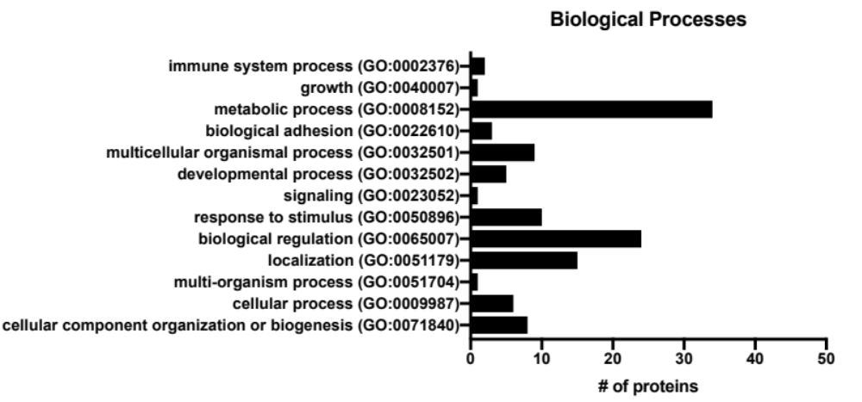
Supplemental Figure 2: Characterization of biological processes of the proteome of RIS-treated hearts. Results from PANTHER analysis show number of proteins present in our dataset of 111 differentially expressed proteins in RIS-treated mouse hearts related to GO terms for biological processes. Results show largest subset of proteins involved in metabolic processes.

Slide 6
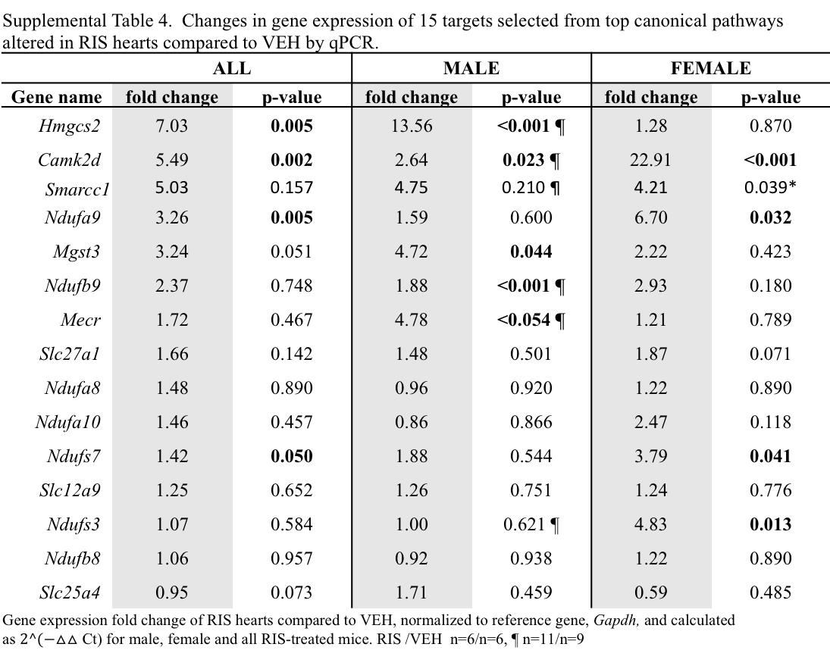
Supplemental Table 4. Changes in gene expression of 15 targets selected from top canonical pathways altered in RIS hearts compared to VEH by qPCR.
 | ALL |  | MALE |  | FEMALE
Gene name | fold change | p-value | fold change | p-value | fold change | p-value
Hmgcs2 | 7.03 | 0.005 | 13.56 | <0.001 ¶ | 1.28 | 0.870
Camk2d | 5.49 | 0.002 | 2.64 | 0.023 ¶ | 22.91 | <0.001
Smarcc1 | 5.03 | 0.157 | 4.75 | 0.210 ¶ | 4.21 | 0.039*
Ndufa9 | 3.26 | 0.005 | 1.59 | 0.600 | 6.70 | 0.032
Mgst3 | 3.24 | 0.051 | 4.72 | 0.044 | 2.22 | 0.423
Ndufb9 | 2.37 | 0.748 | 1.88 | <0.001 ¶ | 2.93 | 0.180
Mecr | 1.72 | 0.467 | 4.78 | <0.054 ¶ | 1.21 | 0.789
Slc27a1 | 1.66 | 0.142 | 1.48 | 0.501 | 1.87 | 0.071
Ndufa8 | 1.48 | 0.890 | 0.96 | 0.920 | 1.22 | 0.890
Ndufa10 | 1.46 | 0.457 | 0.86 | 0.866 | 2.47 | 0.118
Ndufs7 | 1.42 | 0.050 | 1.88 | 0.544 | 3.79 | 0.041
Slc12a9 | 1.25 | 0.652 | 1.26 | 0.751 | 1.24 | 0.776
Ndufs3 | 1.07 | 0.584 | 1.00 | 0.621 ¶ | 4.83 | 0.013
Ndufb8 | 1.06 | 0.957 | 0.92 | 0.938 | 1.22 | 0.890
Slc25a4 | 0.95 | 0.073 | 1.71 | 0.459 | 0.59 | 0.485
Gene expression fold change of RIS hearts compared to VEH, normalized to reference gene, Gapdh, and calculated as $2^(−△△$ Ct) for male, female and all RIS-treated mice. RIS /VEH n=6/n=6, ¶ n=11/n=9

Slide 7
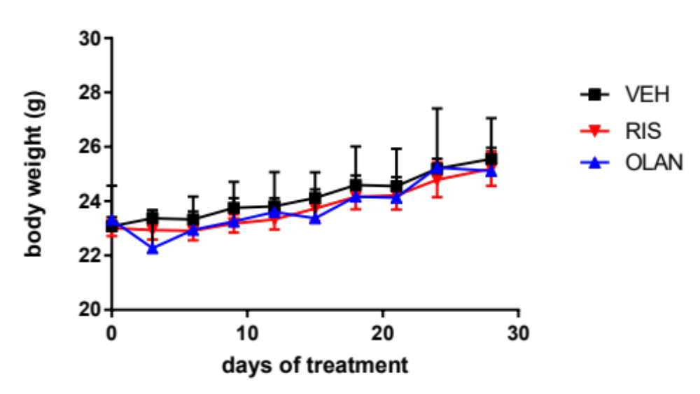
Supplemental Figure 3: C57BL/6J male mice treated with Risperidone (RIS) or Olanzapine (OLAN) are not subjected to gain weight. Body weights of male mice dosed daily with 1mg/kg RIS (red triangles) 5mg/kg OLAN (blue triangles) or vehicle (VEH) control (black squares) were measured every 2 days for the duration of 4 week treatment. Male mice treated with RIS or OLAN did not show significant differences in weight compared to VEH treated mice.

Slide 8
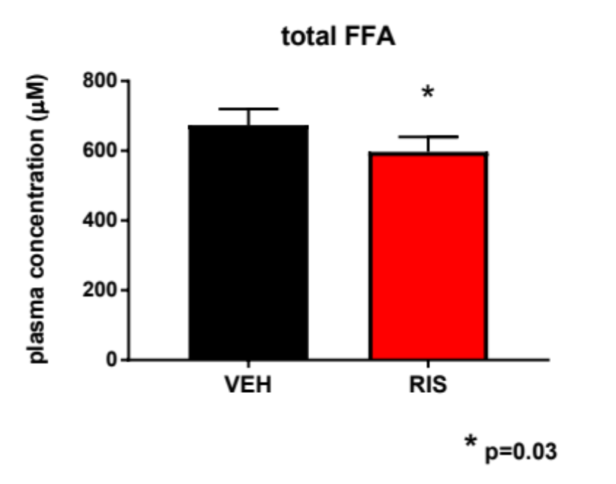
Supplemental figure 4: Total free fatty acid plasma concentrations in male mice treated 4 weeks with Risperidone (RIS) (red bar) is significantly decreased compared to vehicle (VEH) treated mice (black bar). RM one way ANOVA, post hoc Tukey’s test. VEH/RIS N=5/N=7

Slide 9
Supplementary Table 6. Activity measurements in female C57BL/6J mice treated with vehicle or 0.75 mg/kg risperidone.
 | Vehicle (n=8) |  |  | Risperidone (n=8) |  |  | p-value
Daytime Wheel Distance (m) | 483 | ± | 232 | 654 | ± | 193 | 0.578
Nighttime Wheel Distance (m) | 3869 | ± | 204 | 5205 | ± | 543 | 0.049
24-hour Wheel Distance (m) | 4406 | ± | 392 | 5859 | ± | 657 | 0.090
Daytime Wheel Speed (m/s) | 0.170 | ± | 0.013 | 0.192 | ± | 0.013 | 0.261
Nighttime Wheel Speed (m/s) | 0.277 | ± | 0.023 | 0.308 | ± | 0.012 | 0.256
24-hour Wheel Speed (m/s) | 0.223 | ± | 0.016 | 0.250 | ± | 0.011 | 0.187
Daytime Spent Running (%) | 5.6 | ± | 2.3 | 7.4 | ± | 2.1 | 0.564
Nighttime Spent Running (%) | 31.7 | ± | 2.2 | 40.2 | ± | 2.9 | 0.041
24-hour Time Spent Running (%) | 19.0 | ± | 1.8 | 23.8 | ± | 2.2 | 0.121
Daytime Walking Distance (m) | 49.3 | ± | 3.1 | 51.059 | ± | 3.330 | 0.705
Nighttime Walking Distance (m) | 72.9 | ± | 5.3 | 72.752 | ± | 4.400 | 0.986
24-hour Walking Distance (m) | 122.2 | ± | 8.1 | 123.811 | ± | 7.070 | 0.880
Daytime Walking Speed (m/s) | 0.0137 | ± | 0.0004 | 0.0151 | ± | 0.0005 | 0.051
Nighttime Walking Speed (m/s) | 0.0160 | ± | 0.0007 | 0.0165 | ± | 0.0003 | 0.536
24-hour Walking Speed (m/s) | 0.0149 | ± | 0.0005 | 0.0158 | ± | 0.0003 | 0.134
Daytime Spent Walking (%) | 12.2 | ± | 1.0 | 10.5 | ± | 0.7 | 0.165
Nighttime Spent Walking (%) | 13.1 | ± | 1.0 | 11.2 | ± | 0.8 | 0.153
24-hour Time Spent Walking (%) | 12.6 | ± | 0.9 | 10.8 | ± | 0.7 | 0.140
Daytime Spent Still (%) | 82.1 | ± | 1.9 | 82.0 | ± | 1.8 | 0.955
Nighttime Spent Still (%) | 53.8 | ± | 2.9 | 46.2 | ± | 2.7 | 0.079
24-hour Time Spent Still (%) | 68.0 | ± | 1.7 | 64.1 | ± | 2.1 | 0.172
Daytime Spent Sleeping (%) | 77.3 | ± | 1.9 | 77.7 | ± | 1.7 | 0.859
Nighttime Spent Sleeping (%) | 48.9 | ± | 2.7 | 41.2 | ± | 2.4 | 0.052
24-hour Time Spent Sleeping (%) | 63.1 | ± | 1.5 | 59.5 | ± | 1.9 | 0.148
Daytime Sleep (h) | 9.3 | ± | 0.2 | 9.3 | ± | 0.2 | 0.859
Nighttime Sleep (h) | 5.9 | ± | 0.3 | 4.9 | ± | 0.3 | 0.052
24-hour Sleep (h) | 15.1 | ± | 0.4 | 14.3 | ± | 0.4 | 0.148
Values represent mean ± SEM. p-values calculated by Student's t-test.

Slide 10
Supplementary Table 5. Activity measurements in male C57BL/6J mice treated with vehicle or 0.75 mg/kg risperidone.
 | Vehicle (n=4) |  |  | Risperidone (n=4) |  |  | p-value
Daytime Wheel Distance (m) | 153 | ± | 120 | 373 | ± | 119 | 0.241
Nighttime Wheel Distance (m) | 3335 | ± | 780 | 4606 | ± | 1083 | 0.377
24-hour Wheel Distance (m) | 3487 | ± | 856 | 4979 | ± | 1194 | 0.349
Daytime Wheel Speed (m/s) | 0.124 | ± | 0.012 | 0.172 | ± | 0.016 | 0.054
Nighttime Wheel Speed (m/s) | 0.228 | ± | 0.028 | 0.258 | ± | 0.015 | 0.384
24-hour Wheel Speed (m/s) | 0.176 | ± | 0.008 | 0.215 | ± | 0.015 | 0.069
Daytime Spent Running (%) | 2.2 | ± | 1.6 | 5.1 | ± | 1.2 | 0.190
Nighttime Spent Running (%) | 35.5 | ± | 6.9 | 42.1 | ± | 8.3 | 0.561
24-hour Time Spent Running (%) | 18.8 | ± | 4.2 | 23.6 | ± | 4.7 | 0.476
Daytime Walking Distance (m) | 29.1 | ± | 7.2 | 35.807 | ± | 5.055 | 0.477
Nighttime Walking Distance (m) | 92.5 | ± | 10.3 | 80.696 | ± | 12.773 | 0.499
24-hour Walking Distance (m) | 121.6 | ± | 16.8 | 116.504 | ± | 17.744 | 0.841
Daytime Walking Speed (m/s) | 0.0137 | ± | 0.0008 | 0.0143 | ± | 0.0006 | 0.612
Nighttime Walking Speed (m/s) | 0.0147 | ± | 0.0008 | 0.0142 | ± | 0.0008 | 0.634
24-hour Walking Speed (m/s) | 0.0142 | ± | 0.0008 | 0.0142 | ± | 0.0006 | 0.995
Daytime Spent Walking (%) | 7.8 | ± | 0.6 | 8.3 | ± | 1.1 | 0.651
Nighttime Spent Walking (%) | 16.3 | ± | 1.5 | 13.7 | ± | 1.5 | 0.266
24-hour Time Spent Walking (%) | 12.0 | ± | 0.8 | 11.0 | ± | 1.3 | 0.534
Daytime Spent Still (%) | 91.1 | ± | 1.6 | 84.9 | ± | 0.9 | 0.016
Nighttime Spent Still (%) | 46.4 | ± | 5.4 | 40.5 | ± | 6.8 | 0.523
24-hour Time Spent Still (%) | 68.7 | ± | 3.5 | 62.7 | ± | 3.4 | 0.259
Daytime Spent Sleeping (%) | 88.2 | ± | 1.4 | 81.8 | ± | 1.0 | 0.008
Nighttime Spent Sleeping (%) | 40.4 | ± | 4.6 | 35.6 | ± | 6.6 | 0.572
24-hour Time Spent Sleeping (%) | 64.3 | ± | 2.9 | 58.7 | ± | 3.2 | 0.245
Daytime Sleep (h) | 10.6 | ± | 0.2 | 9.8 | ± | 0.1 | 0.008
Nighttime Sleep (h) | 4.8 | ± | 0.5 | 4.3 | ± | 0.8 | 0.572
24-hour Sleep (h) | 15.4 | ± | 0.7 | 14.1 | ± | 0.8 | 0.245
Values represent mean ± SEM. p-values calculated by Student's t-test.

Slide 11
Supplemental files:
Supp file 1: RIS DE dataset and IPA analysis
Excel file summarizing all annotated dataset and IPA analysis of DE proteins in RIS hearts
Supp File 2: Panther analysis of RIS DE dataset
Excel file summarizing Panther analysis of DE dataset
Supp File 3: VLAD analysis of RIS DE dataset
Excel file summarizing all VLAD analysis of DE dataset
Supp File 4: OLAN DE dataset and IPA analysis
Excel file summarizing all annotated dataset and IPA analysis of DE proteins in OLAN hearts

