Slide 1
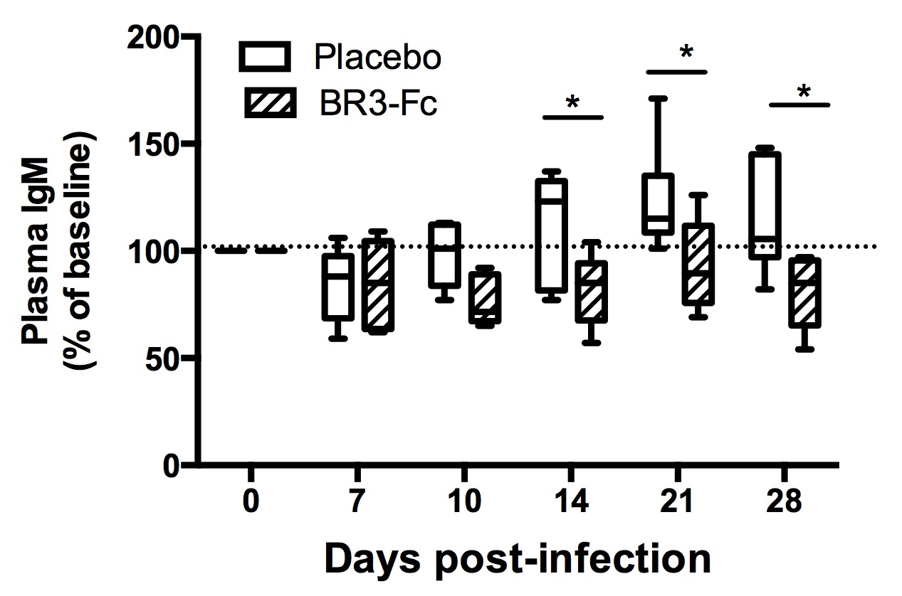
Supplemental Figure 5. Decreased levels of plasma IgM after BAFF neutralization in SIV-infected macaques.
ELISA was used to quantify total IgM in plasma of Placebo (n=6, white bars) and Treated (n=6, hatched bars) macaques. Change in IgM concentration was expressed as the percentage of baseline value (D0) for each animal. A dotted line indicates the 100% value. Box-and-whiskers (5-95 percentile) plots with horizontal bars indicating Median values are shown for each group. Statistical comparison was performed using two-way ANOVA with Bonferroni’s multiple comparisons test. Significant statistical values are indicated * p<0.05.

