Slide 1
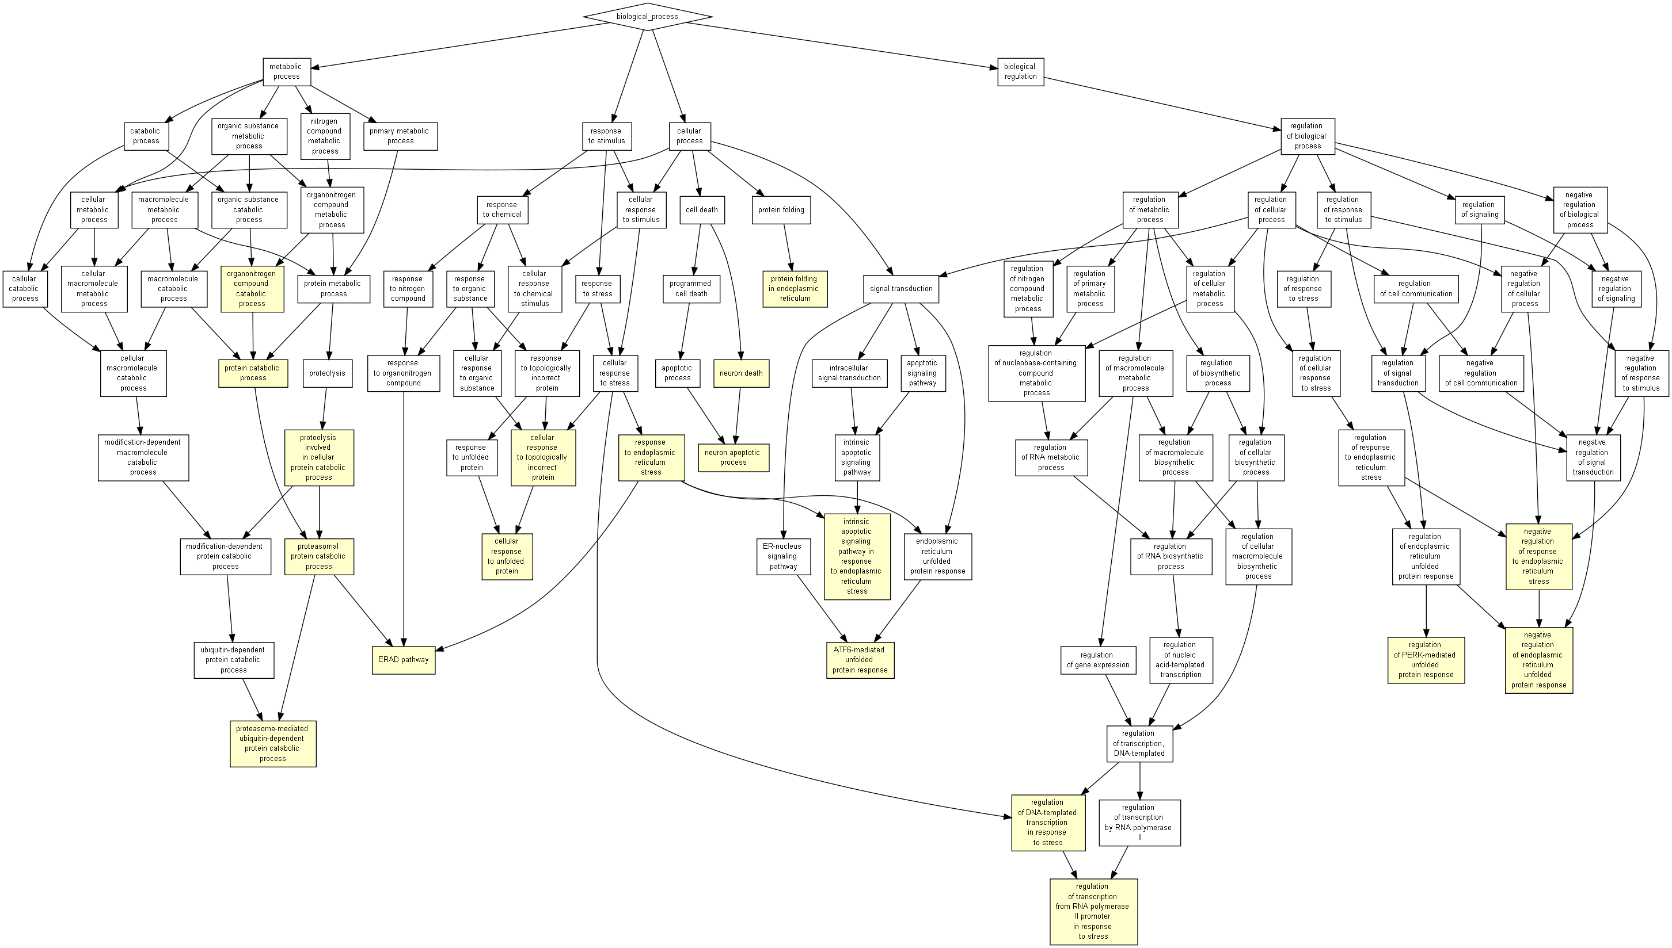
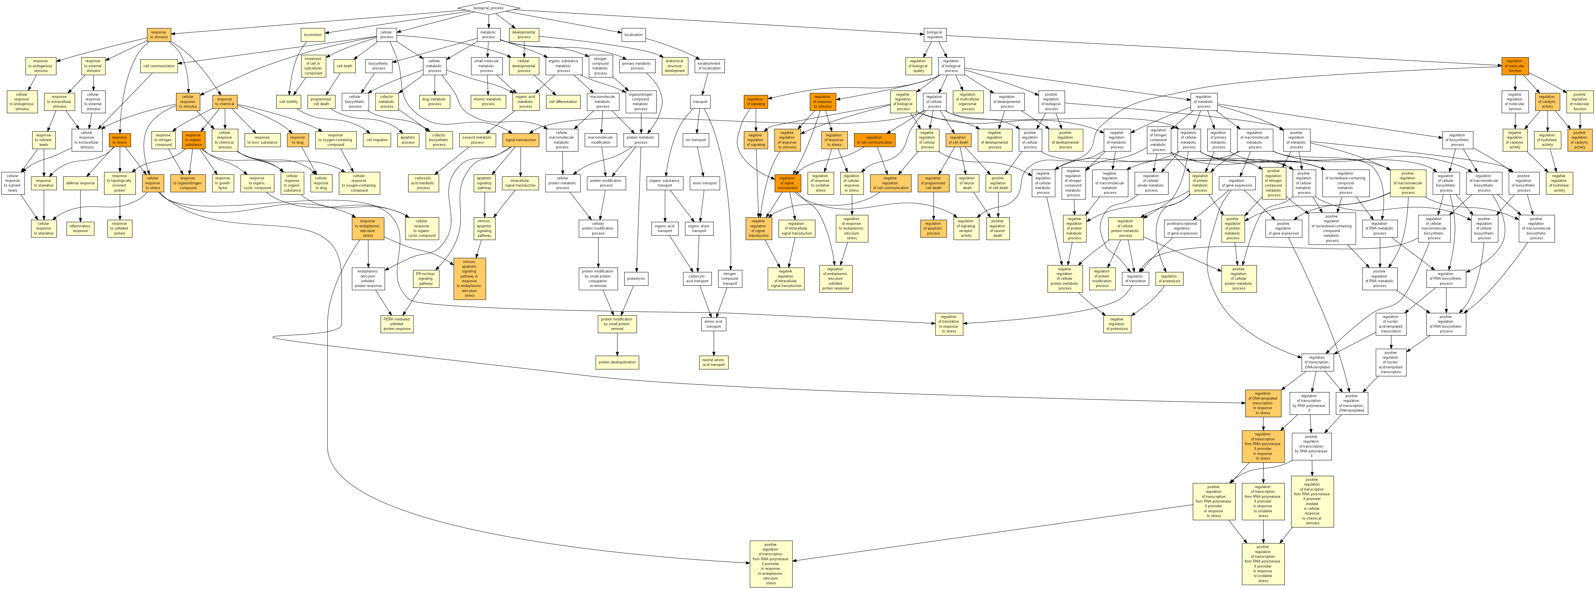
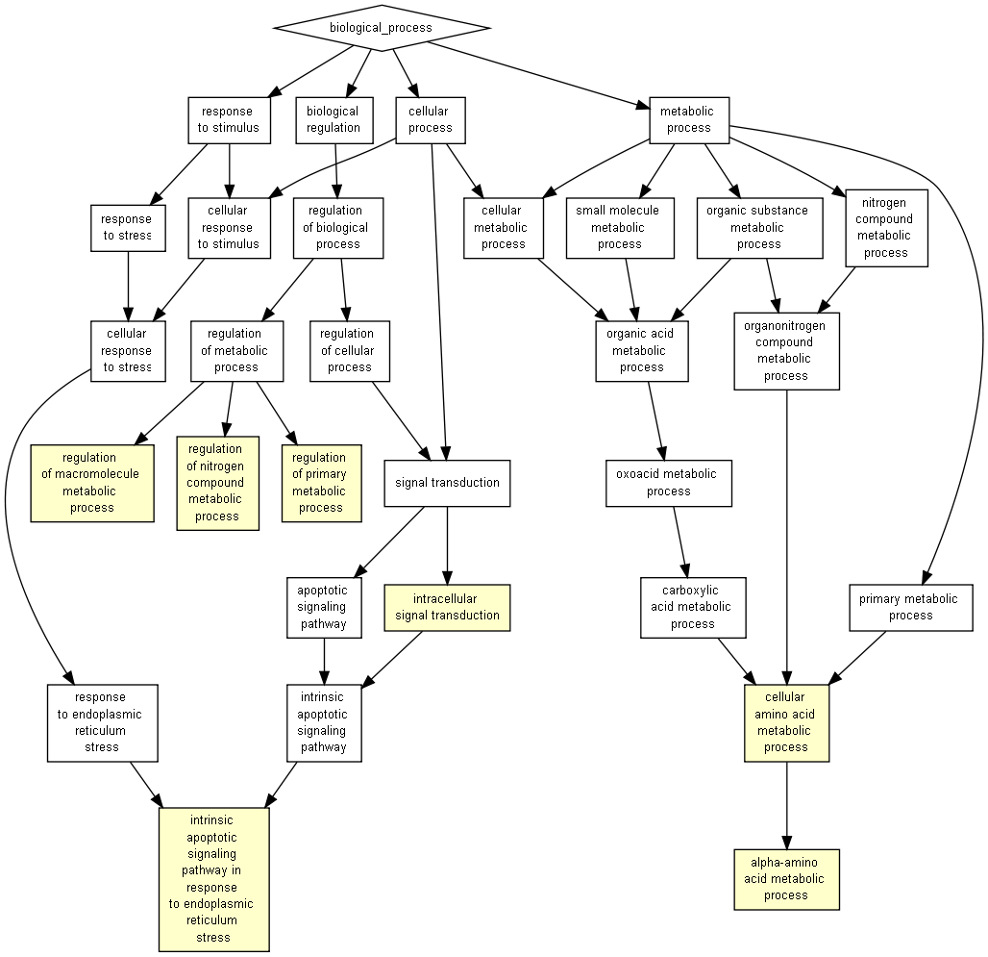
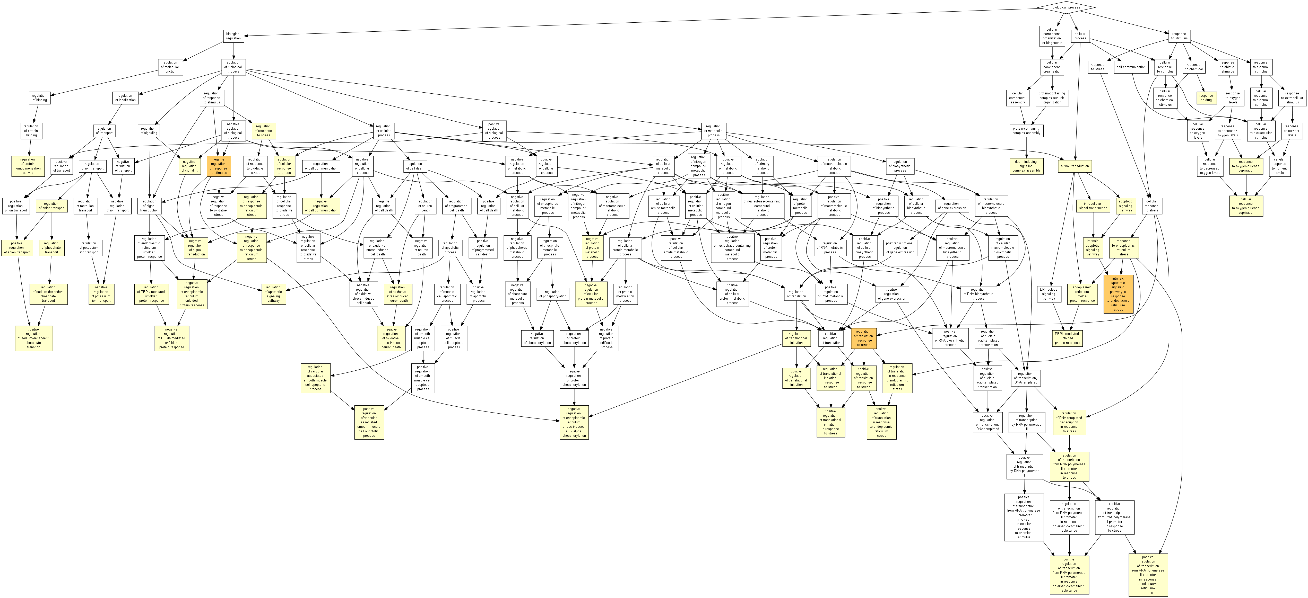
Generic analysis on the basis of fold expression (310 genes)
GRP94-correlated genes with P<0.05 (1178 genes)
CHOP-correlated genes with P<0.05 (1010 genes)
ATF4-correlated genes with P<0.05 (1198 genes)
Supplementary Figure 2. Diagrammatic depiction of major biological processes revealed by Gene Ontology Enrichment analysis (http://cbl-gorilla.cs.technion.ac.il/) for all transcripts that were upregulated according to standard fold induction analysis (top left) or exhibited positively correlated expression (P<0.05, Pearson’s) with each of GRP94, CHOP or ATF4.

Slide 2
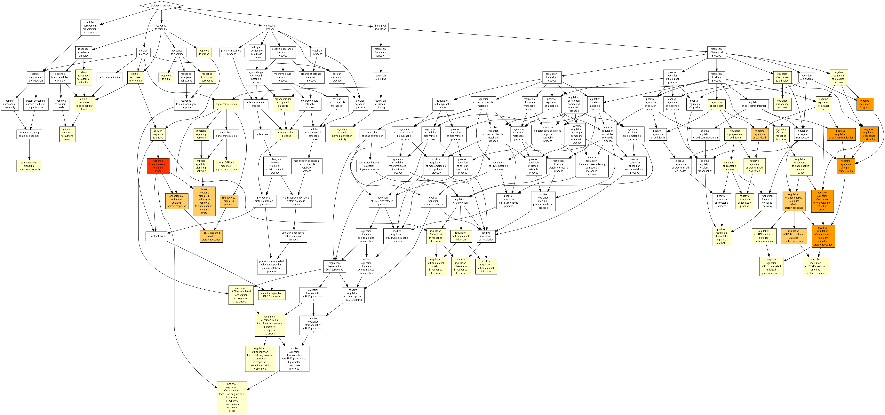
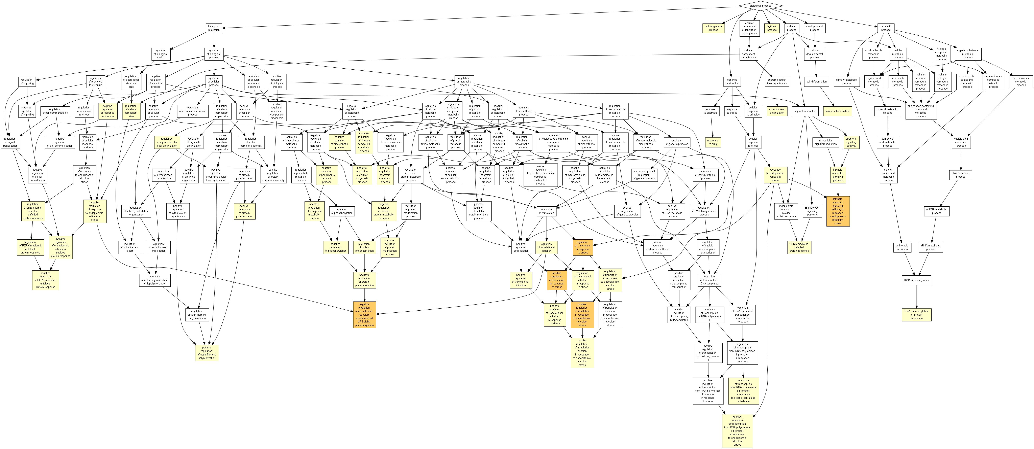
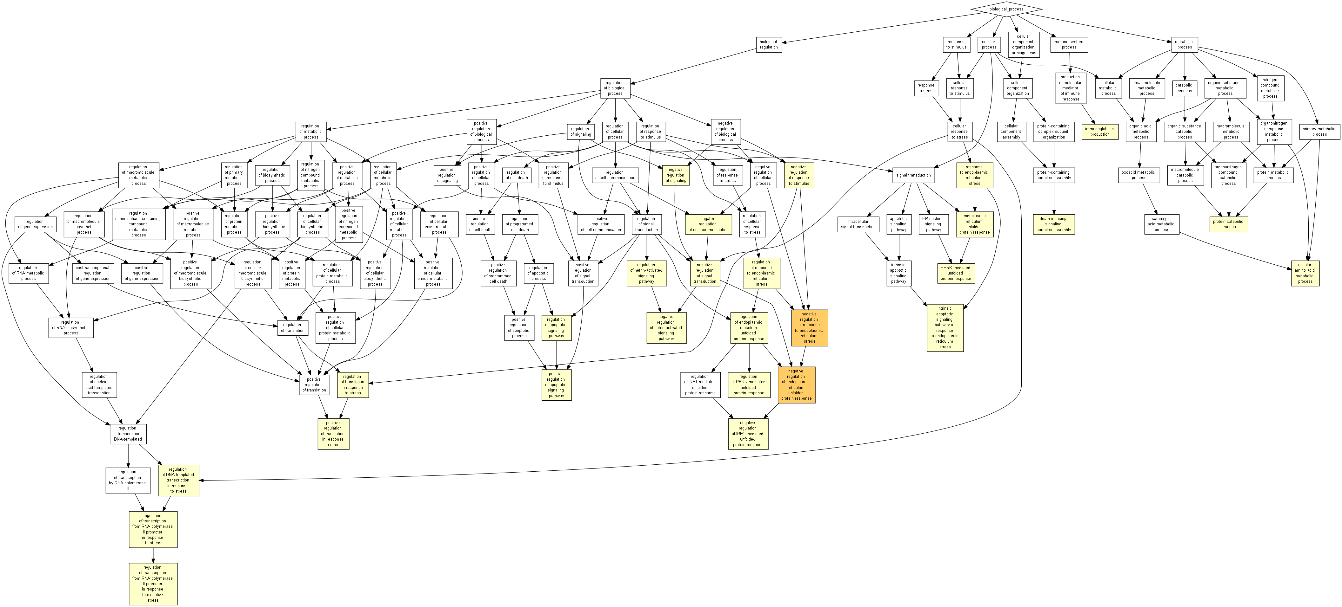
BiP-correlated genes with P<0.05 (1182 genes)
P58IPK-correlated genes with P<0.05 (1202 genes)
ERdj4-correlated genes with P<0.05 (1250 genes)
Supplementary Figure 3. Diagrammatic depiction of major biological processes revealed by Gene Ontology Enrichment analysis (http://cbl-gorilla.cs.technion.ac.il/) for transcripts that exhibited positively correlated expression (P<0.05, Pearson’s) with each of BiP, ERdj4 or P58IPK.

Slide 3
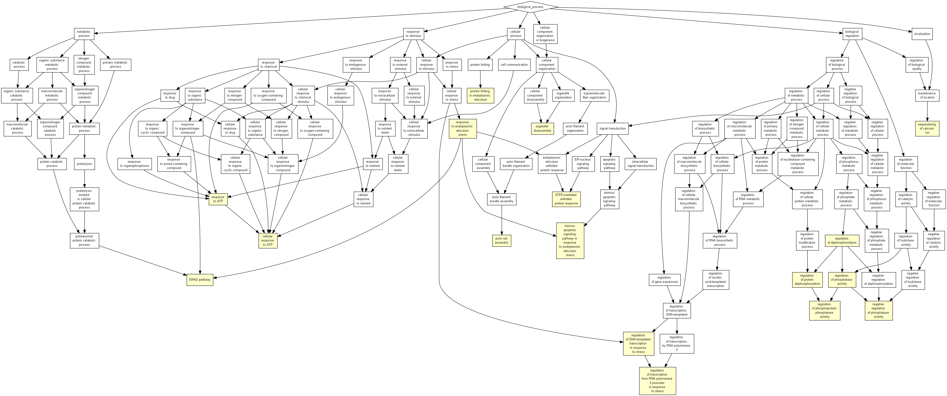
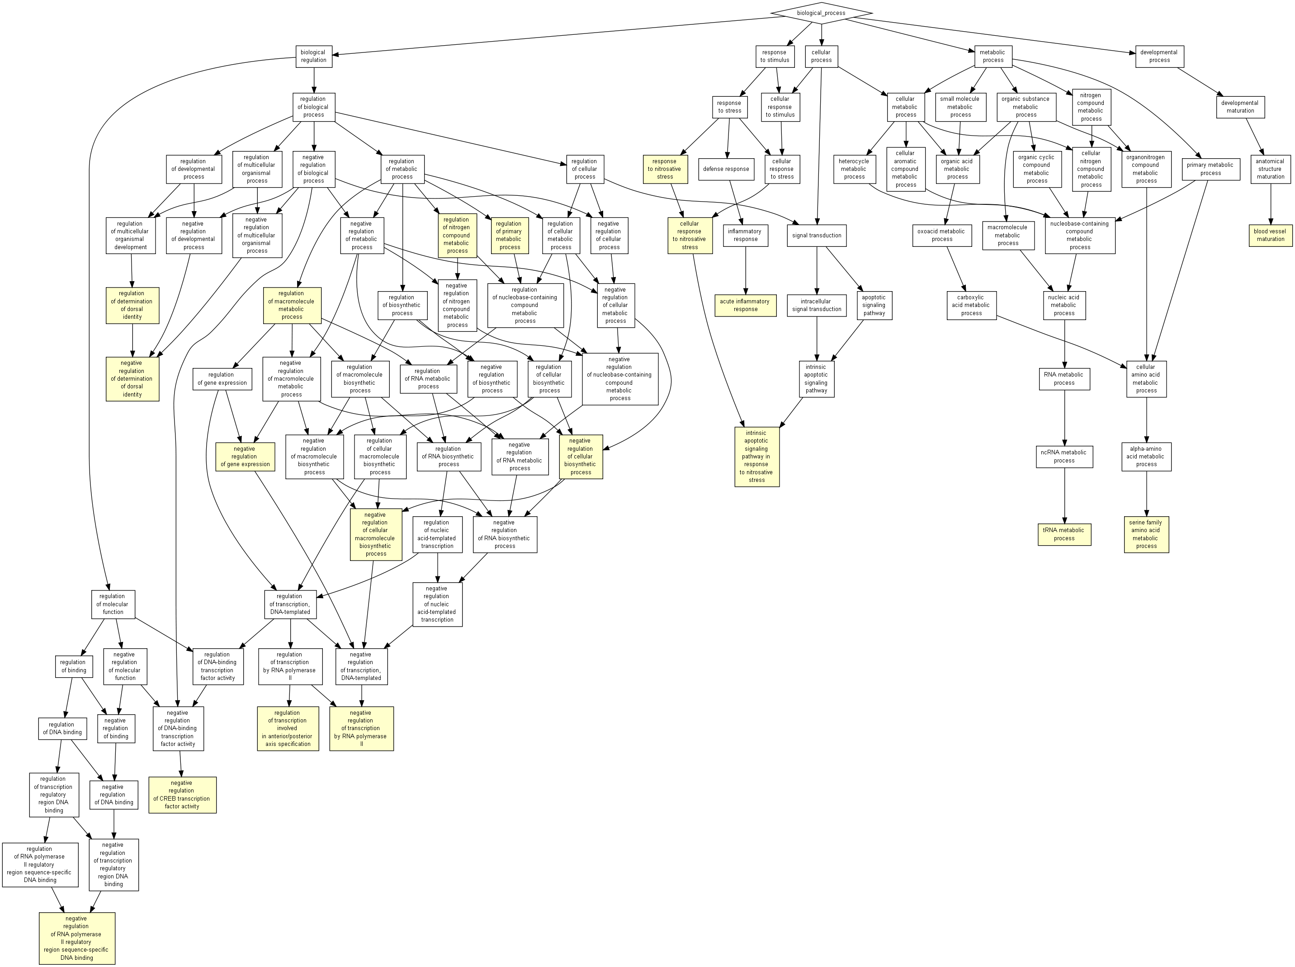
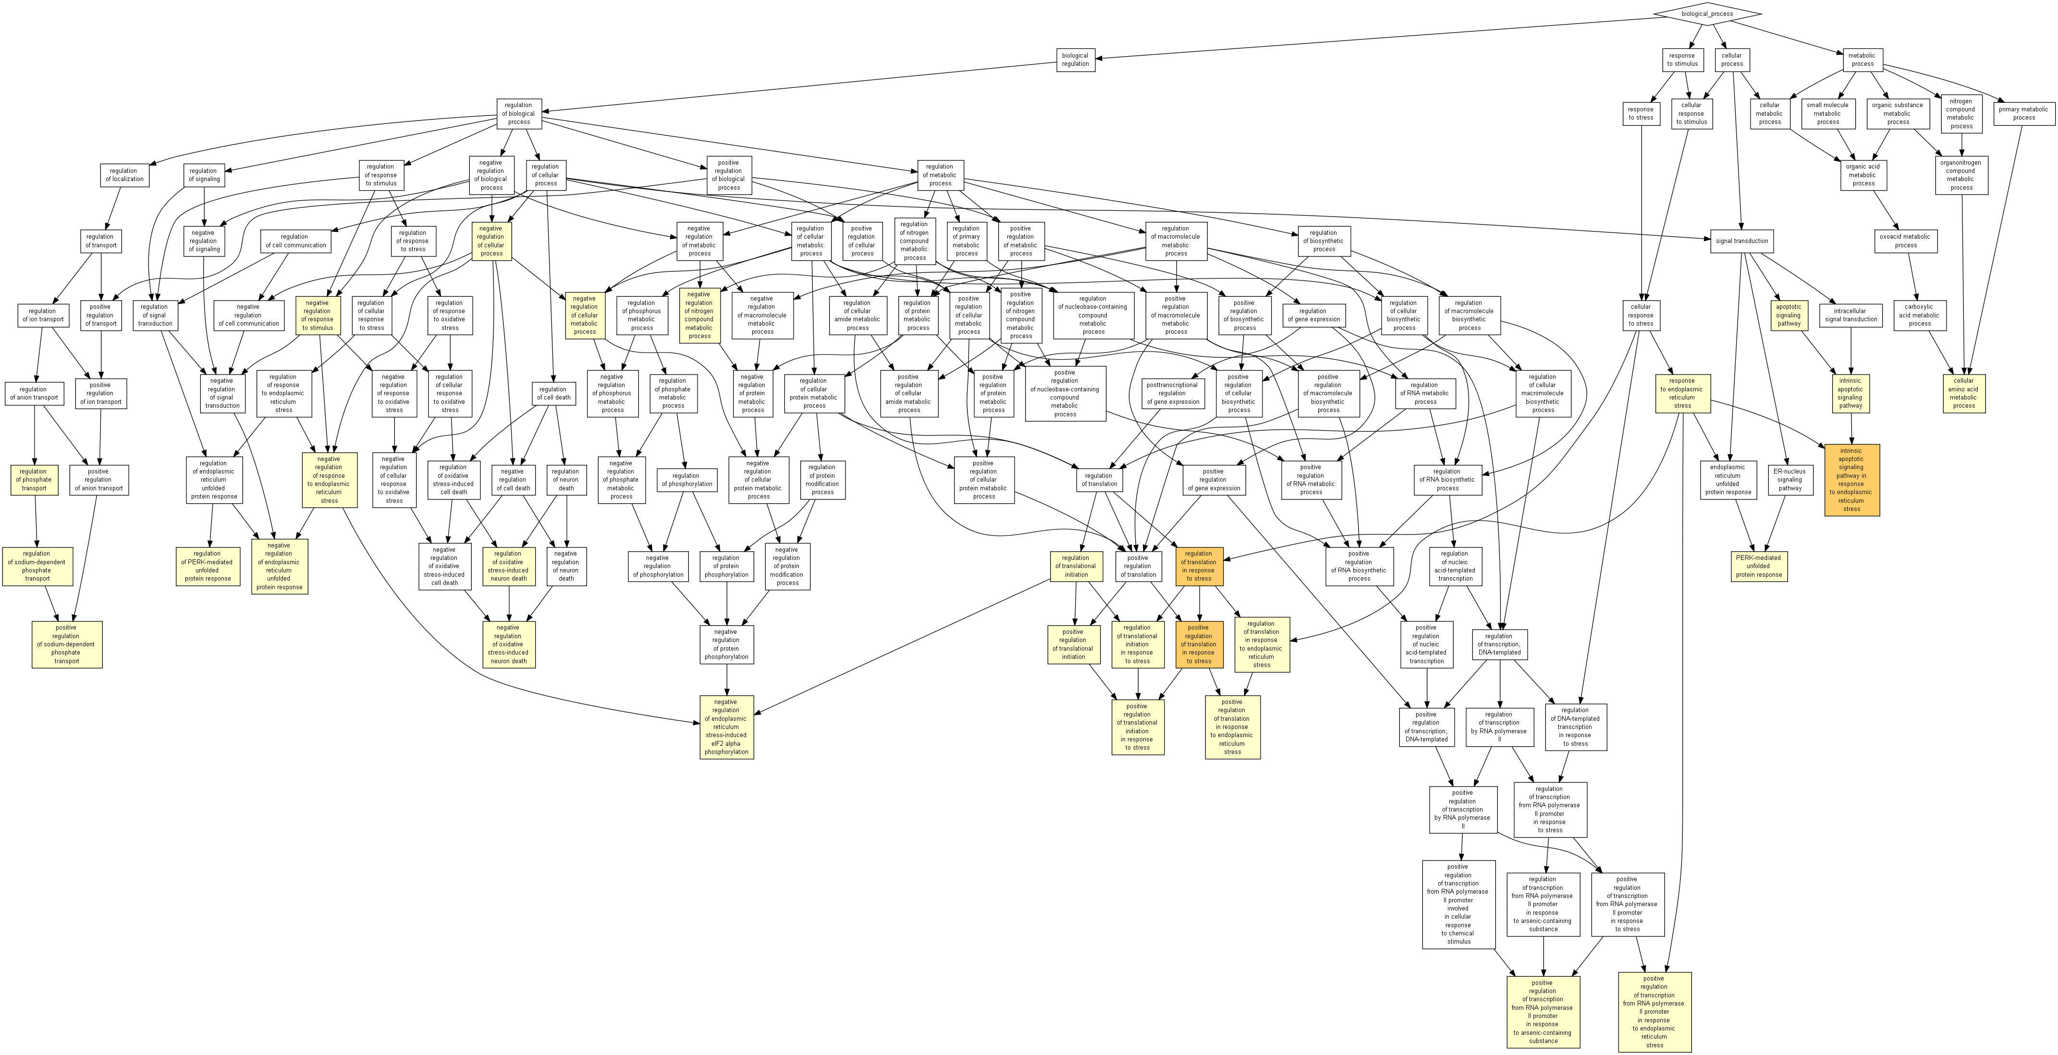
GRP94-correlated genes with P<0.05 (1869 genes)
CHOP-correlated genes with P<0.05 (1606 genes)
ATF4-correlated genes with P<0.05 (1859 genes)
Supplementary Figure 4. Diagrammatic depiction of major biological processes revealed by Gene Ontology Enrichment analysis (http://cbl-gorilla.cs.technion.ac.il/) for transcripts that exhibited either positively or negatively correlated expression (P<0.05, Pearson’s) with each of GRP94, CHOP or ATF4.

Slide 4
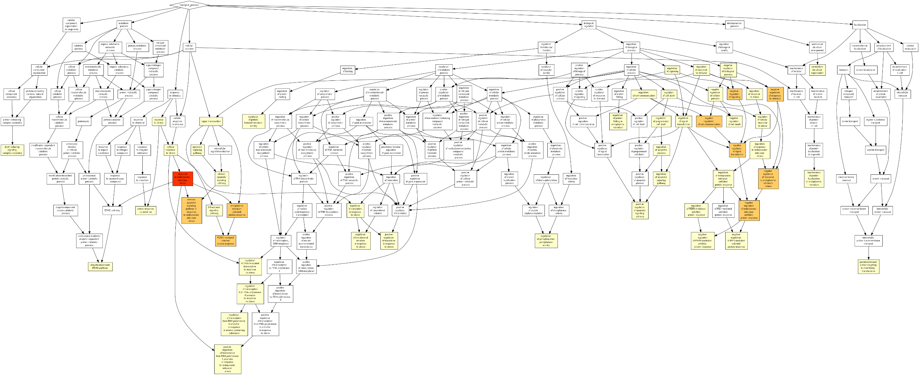
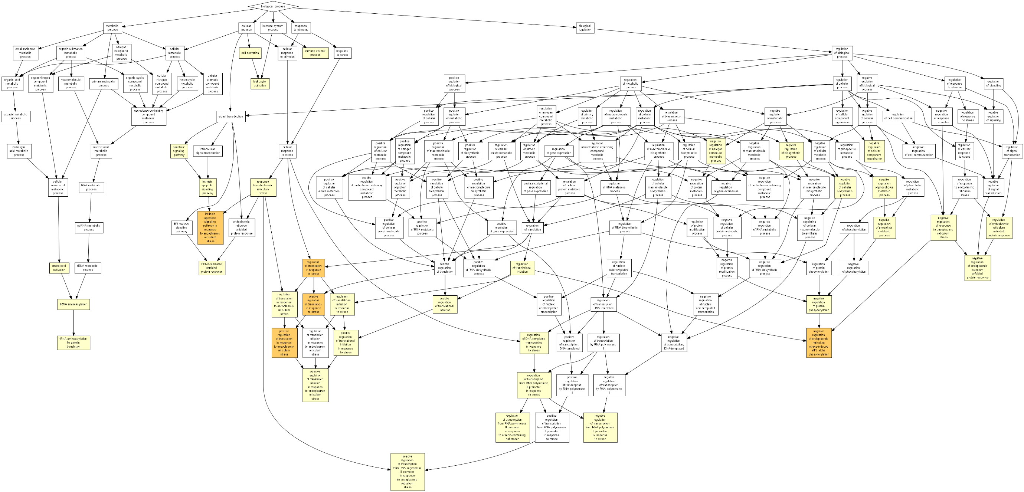
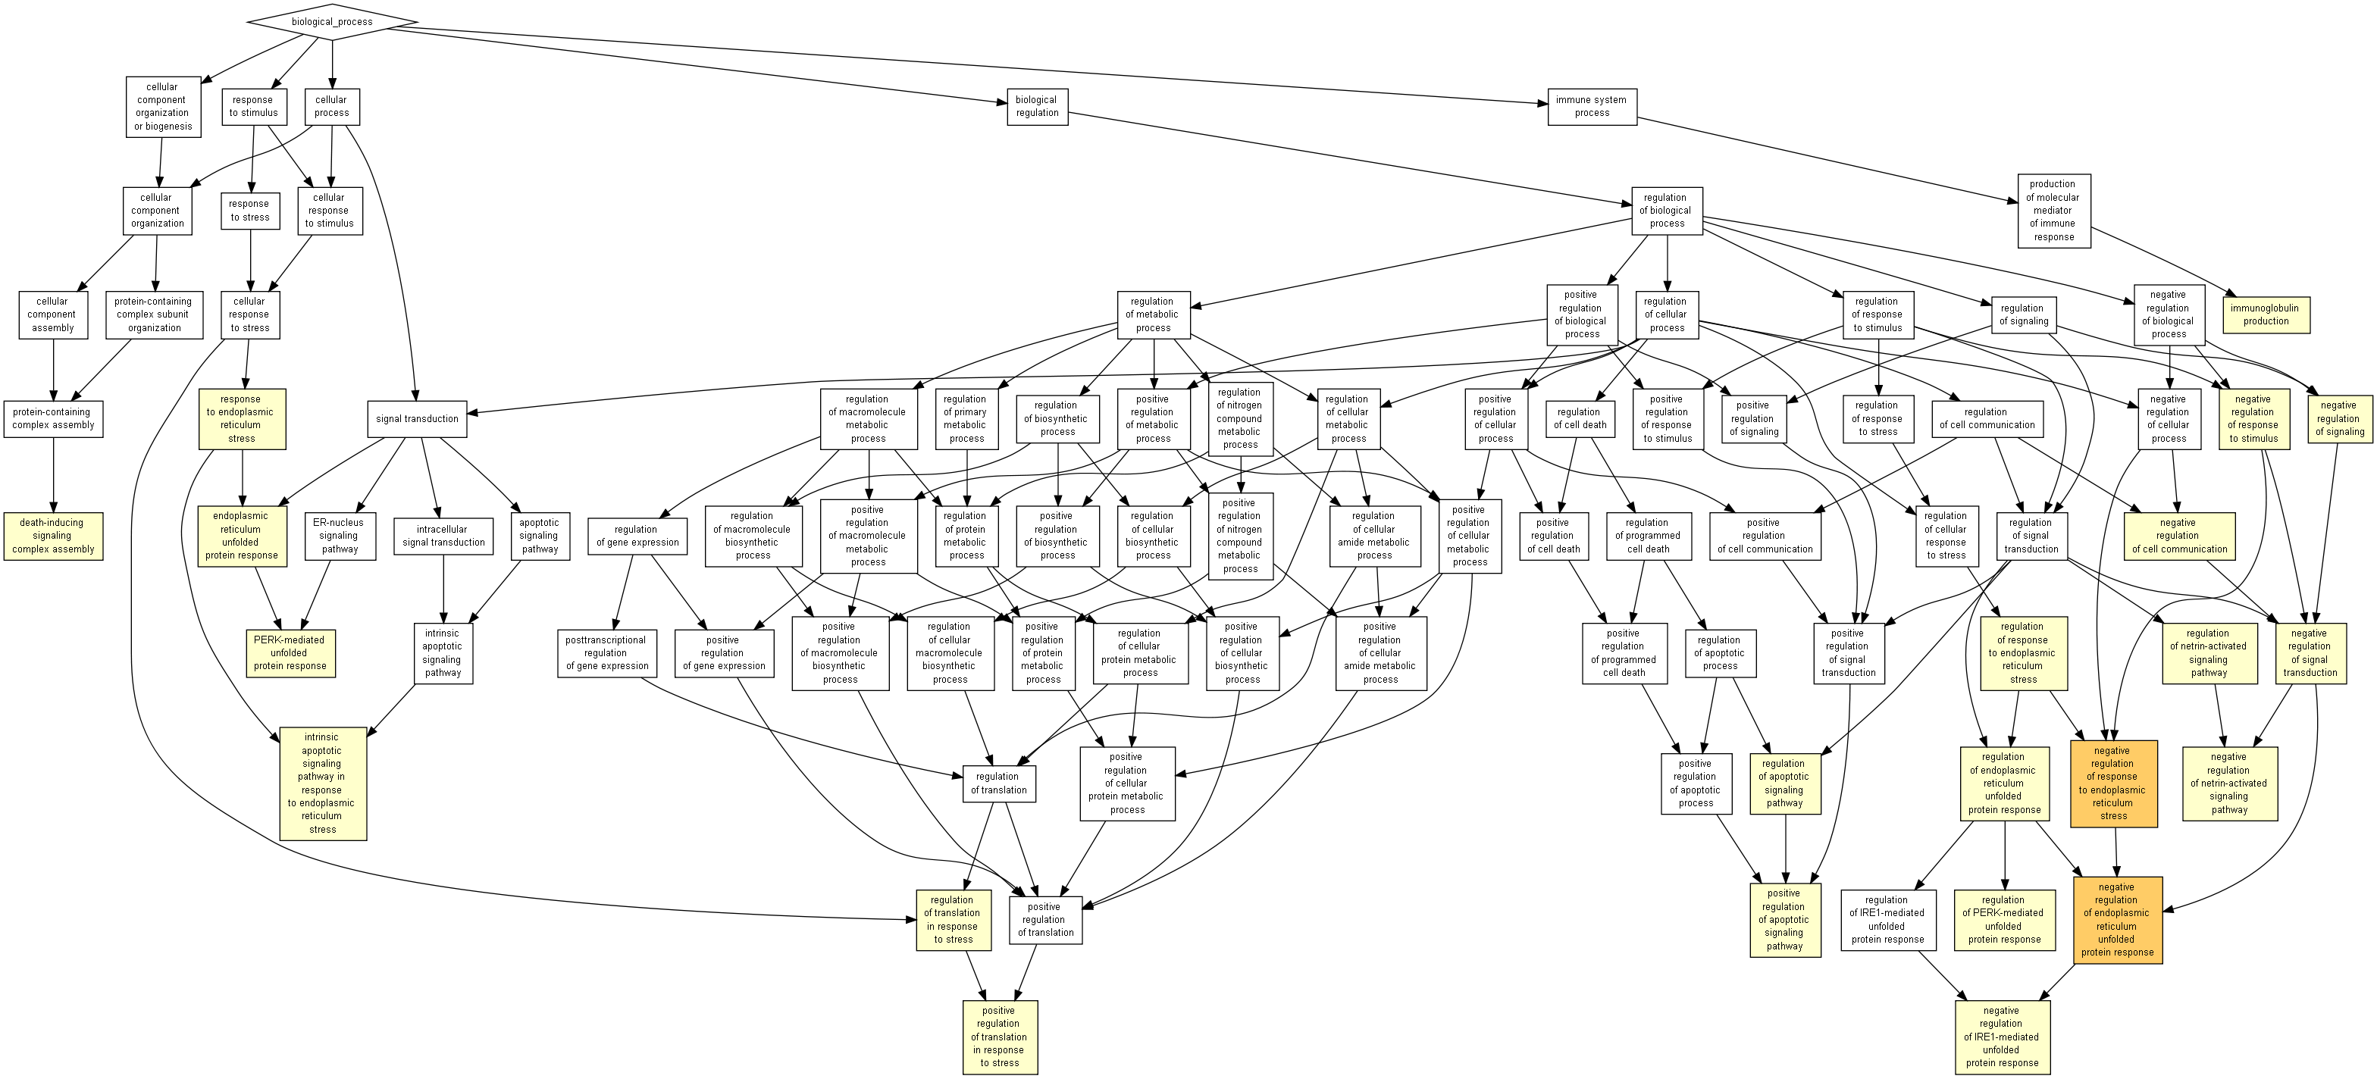
BiP-correlated genes with P<0.05 (1877 genes)
P58IPK-correlated genes with P<0.05 (1853 genes)
ERdj4-correlated genes with P<0.05 (1931 genes)
Supplementary Figure 5. Diagrammatic depiction of major biological processes revealed by Gene Ontology Enrichment analysis (http://cbl-gorilla.cs.technion.ac.il/) for transcripts that exhibited either positively or negatively correlated expression (P<0.05, Pearson’s) with each of BiP, ERdj4 or P58IPK.

