Slide 1
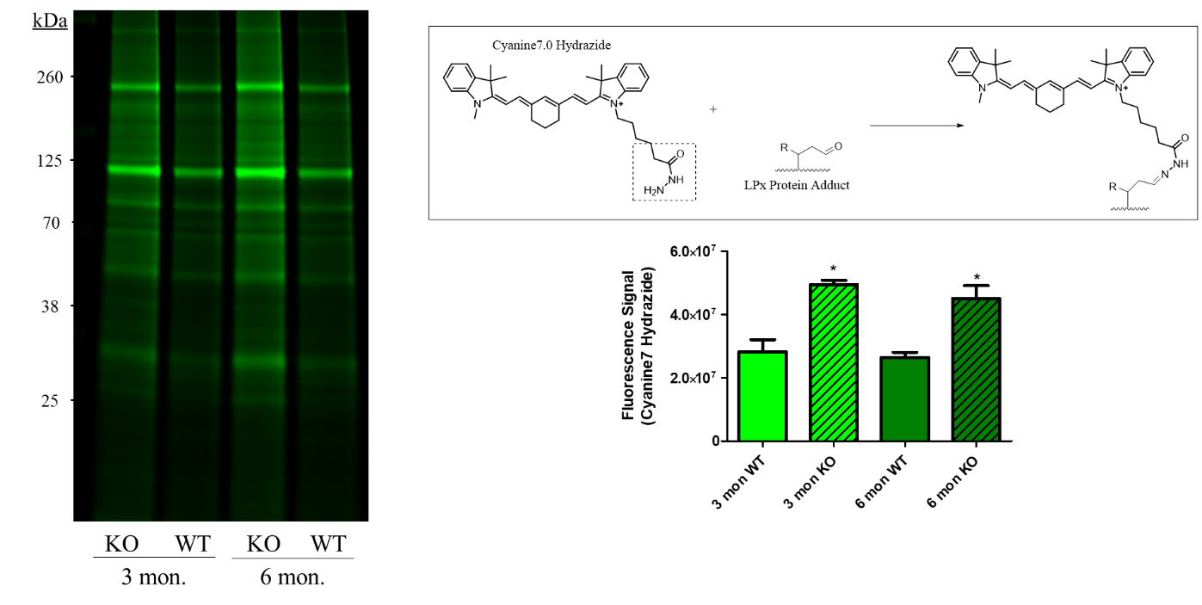
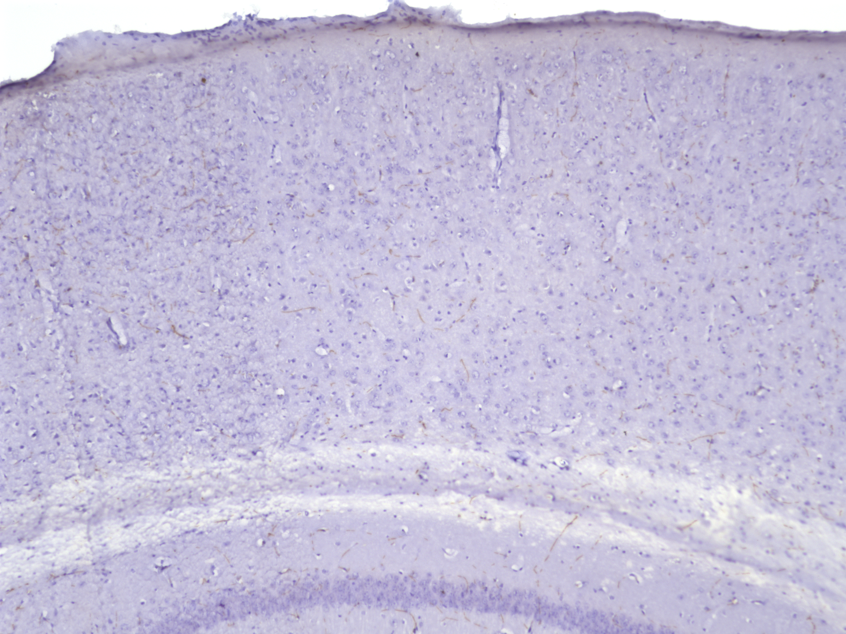
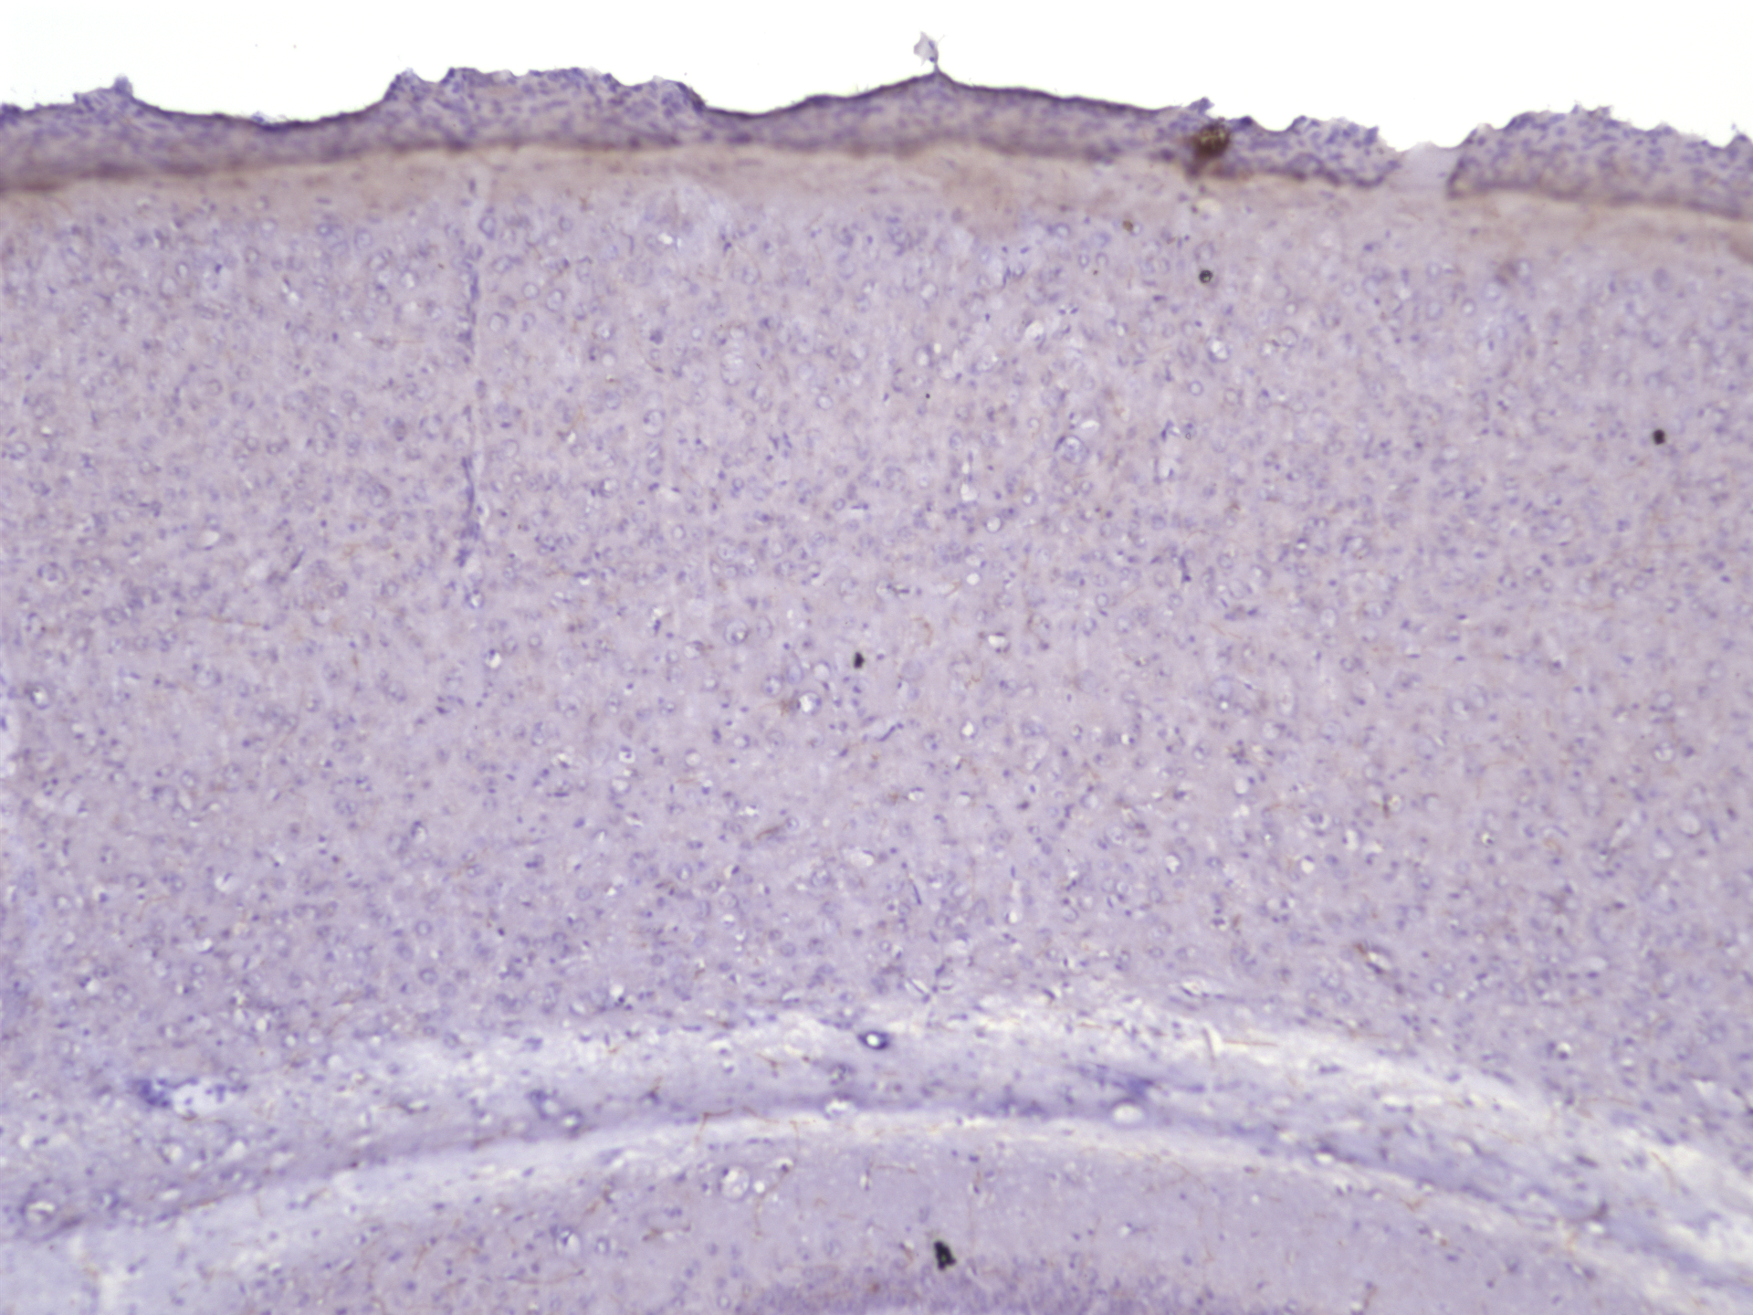
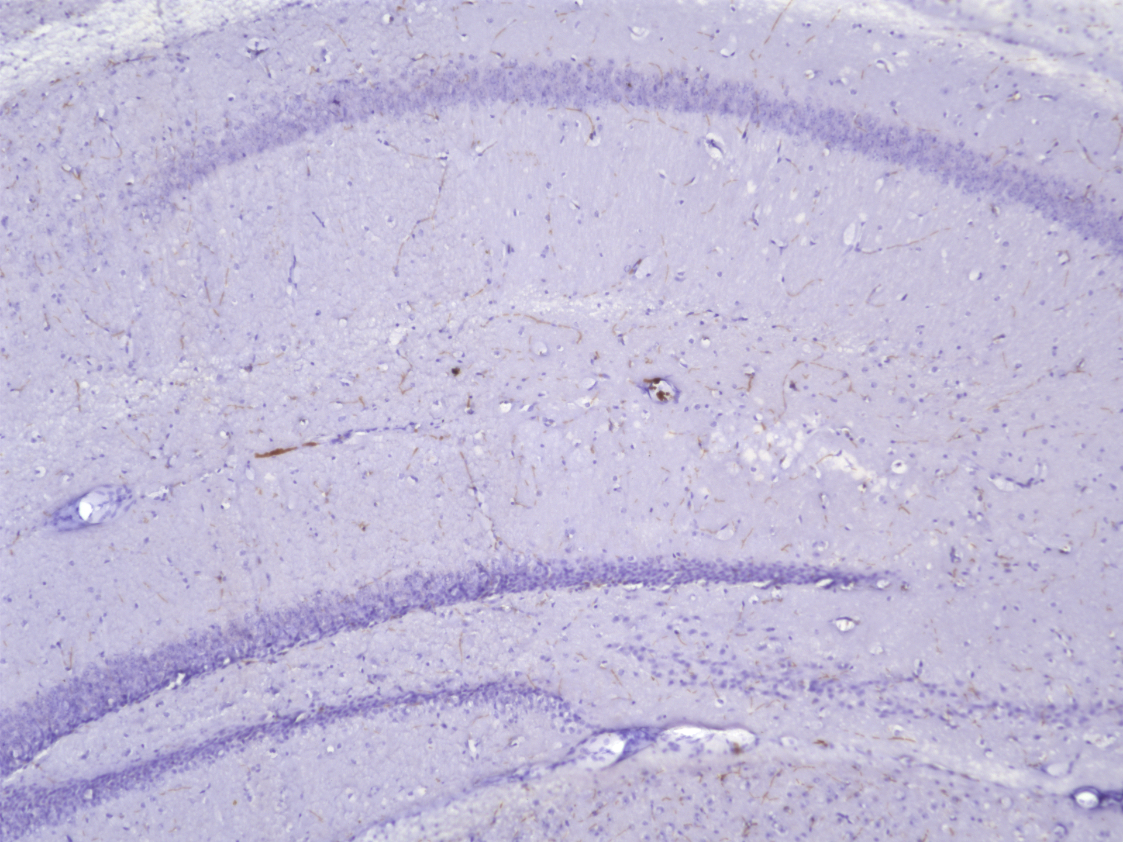
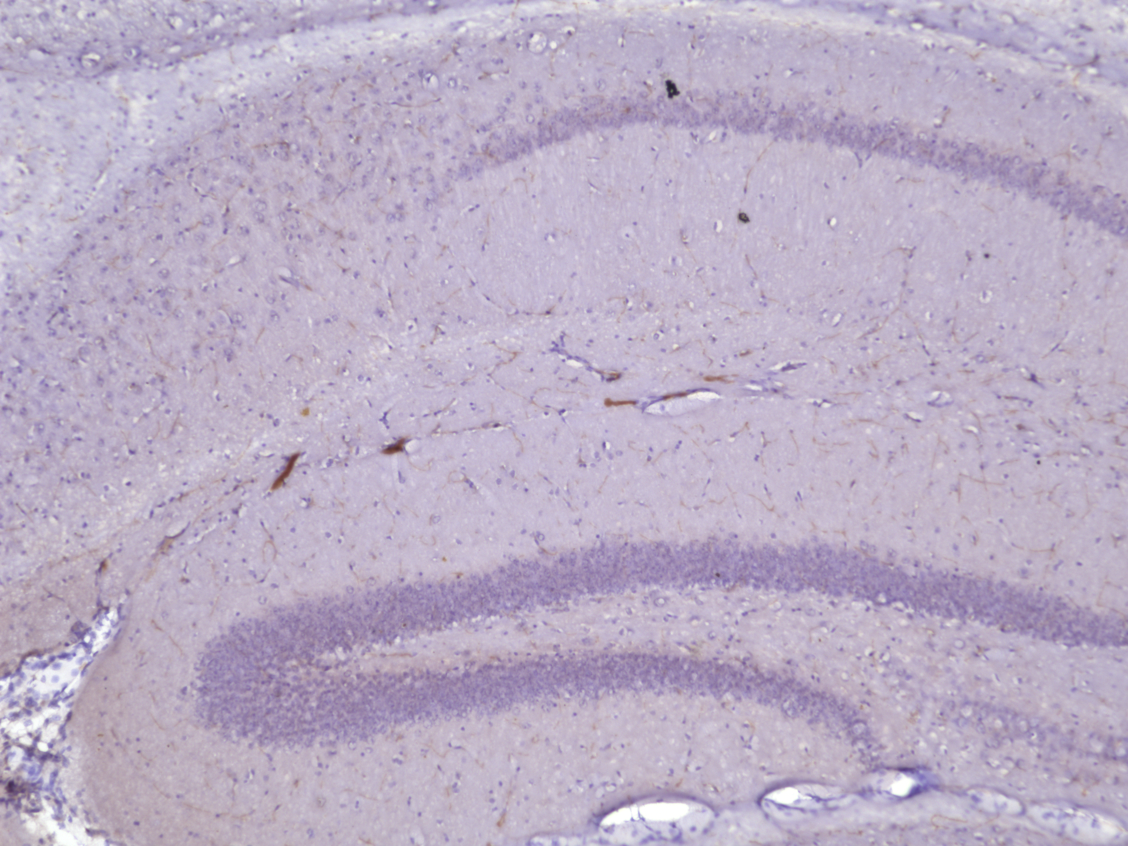
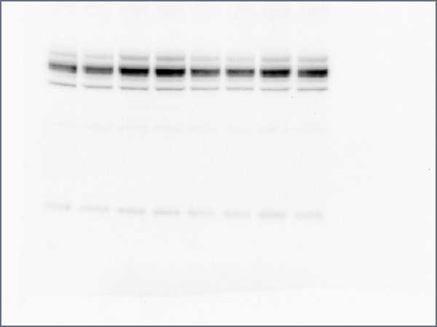
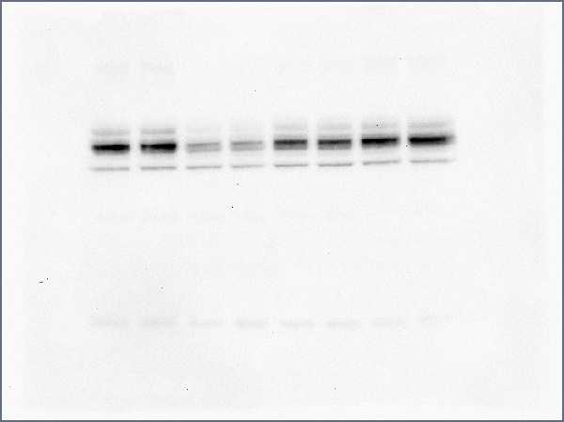
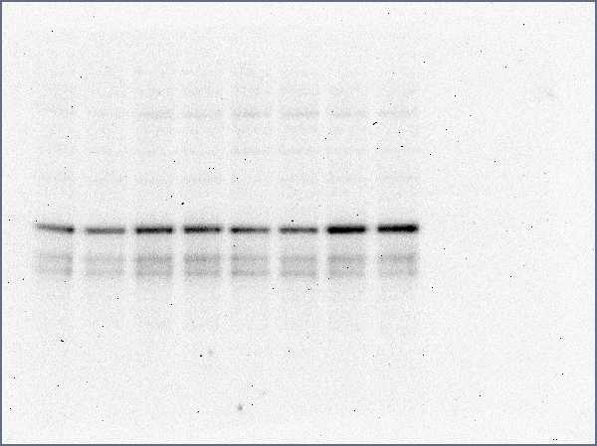
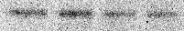

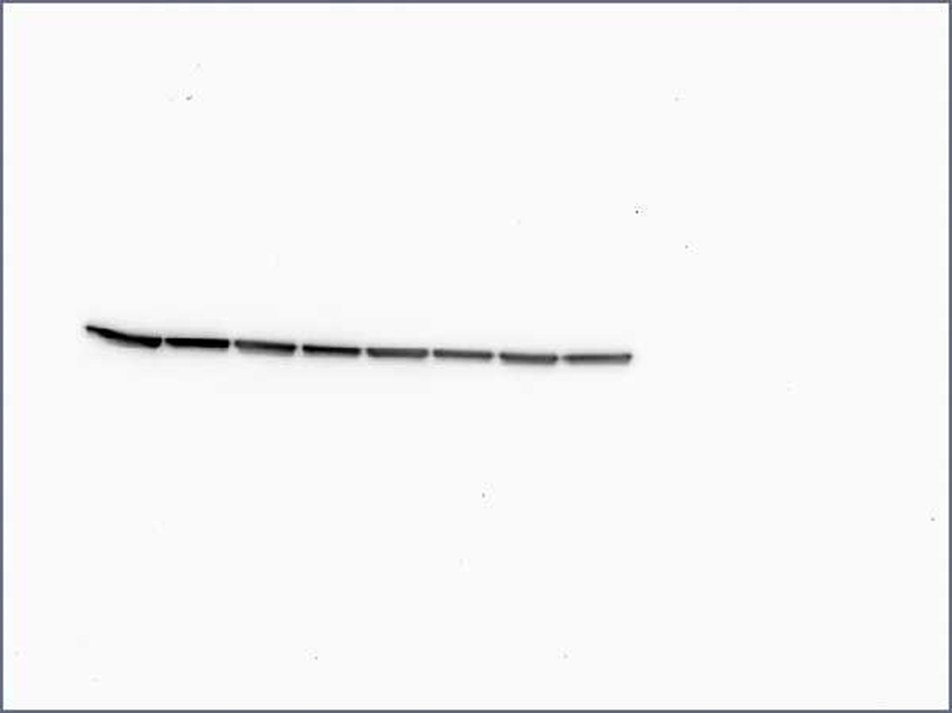
A
B
WT
KO
cortex
hippocampus
C
Cortex
Hippocampus
S1. (A) Representative immunoblot of whole brain homogenates of 3 and 6 month old WT and ALDH2^{-/-} mice probed with 50µM Alexa 488 hydrazide and imaged using a LICOR Sa imaging system. Schematic representation of the structure of Cyanine 7.0 hydrazide and resulting LPx protein adduct after derivatization reaction. The signals from the hydrazide dye were quantified for all samples. (B) Representative images of brain slides of 6 month old WT and ALDH2^{-/-} brain slices probed with 4-HNE stain. (C) Representative images of immunoblots of 14 month old cortex and hippocampal homogenates (50 µg protein) probed with PSD-95 and pCREB.
WT
KO
WT
KO
PSD-95
pCREB
β-actin

Slide 2
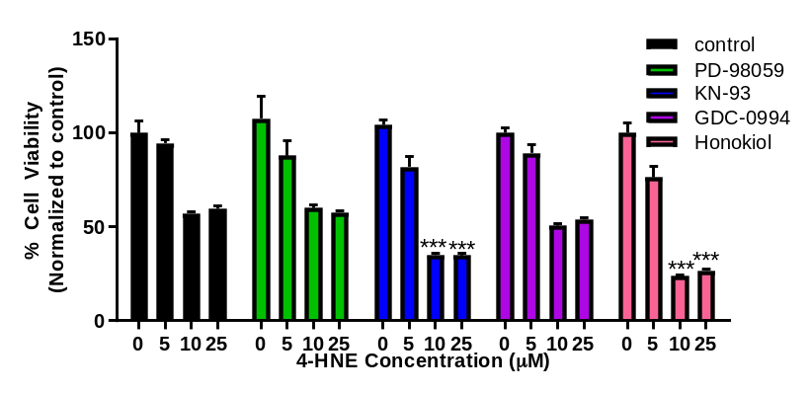
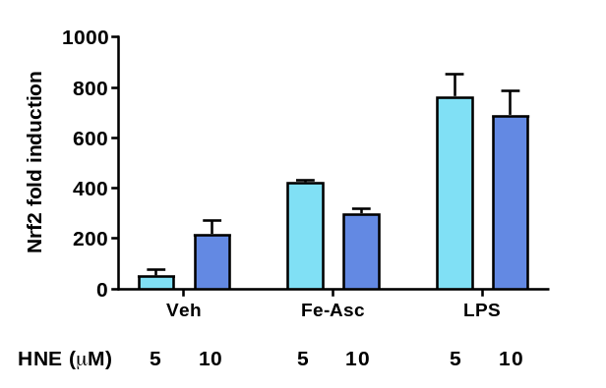
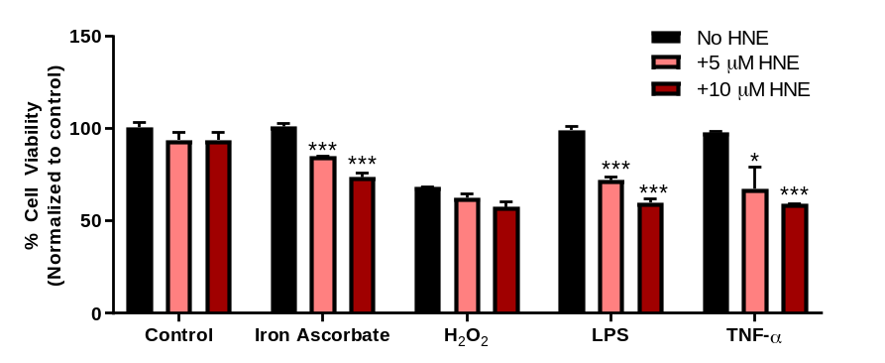
A
S2. (A) Quantitative analysis of cell viability of SH-SY5Y cells preincubated with 10µM of various kinase and stress response pathway inhibitors for 2h then 0, 5, 10 and 25µM 4-HNE for 24h measured by the MTS assay. (B) Nrf2 gene expression in SH-SY5Y cells pre-treated for 2h with 5 or 10µM 4-HNE then 50µM Fe-Asc or 1ug/mL LPS for 4 hours. Neh2-luc SH-SY5Y cell line was used to measure activation of Nrf2 by luciferase activity measured using a single luciferase assay system (Promega). (C) Quantitative analysis of cell viability of SH-SY5Y cells pre-treated with 5 or 10µM 4-HNE for 2h then 50µM Iron Ascorbate, 50µM CoCl₂, 50µM C₂O₂, 1ug/mL LPS or 1ng/mL TNF-α for 24 hours measured by the MTS assay. Data represent mean ± S.E.M analyzed by one-way ANOVA with Dunnett’s or Tukey’s multi-comparison analysis (*P<0.05, **P<.001, ***P<0.001).
B
C

Slide 3
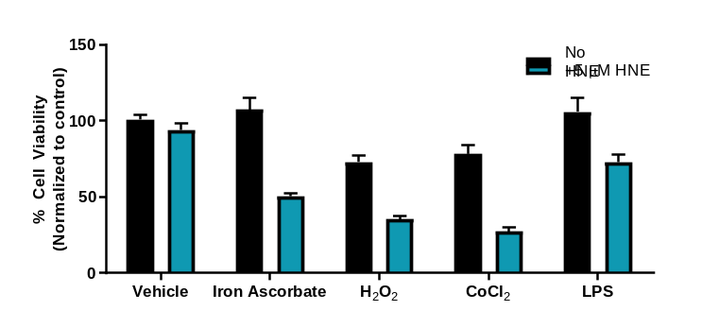
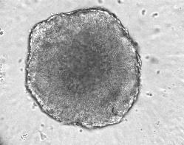
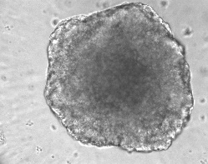
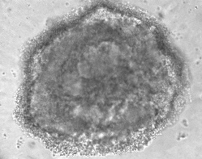
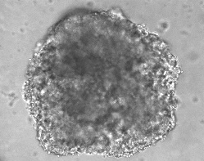
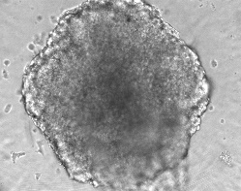
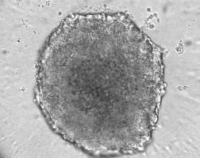
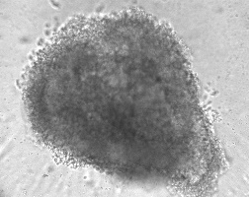
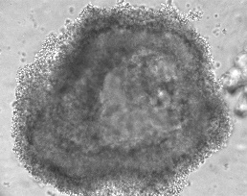
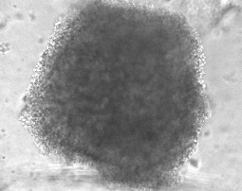
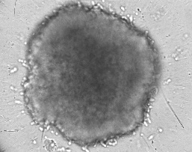
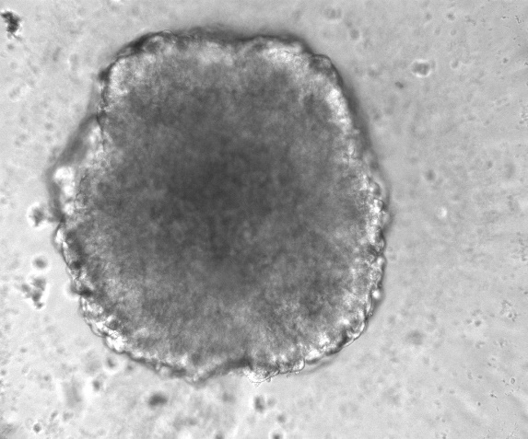
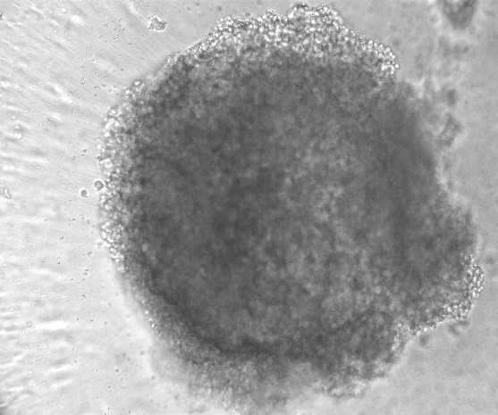





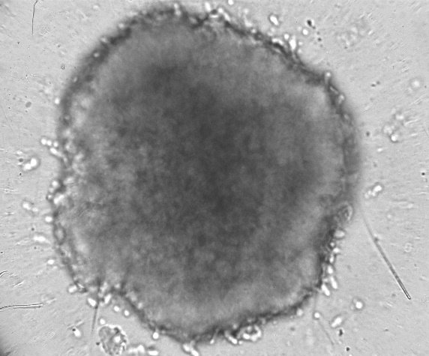
A
S3. (A) Quantitative analysis of cell viability of SH-SY5Y spheroids treated with 5µM 4-HNE for 2h then 100µM Iron Ascorbate, 100µM H₂O₂, 100µM CoCl₂, or 1ug/mL LPS for 24h by the CellTiter-Glo 3D Cell Viability Assay (Promega). Neurospheres were formed by plating in hanging drop pates and grown for 9 days. Treatment was on the 10th day. (B) Representative images of the neurospheres taken from the Keyence brightfield imaging microscope. Data represent mean ± S.E.M analyzed by one-way ANOVA with Dunnett’s or Tukey’s multi-comparison analysis (*P<0.05, **P<.001, ***P<0.001).
B
- HNE
+ HNE
- HNE + HNE
- HNE + HNE
Iron Ascorbate
CoCl₂
H₂O₂
LPS

Slide 4
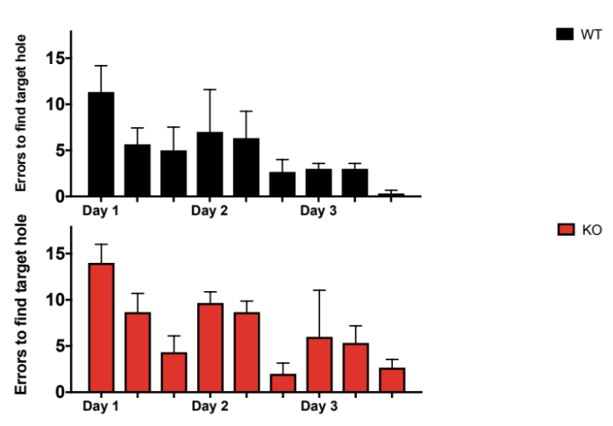
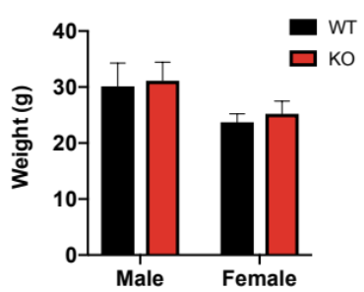
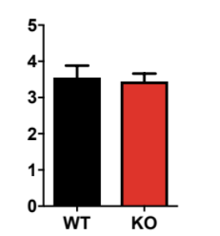
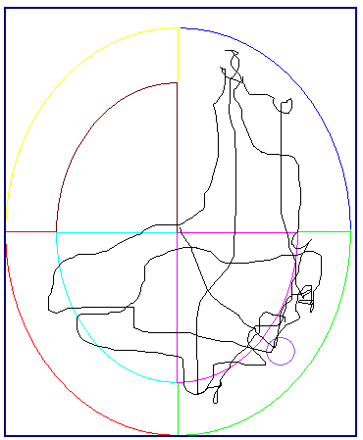
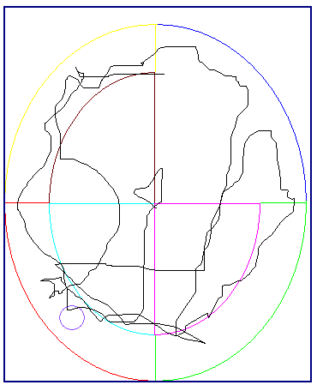
A
Weight
B
Nesting Score
C
Training
D
Barnes Maze
WT
KO
S4. (A and B) Quantitative analysis of the weight (A) and nesting scores (B) of 9 month old WT and ALDH2^{-/-} mice. n=6-8 mice (C) Quantitative analysis of errors made over 3 days during the training phase of the Barnes maze test of 9 month old WT and ALDH2^{-/-} mice. (D). Representative images of the testing phase of the Barnes maze test. The mice were tracked via a camera recording system, with the target hole depicted in the small red circle.

Slide 5
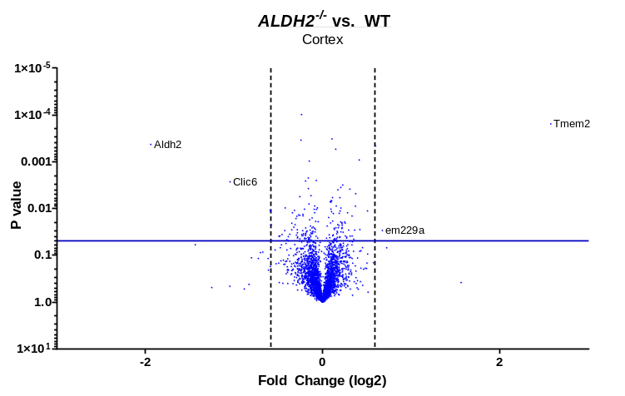
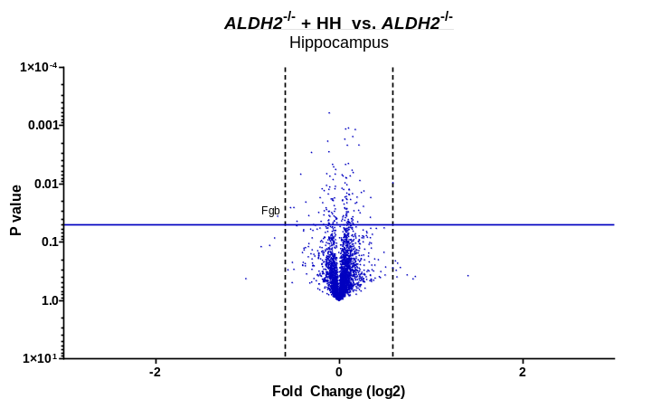
A.
S5. (A) Volcano plot comparing results from TMT proteomics performed on the cortex of WT and ALDH2^{-/-} mice. (B) Volcano plot comparing results from TMT proteomics of hippocampi of ALDH2^{-/-} mice treated daily with 10mg/kg HH via i.p for 2 weeks and ALDH2^{-/-} nontreated controls. Volcano plots: vertical line shows .05 P-value, while horizontal line depicts 1.5 fold change. All studies were performed on 14 month old mice.
B.

Slide 6
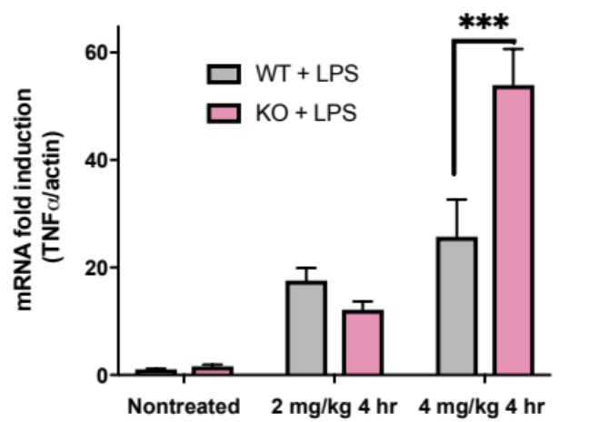
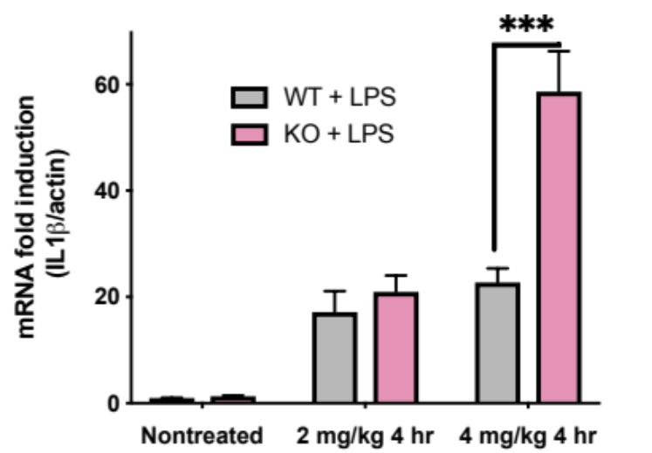
A
S6. (A and B). qRT-PCR analysis of TNF-α (A) and IL-1β (B) gene expression from 9 month old mice dosed with 2mg/kg or 4mg/kg LPS. Data represent mean ± S.E.M analyzed by one-way ANOVA with Dunnett’s or Tukey’s multi-comparison analysis (*P<0.05, **P<.001, ***P<0.001).
B

Slide 7
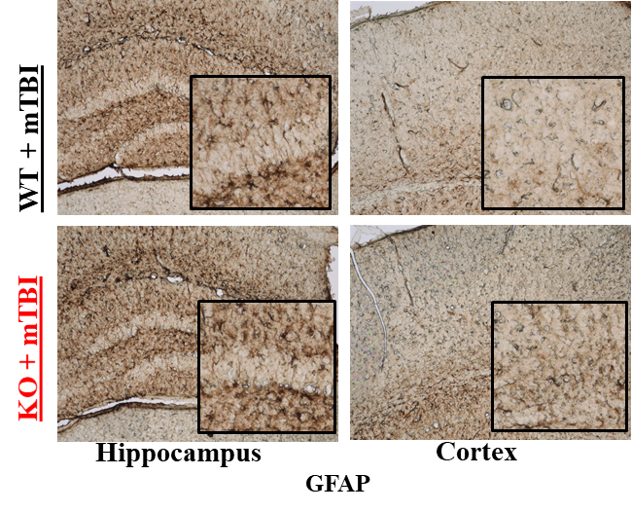
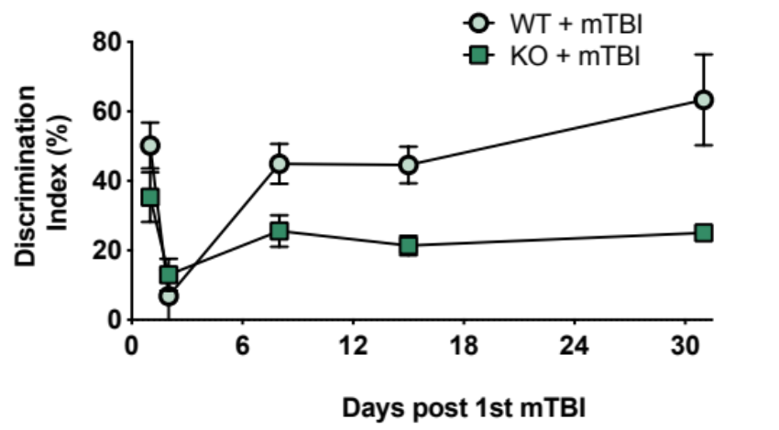
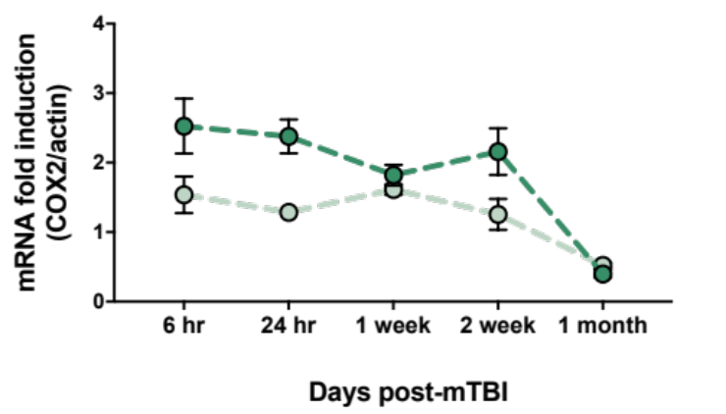
A.
B.
S7. A. qRT-PCR analysis of COX2 gene expression of WT and ALDH2^{-/-} mice 6h, 24h, 1W, 2W and 1M post-mTBI. B. Representative images of brain slices of WT and ALDH2^{-/-} mice 24 hours post-mTBI probed with GFAP. All samples were normalized to the housekeeping gene, β-actin. Data represent mean ± S.E.M analyzed by one-way ANOVA with Dunnett’s or Tukey’s multi-comparison analysis from (n=4-6): *P< 0.05, **P<.01, ***P< 0.001, ****P<.0001

Slide 8
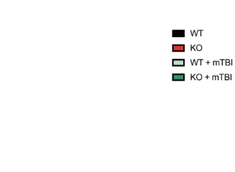
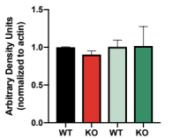
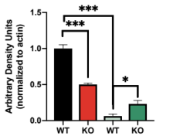
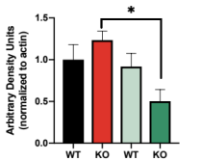
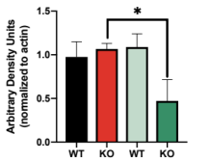
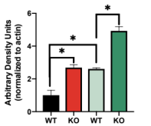
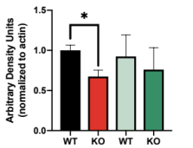
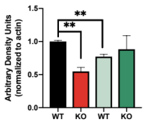
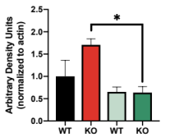
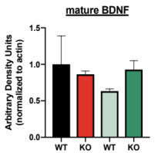
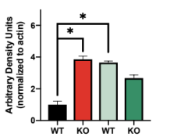
A
PSD-95
Tau
Pro-BDNF
mBDNF
pCREB
B.
PSD-95
Tau
Pro-BDNF
mBDNF
pCREB
S8. (A and B) Representative images and quantitative analyses of immunoblots of PSD-95, Tau, Pro-BDNF, mBDNF and pCREB expression levels in the ipsilateral (A) and contralateral (B) hemispheres 24 h post-mTBI.

Slide 9


A.
B.
PSD-95
95kDa
Synaptophysin
38kDa
GFAP
55kDa
Tau
50kDa
Tau
Tau
Days post-mTBI
Days post-mTBI
S9. (A and B) Representative images and quantitative analyses of Immunoblots of PSD-95, Synaptophysin, GFAP and Tau expression levels in the ipsilateral (A) and contralateral (B) hemispheres 0, 1 and 7 days post-mTBI.

Slide 10




A.
B.
C.
D.
S10. (A). Quantitative analysis of the performance of WT and ALDH2^{-/-} mice 24 hours and 1 week post-mTBI or null controls in NOR when treated with 1mg/kg (i.p) NMZ or vehicle daily with the first treatment 20 minutes post-mTBI. (B-D). qRT-PCR analysis of TNF-α (B), COX2 (C) and IL-1β (D) gene expression in the ipsilateral hemispheres of WT and ALDH2^{-/-} mice 24 hours and 1 week post-mTBI or null mouse controls when treated with 1mg/kg (i.p) NMZ daily with the first treatment 20 minutes post-mTBI. All samples were normalized to the housekeeping gene, β-actin. Data represent mean ± S.E.M analyzed by one-way ANOVA with Dunnett’s or Tukey’s multi-comparison analysis from (n=4-6): *P< 0.05, **P<.01, ***P< 0.001, ****P<.0001

