Slide 1
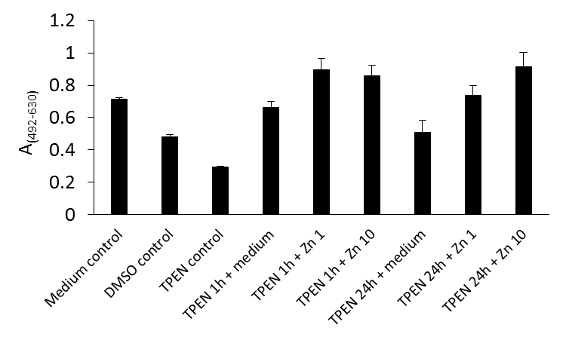
Fig. S2
(A)
Inoculation
Exchange medium
Wash & measure
Time (hour)
0
1
24
48
(B)
++
++
++
+
+
+
*

